Slide 1
Proposal for Development of Community Child and Adolescent Mental Health Service Model (Karnataka)
Dr. Shekhar Seshadri
Dept. of Child & Adolescent Psychiatry
NIMHANS, Bangalore
19th June 2014

Slide 2
Objectives
Establishment of community-based child and adolescent services.
Training and capacity building of childcare workers and staff from various governmental and non-governmental agencies, including schools.
Develop a comprehensive community child and adolescent mental health service model that may be replicated elsewhere in the country.

Slide 3
Geographic Location and Area
1 Urban Ward:
3 slums (total population=5,335) + larger community
2 PHCs (2 MOs, 2 Health Assistants, 16 Link Workers)
15 government schools (& 10 private schools)
15 Anganwadis
NGOs
* Rural area to be added later.

Slide 4
Principles & Technical Approach
Universal access to child (mental) healthcare
Equitable coverage (with focus on vulnerable children and adolescents)
Community involvement and participation to ensure sustainability
Adoption of multi-sectional approach through involvement of various sectors such as health, education, women and child welfare.

Slide 5
Mental Health Intervention Spectrum for Mental Disorders

Slide 6
Proposal Implementation: Phase (1)
Activity 1: Mapping of Existing Community Services
What?
identify types of services provided by the agency/services
understand child mental health issues in the community.
assess the capacity needs and gaps of the service providers.
assess scope for RBSK/RKSK implementation
How?
key informant interviews and focus group discussions
With Whom?
NGOs,
public health professionals
private health professionals
schools/teachers
Government departments (Education, Health, Labour, Women & Child Development, Disability, Social Justice, NRHM, JJ Act functionaries); teachers, doctors, Anganawadi Workers, ANM’s and ASHA Workers

Slide 7
Proposal Implementation: Phase 2
Activity 1: Service Delivery
Intervention | Type of Service Provided | Targeted Children/Adolescents | Service Providers
Preventive &Promotive Services | Developmental play program | Pre-school children | Aanganwadi workers
 | Life Skills program in schools. | School children (ages | Teachers
 | Life Skills program in NGO and other community spaces. | Children in institutions; special populations and vulnerable children and adolescents served by NGOs. (Example street children; substance abuse issues; HIV+ children etc) | Government staff (such as child protection staff); NGO workers

Slide 8
Service Delivery
Intervention | Type of Service Provided | Targeted Children/Adolescents | Service Providers
Treatment/ Curative Services | Case identification | All children availing of preventive/ promotive services and other individual children who may have psychiatric problems or developmental disabilities, thereby requiring specialized services and care. | Teachers, health workers, private & public health practitioners (paediatricians/ general physicians), government and NGO staff in consultation with NIMHANS team
 | Basic/ first level psychosocial support and care
 | Standard treatment for known (psychiatric) disorders
 |  |  | NIMHANS Child & Adolescent Psychiatry Dept. and/or other Mental Health Centers (Referral)

Slide 9
Conditions Covered by Curative Services
Behaviour/Emotional Disorders | Sub-Threshold Disturbances | Neurodevelopmental Disorders
Oppositional Defiant Disorders Conduct Disorders Anxiety disorders Depressive disorders Elimination disorders Somatoform disorders Other uncommon disorders – Obsessive Compulsive Disorders, tics, psychoses, bipolar disorders | Scholastic backwardness Learning difficulties School refusal Temper tantrums Difficult temperament Aggressive tendency Suicidality Running away from home Bullying Pica Early unspecified developmental delays Truancy School drop-outs Conduct symptoms Oppositional Defiant Disorder Excessive shyness Examination anxiety Stress-related problems Inter-personal problems in adolescence | Intellectual Disability Autism Speech delays / disorders Non-Specific Global Delays in young children) Attention Deficit Hyperactive Disorder Specific Learning Disabilities Cerebral Palsy

Slide 10
Proposal Implementation: Phase 2
Activity 2: Training & Capacity Building
Training for Whom?
Gate-Keepers:
Teachers
Health workers ( private & public health practitioners, Link workers)
Anganwadi workers
NGO staff
ICPS Staff:
Program officers
Counsellors
Social workers
House Parents

Slide 11
Training Content?
Psychological health promotion
Parent education leaflets
Behavior therapy training packages
Consultation liaison clinics
Screening for early diagnosis
Disability related interventions
Small modules for grass root workers
Universal preventive interventions (violence prevention, problem solving, suicide prevention, bully victim problems)
Programmes for externalizing behaviours (anger control)
Programmes for internalizing behaviours (stress and coping)
School programmes (teacher training, life skill education)
Referral protocols
Working with children in difficult circumstances (street children, high risk behaviors)

Slide 12
Training Material?
Information, Education and Communication Materials
Videos
Manuals for various trainer groups
Creative materials for use with children/adolescents

Slide 13
Outcomes
Increased access to and availability of preventive, promotive and curative child and adolescent mental health services in the community.
Increased access to and availability of mental health services to vulnerable children (disabled and other special groups).
Development of training materials and manuals.
Development of capacities in community childcare workers.
A tested out model for widespread implementation for promotive, preventive and curative interventions in child and adolescent mental health in the community.

Slide 14
Timelines
Year 1 | Year 2 | Year 3
Staff Recruitment and Orientation | Training of Community Childcare Workers | Refresher Staff Training
Mapping: Identification and Assessment of Community Needs & Resources | Preventive/ Promotive programs | Refresher/ Follow-up Community Childcare Workers Training
Development of Training Materials | Curative Services | Revision of Training Material
Finalization of Service Model | Monitoring of Services | Development of Training Packages
Staff Training |  | Preventive/ Promotive programs
 |  | Curative Services
Training of Community Childcare Workers |  | Monitoring & Evaluation of Services
Preventive/ Promotive programs |  | Documentation and Finalization of Model
Curative Services |  | Dissemination of Model

Slide 15
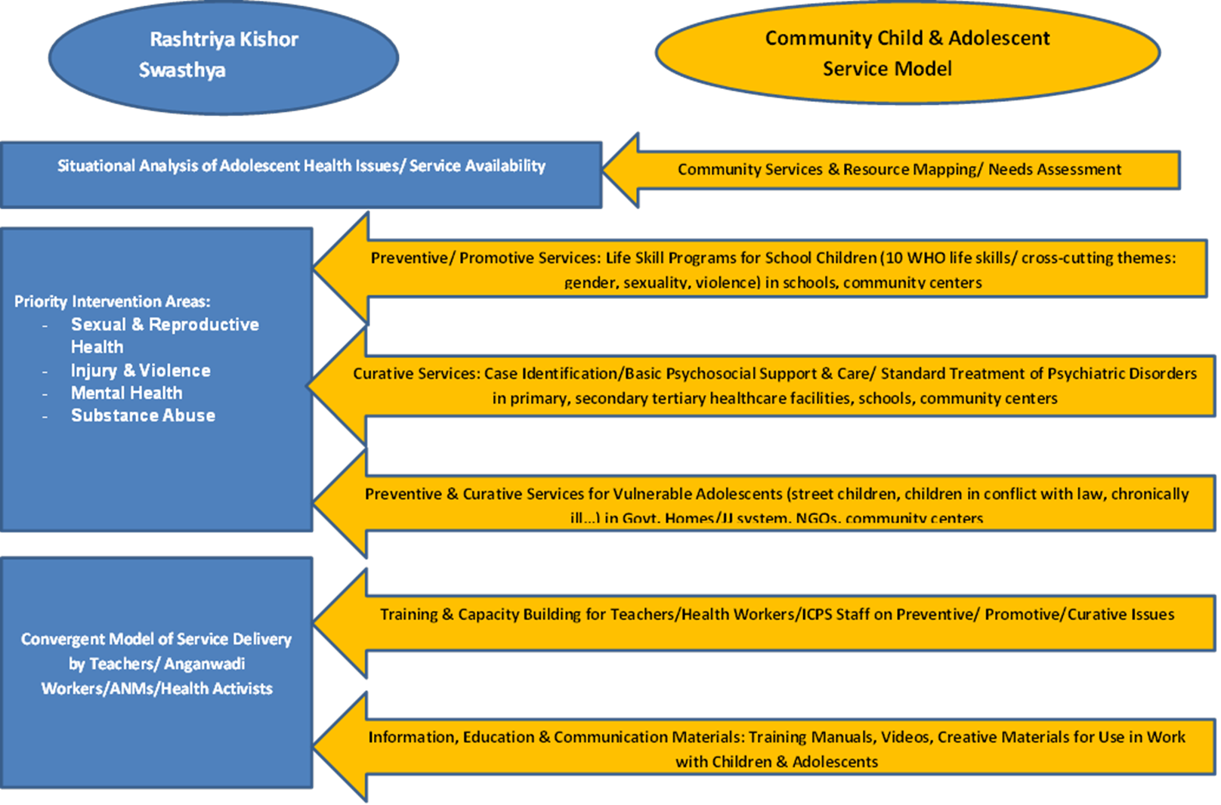
How the Community CAMH Service Model Operationalizes RKSK

Slide 16
Communication Strategies for Adolescent Programs
What May NOT Work:
Conventional/top-down approaches
Information-giving (hoping it will lead to behaviour change)
Flyers, leaflets, posters, lectures

Slide 17
Communication Strategies for Adolescent Programs
Suggested Methods…What May Work…

Slide 18
Methodology
Didactic vs. experiential
Context vs. content
Process vs. outcome
Performative(real) vs. conceptual

Slide 19
Contexts of Application
Gender
Sexuality
Conflicts
Abuse
Violence
Risk taking
Self harm
Pressures

Slide 20
Examples of Use of Theatre
Theatre for children
Performed by adults
Themes from mythology,folk tales etc
Children as audience
Entertainment and informing as functions

Slide 21
Theatre by Children
Annual school plays
Play competitions
Scripts chosen and directed by adults
Some engagement
Learning group work,collaboration
Skill development involved

Slide 22
Theatre-in-Development
Use of theatre technique for developmental issues
Has thematic specificity
A powerful alternative to providing information

Slide 23
Theatre-in-Education
To teach subject
Life skills education

Slide 24
Life Skills Education
What is the purpose of education?
Contemporary concerns
Construction of knowledge

Slide 25
Life Skills Defined
Decision-making… Problem Solving
Critical Thinking…Creative Thinking
Effective Communication…Interpersonal Relationships
Self-awareness…Empathy
Coping with Stress…Coping with Emotions

