Slide 1

Working with
Pre-School Children
A Training Workshop for Pre-School Teachers
Visthaar, Bangalore
24th to 26th August 2015

Slide 2
Our Learning Objectives
Understanding developmental needs of pre-school children.
Identifying and assessing key areas for pre-school child development.
Learning skills for early childhood education and development.
Learning about common developmental disabilities and early childhood emotional and behaviour problems and how to respond to them.
Understanding and responding to trauma reactions in young children.

Slide 3
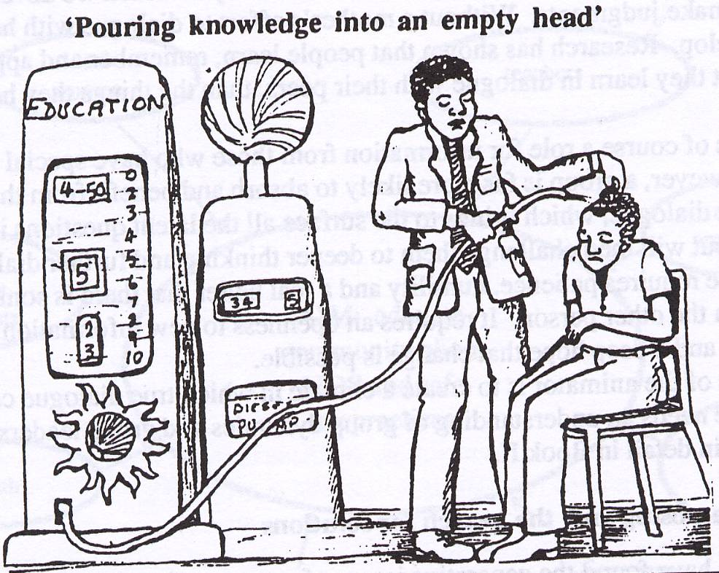
Our Learning Methods
Slides/ materials
Do-and-learn (skills)
Role Plays
Case-Studies
Participatory Group Activities and
Discussion

Slide 4
I. Children & Childhood

Slide 5
Setting the Tone…Re-Connecting with Your Childhood
Activity:
Close your eyes and remember your early childhood (pre-school) days. Re-visit people, places, events that occurred then with reference to:
  i) happy early childhood experiences
  ii) difficult early childhood experiences
  iii) traumatic early childhood experiences.
Share your childhood memory with their group members. Anyone who wishes to share in the larger groups may also do so.

Slide 6
Discussion:
How did you feel when you re-visited happy memories versus difficult and traumatic ones?
Who helped/ how did you cope?
The importance of being in touch with your own early childhoods so you know what it is like to be a young child, what makes young children happy, angry or sad…what children like to do etc.
How this sensitivity is essential to working effectively with children– and realizing that early childhood memories stay with us/ influence for years after.

Slide 7
Identifying Child Developmental Needs & How They are Impacted by Conflict/ War Situations
Objectives:
To identify children’s physical, social, emotional and cognitive needs.
To understand how these developmental needs have been impacted by war/conflict situations.

Slide 8
Key Areas for Child Development
Physical
Emotional
Cognitive
Social
Language

Slide 9
Process:
Divide into 5 sub-groups.
Round 1: Sort cards into 5 domains of development. (Each group picks up cards relevant to their domain).
Round 2: Within each domain, sort cards for abilities & skills to match needs and opportunities. (Within each group, after initial round of sorting, further categorize and match the cards).
View the categorization in plenary…discuss.
Generate ideas/ activities to further child development in each domain—physical, social, speech and language, emotional & cognitive areas. What types of activities can we do/ do you do? Let us develop a list…

Slide 10
Physical Development (1)
Abilities & Skills Needs & Opportunities
Social Development (2)
Abilities & Skills Needs & Opportunities
Speech & Language Development (3)
Abilities & Skills Needs & Opportunities
Emotional Development (4)
Abilities & Skills Needs & Opportunities
Cognitive Development (5)
Abilities & Skills Needs & Opportunities

Slide 11
Let’s Talk about Attachment…
Nature of the bond between child and care-giver
Usually, attachment figure is mother (sometimes there can be extended attachments)
Strong attachment is related to security and well-being
Loss of attachment figure (through loss or separation) can give rise to insecurity and related anxiety problems—clinginess and expectation.
Contexts/ Situations where child is at risk of insecure attachment:
  Children in intact families
    Parental conflict
    Neglect
    Non-response to child’s needs
    Physical/ sexual abuse
    Frequent separation experiences.
  Children in conflict areas:
    Abandoned/orphaned
    Suffering loss in conflict areas,
    Institutional upbringing,
    Frequent change of care takers

Slide 12
Physical Development
General growth and nutrition
Sensory experiences
Gross Motor Skills: mobility, ability to handle objects
Fine Motor Skills: pre-writing skills, transfer functions, eye-hand coordination
Physical skills necessary self- help: buttoning, brushing, feeding etc.
…Types of activities you do for physical development?

Slide 13
Physical Skill Development Activities
Physical Skill | Activity/ Techniques
Sensory Experiences | Creating sensory spaces: getting child to touch objects with different surfaces/ different textures, tasting different foods…sand/ water play
Gross Motor Skills | Physical play/ running/ jumping/ skipping/swimming
Fine Motor Skills | Beading, colouring, block placement, assembling, clay modelling, drawing different shapes, shading, filling dotted lines, finger painting, writing in sand, block printing
Physical skills for self-help activities | Instruction, modelling, pictures, demonstration on a toy, shaping

Slide 14
Social Development
Recognizing familiar people
Understanding rules of play
Peer interaction
Understanding of spaces (and what happens there)
Understanding of sequences and routines
…Types of activities you do for social development?

Slide 15
Social Skill Development Activities
Simple rule-based games
Naming and pointing familiar people
Naming and pointing familiar spaces/ places where child goes + discussion about what is done there
Supervised peer interaction, group play, cooperative play (exposure to playgrounds/ play spaces)
Use of pictures to explain day’s routine/ sequencing
…Others?

Slide 16
Language Development
Increase fund of words.
Ability to construct short sentences.
Ability to communicate needs and experiences.
Ability to describe.
…Types of activities you do for language development?

Slide 17
Speech and Language Skill Development Activities
Naming and pointing games
Story telling
Phone games
Describing games (using pictures or real life observations/events or television clips)
Concept book/ flash cards
…Others?

Slide 18
Cognitive Development
Fund of information
Knowledge of use of objects
Ability to form associations
Ability to form categories
Sequencing and organizing abilities
Ability to understand concepts such as shape, size, distance, directions
…Types of activities you do for cognitive development?

Slide 19
Cognitive Skills Development Activities
Puzzles
Identification of colors, shapes
Story telling (including discussions)
Story Completion
Use of pictures for sequencing events/ stories
Play to demonstrate use of objects
Attention enhancing tasks (joining dots, spotting the difference, eye-hand coordination activities)
Concept book/ flash cards
…Others?

Slide 20
Emotional Development
Attachment and bonding
Ability to identify emotions
Ability to report emotional states
Ability to regulate emotions
Ability to recognize emotional state of another person and ascribe simple reasons to causality
Differentiating between positive and negative emotions
…Types of activities you do for emotional development?

Slide 21
Activities for Emotional Development
Providing frequent and timely responses of love/ affection to child, incl. positive feed-back, verbal and non-verbal.
Identifying emotions through pictures
Story telling
Story completion
Visual analogue (emotion scale)
Listing situations in which a certain emotion is felt (‘you are happy when…’)
…Others?

Slide 22
Vulnerability of Pre-Schoolers
Let us discuss how in the post-conflict situation (in your communities) how children’s developmental needs/ abilities are affected…and why?
Who are some of the most vulnerable young children?
All children are vulnerable and they are all affected by the conflict/war in different ways and in varying degrees. But some are more vulnerable than others and these are at greater risk to emotional problems and mental health disorders
Children who have…
-Lost both parents
Lost one parent (belong to single-parent, especially single-mother families)
Displaced children (living in camps)
Separated from their family/ living alone
Children in homes
Difficult/ dysfunctional family contexts
Disabled
Physically/ sexually abused children

Slide 23
Difference between Pre-school Children and Older Children?
Pre-schoolers experience and process life events, differently from older children, due to age, cognitive capacity and information/support available to them.
Unlike older children, younger ones, may not have the verbal ability or do not choose to verbally express their emotions.
Other less direct and directive methods, such as play and art are therefore necessary to understand and communicate with young children, incl. to learn.

Slide 24
II. Children with Disabilities

Slide 25
In your classroom…
Think of one child whom you feel is different from others…
What is this child like?
Looks different…?
Does things differently from others…?
Cannot do the things that other children do…?

Slide 26
What is disability or developmental problem?
Lack of skills/ abilities in one or more of the areas of child development.
Delay in skills/ abilities in one or more of the areas of child development.
Results in impaired day-to-day functioning of the child/ problems with activities for daily living.

Slide 27
Types of Disability
Physical Disability
  Vision problems
  Hearing disability (which results in speech problems)
  Other oro-muscular problems(causing speech problems)
  Locomotor Disability
Locomotor Disabilities
  Due to congenital defects/ malformations
  Brain damage that leads to spasticity/ problems with body movement
  Child may have trouble with self-help skills
  Child may have problems with eye-hand coordination tasks such as writing
  Some may also have intellectual disability but not necessarily/ not all

Slide 28
Intellectual Disability
Mild ID:
  Able to learn practical life skills & function in daily life.
  Attains reading and math skills up to grade levels 3 -6.
  Able to blend in socially.
Moderate ID:
  Noticeable developmental delays (i.e. speech, motor skills)
  May have physical signs of impairment (i.e. thick tongue)
  Can communicate in basic, simple ways
  Able to learn basic health and safety skills
  Can complete self-care activities—requires much training.
Severe ID
  Considerable delays in development
  Understands speech, but little ability to communicate
  Able to learn daily routines
  May learn some very simple self-care—with a lot of training.
  Needs direct supervision in social situations
Profound ID
  Significant developmental delays in all areas (physical/ social/ emotional/ language/ speech)
  Obvious physical and congenital abnormalities
  Requires close supervision/ Not capable of independent living
  Requires complete assistance in self-care activities

Slide 29
10 Questions for Basic Disability Assessment
1. Compared with other children, did the child have any serious delay in sitting, standing or walking?
2. Compared with other children does the child have difficulty seeing, either in the daytime or at night?
3. Does the child appear to have difficulty hearing?
4 .When you tell the child to do something, does he/she seem to understand what you are saying?
5. Does the child have difficulty in walking or moving his/her arms or does he/she have weakness and/or stiffness in the arms or legs?
6. Does the child sometimes have fits, become rigid, or lose consciousness?
7. Does the child learn to do things like other children his/her age?
8. Does the child speak at all (can he/she make himself/herself understood in words; can he/she say any recognizable words)?
9. Is the child's speech in any way different from normal (not clear enough to be understood by people other than his/her immediate family)?
Can he/she name at least one object (for example, an animal, a toy, cup/ spoon)?
10. Compared with other children of his/her age, does the child appear in any way mentally backward, dull or slow?

Slide 30
Activity
With reference to the child you thought of in your class and described as having a problem/ disability:
The parents want to know if this child has a problem.
As his/ her pre-school teacher, you need to tell them whether the child has a problem/ disability.
Use the 10 questions to screen the child—does he/she have a disability or not?

Slide 31
Screening for Disability: Ages 2 to 6 yrs
Developmental Functions and Tasks |  | Ability to Perform Developmental Functions and Tasks
 |  | To high Extent | To Some Extent | To Low extent/ Not at all
Motor Skills
1. | Throws a ball
2. | Jumps in place
3. | Holds pencil to scribble/ draw
4. | Folds paper in to half in imitation*
5. | Takes out small objects from a container

Slide 32
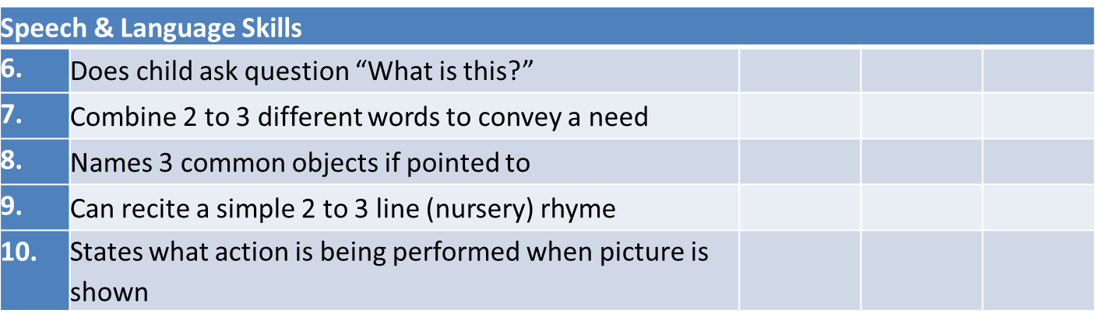

Slide 33
Cognitive Skills
11. | Able to sit in one place for at least 15 minutes (to do a task)
12. | Comprehends and executes simple instructions (shut the door, brings object as asked)
13. | Identifies sizes/ age (big-small, younger-older)
14. | Identifies functions of objects (such as telephone, glass of water, vehicle)
15. | Identifies at least 5 body parts (can name/ point)

Slide 34
Social Skills
16. | Recognizes family members/ familiar people like teacher
17. | Recognizes spaces (kitchen/bathroom/street) and their function
18. | Understands rules of simple games (passing a ball or taking turns)
19. | Interacts/ plays & talks with other children
20. | Can enumerate routine/ daily activities

Slide 35
Emotional Skills
21. | Can recognize common emotions (when pictures of faces are shown)
22. | When upset/ frustrated, can be easily comforted
23. | Is explorative and curious (not inhibited/ anxious)
24. | Is comfortable when mother/caregiver is away/ leaves
25. | Helpful and caring of other children (shares toys/ comforts others when hurt or crying)

Slide 36
Case Studies
Case 1: A 3-year old child was born prematurely and had extended NICU care. The child now has feeble movements and slow response.
Case 2: A 5-year old boy has not yet attained toilet control and does not seem to grasp concepts at school.
Case 3: A 6 year old girl has adequate self-help skills and comprehends instructions. However, she talks to strangers and is easily angry and irritable. She is also unable to read and write at school.

Slide 37
Responding to Physical and Intellectual Disabilities in Pre-Schoolers
Areas of Focus
Motor skills (Motor skill development activities)
Social skills (Social skill development activities)
Language and communication (Language/ communication skill development activities)
Self-help skills training

Slide 38
Severe Motor Skill Problems/ Cerebral Palsy
Passive joint exercises
Active joint exercises
Pressure point massages
Special chair and other prosthesis

Slide 39
Severe Speech and Language Problems
Oral Stimulation Therapy
  Oral/ mouth massages
  Blowing balloon/ straw/ whistle
Make different kinds of sounds using lip/tongue/palate

Slide 40
Techniques for Teaching Self-Help Skills Training
Define target behaviour. (What do you want child to be able to do?)
Prompts: physically guide child through behaviour/ action.
Clear instruction on what to do
Modelling/ demonstration
Shaping (adding new behaviours)
Chaining (series of behaviours to make up the target behaviour)
Rewards
Let us use an example…how to train a child to brush her teeth or have a bath?

Slide 41
DAY 1/EVENING:
FILM SCREENING

Slide 42
III. Common Emotional & Behavioural Issues in Pre-School Children

Slide 43
Identifying Common Emotional & Behavioural Issues in Pre-Schoolers
Case 1: Rashmi, a 5 year old child’s father left home two months ago in search of work. The child has become very clingy to the mother. It is now time for the child to resume school but she refuses to go—she becomes very tearful and throws tantrums daily at school time as well as other times when she does not get what she wants. She also wets her bed at night now-a-days.
Case 2: Raul, a 4 year old boy. His uncle’s family has re-located to stay with his family. He has three cousins with whom he has to share sleeping space and toys. He is observed in school to be pushing and hitting other children and snatching their things.
Case 3: Teesta is a 3 year old girl. Her pet dog drowned in the river near her house. It has been a month since the incident and she is found to be silent and crying all the time, and not wanting to play with other children. Her mother also says that she hardly eats any food and keeps waking up and crying in the middle of the night.

Slide 44
The Anxious Child…
clings to parent/ caregiver all the time and refuses to go anywhere on her own/ leave care-giver.
refuses to go to school and/or shows clinging/ crying behaviour at the time.
has fears such as:
  being lost and unable to return to home or family.
  being abandoned (“If mom drops me off at school, she’ll never come back”)
  something bad happening to a parent or other loved one during, or because of, the separation.
  constantly complains of body aches and pains which on medical examination may have no physical basis.
  has bed-wetting behaviours (recent onset i.e. was toilet trained but has reverted to bed wetting).
  Has thumb-sucking and nail-biting behaviours.

Slide 45
The Angry Child
Often irritable and easily provoked into verbally or physically abusive behaviours.
Anger is also expressed in the form of temper tantrums and demanding behaviours.
Has difficulty controlling aggressive impulses.
Has poor peer interaction skills.
Frequently gets into fights with others.
May not have developed empathy i.e. is unable to identify and respond to others’ feelings/ emotions (social skills deficit).

Slide 46
The Depressed Child
Appears sad all the time.
Cries frequently and easily.
Is irritable and easily upset.
Does not perform activities for daily living.
Is not interested in play and other activities.
Tends to keep to him/herself and not engage with others.
Has feeding problems.
Has sleep problems.

Slide 47
Addressing Child Psychosocial & Protection Issues: Levels of Response and Interventions
COUNSELING
&
THERAPY
- In-depth individual work
- Referral
- Therapeutic groups
DEVELOPMENTAL NEEDS
- Psychological First Aid
- Recreational Groups
- Back to School
NORMALIZATION
- Providing food, shelter, water/sanitation, healthcare, physical safety.
- Physical presence & reassurance.
BASIC NEEDS & SOLIDARITY

Slide 48
Level of Intervention | Examples of Response
Solidarity | Providing for/ advocating for basic needs to be made available to children, including food, shelter, water/sanitation, healthcare and protection/physical safety. Being physically present/ making yourself accessible to them. Listening and providing comfort to calm them—such as is done through psychological first aid.
Normalization | Structuring the day for children. Ensuring that they return to school. Ensuring peer interactions and play time to enable them to adapt to the changed + (age-appropriate) recreational groups and creating child friendly spaces.
Addressing Developmental Needs: | Recreational and play groups and child friendly spaces. Free play sessions with age-appropriate games and play for children, including early childhood development activities. Working with parents to respond to their children’s social and emotional needs. Psychological first aid provision to ensure that children have access to food/ nutrition, healthcare, shelter, security and other basic needs.
Counseling and In-Depth Therapy | Assessment—check for emotional and behavioral problems the child/ psychiatric diagnosis if applicable/ establish the child’s level of functioning/ psychosocial context, including family experiences/education /experience of the conflict/violence. Developing goals for (and with) the child to address problems. Developing a plan for how to work individually with the child, in accordance with the goals set (counseling + medication) Monitoring child’s progress through the healing process and recovery.

Slide 49
Our Focus…
Basic needs and solidarity
Normalization/ Routine
Developmental activities
First level responses to children in difficult situation or with emotional/ behaviour problems

Slide 50
IV. Communication Techniques with
Pre-School Children

Slide 51
A. Talking with Young Children

Slide 52
Skill 1: Getting to Know the Child
Rapport Building:
First stage of building a relationship with the child.
3 steps to rapport building get to know the child
Step 1: Greeting the Child
Step 2: Preliminary Establishment of Context
Step 3: Let’s get to know each other (activities)

Slide 53
Step 1: Introducing yourself (as PSS Counselor/Childcare worker)
  Greeting
    Greet the child.
    Shake hands if appropriate.
    Tell her your name and ask her’s.
  Clearing misconceptions about counselling/ alleviating fears
    “I am not here to give you medicines or injections. Am only here to teach you…and to talk to you and play with you when you feel like it…and just to be with you.”
  Normalizing the phenomenon of getting help
    ‘When you have fever or tummy ache, you go to a doctor to help you. In the same way, when you are feeling sad and upset about many things, I am here to help you feel better and see how to solve some of the problems you might have. We can play or talk about the things that are worrying you and we can see how best to make them better.’

Slide 54
Step 2: Preliminary Establishment of Context
  Universalizing the child’s experience:
    ‘Like you, lots of children, have had difficult experiences. So many children are sad and upset and need help with what they are feeling and experiencing. None of these children, nor you, are bad people or crazy people.’
  Individualize the child’s experience: In response to what the child may say about why he/ she is with you:
    ‘While many children may have gone through experiences and troubles similar to your’s, your experience is still different and special. Everyone needs help in different ways. I am here to understand and support you.’
  Ensuring Confidentiality
    ‘I want you to also know that when we talk or play, whatever we share will be between us. I won’t tell anyone about your feelings or upsets. If there is a time/ a need to have to tell some of it to other people, I will only do it after consulting you and getting your permission—never without.’

Slide 55
Step 3: Let’s get to know each other…
  Ask child neutral, non-threatening questions to elicit information about his/ her likes/ dislikes and interests:
    What did you eat today?/What have you been doing all morning?
    Flip a coin: The counselor and the child each choose ‘heads’ or ‘tails’ of a coin. When the coin is flipped, depending on what comes up, the person has to reveal a personal detail i.e. if the counselor chose ‘heads’ and heads comes up, she must reveal a fact about herself; if ‘tails’ comes up, it is the child’s turn to reveal a fact about herself. Example: “Blue is my favorite colour”, or “my favourite food is …”.
  Establish a spirit of collaboration
    Do an activity together—drawing/ coloring, a puzzle, reading a story…anything that interests the child.

Slide 56
Activity 1: Getting to Know the Child
Objective:
To learn to build rapport with the child.
Process:
Role play in pairs…
  Introduce yourself to the child
  Establish context of interaction.
  Get to know each other better
Discussion:
Volunteers?
What did we do right?
What elements of the 3 steps were we able to implement?

Slide 57
Skill 2: Listening and Interest
Reflective Listening/ Verbal response:
  Ok…
  Hmm…
  Alright…
  Yes…
Attentive listening:
  Maintaining eye contact
  Nodding of the head
  Body posture like leaning forwards towards the child.
  Empathetic gestures like supportive pat on the shoulder or hand.

Slide 58
Appropriate Body Language:
  Attentive but relaxed sitting posture (no slouching/ drooping).
  No fidgeting.
  No writing notes/ doing other activities.
  No looking elsewhere/ poor eye contact.
Listening Dos and Don’ts…
DO… Show interest. Be empathetic and understanding. Demonstrate your interest through verbal and non-verbal cues. Listen for causes of the problem. Observe silence as appropriate. | DO NOT… Argue. Interrupt. Be inattentive. Do other work. Pass judgment. Give advice immediately. Jump to conclusions.

Slide 59
Activity 2: Listening & Interest
Objectives:
Learning different ways of listening.
Process:
Divide into pairs. One member of each pair leaves the room and one stays in.
Round 1: Group that is outside (when they re-join their partners) to talk for a minute continuously about some very important event in their lives to their partners. Instruct the group inside to sit with their fingers blocking their ears i.e. not to listen to their partners talking.
Round 2: Group outside to talk for a minute about some very happy event in their lives tot heir partners. Instruct the group inside to look away, not make eye contact, not respond and act as if they are not listening.
Round 3: Group inside and outside to talk non-stop to their partners. Neither should listen.
Round 4: Group outside to share some very difficult experience in their lives with their partners. Instruct the group inside to be attentive, make eye contact, and express emotion.

Slide 60
Discussion:
How the group outside felt during each round of the game?
Various levels of listening i.e. from not listening at all (1) to ‘hearing’ without listening (2) to talking so much that there is no listening (3) and finally active listening (4). In which round is good communication taking place? Why?

Slide 61
Skill 3: Recognizing and Acknowledging Emotions
What are the ways in which we recognize and identify emotions?
  Non-verbal cues: facial expressions, gestures
  Verbal expressions: tone of voice, actual content of speech
  Other behaviours
Of course we sympathize…and we feel for the child but how do we show it?
  Non-verbal cues (holding hands, facial expressions, hugging…)
  Verbal expressions ( tone of voice, “I know it must have been difficult…it seems like you are really hurt and angry…”
  NO judgement of emotions expressed! Emotions are neither good nor bad…they just are and we feel them, no matter that. “It is alright for you to feel angry and frustrated…”

Slide 62
Activity 3: Recognizing and Acknowledging Emotions
Objective:
How to identify and recognize emotions.
How to communicate to a child that you recognize & acknowledge his/her emotions.
Process:
Divide into pairs.
Read the children’s expressions provided.
Identify the emotions expressed.
Next, one participant assumes role of child and the other that of PSS counselor.
Use the dialogues of the children (below) and do the following:
Role-play your response to the child. How will you respond to them?
  State your verbal response—to show that you recognize and acknowledge the emotions felt by the child.
  Demonstrate non-verbal responses you would provide.

Slide 63
Children’s Narratives
(Activity 3: Recognizing & Acknowledging Emotions)
Saira, age 3:
“I want to play with this toy…I will not eat now. “ (Mother/ care-taker tries to cajole her. Child crying and stamping her foot and hitting out).
Shekhar, age 4
“My mother is very sick . She does not eat anything. She doesn’t play with me or take me to school any more. She doesn’t talk to me any more—her eyes are always closed when she is lying down.”
Saira, age 5
“Anna at school is bad. He took me again and again to the store room …he said he will show me something special. And he hurt me in my wee-wee, with his hand. I don’t like him.”

Slide 64
Skill 4: Non Judgemental Attitude & Acceptance
What does non-judgemental attitude mean?
Allowing the child to be destructive and hit other children?
Telling the child it is alright not to go to school if she does not want to?
Assuring the child it is alright for him cry about his father’s death?
Acknowledging to the child that the toilets in the institution are indeed dirty and disgusting?
Non-judgemental attitude involves…
Recognizing and acknowledging a feeling/emotion—WITHOUT being judgemental about whether that feeling is ‘right’ or ‘wrong’.
NOT giving your personal opinion in a way that is critical or blaming in any way.
Accepting the child for who and what he/she is.

Slide 65
Activity 4: Non-Judgemental Attitude
Objectives:
To understand what non-judgemental attitude means.
To reflect non-judgemental attitude in communication with children.
Process:
Read the scenario/conversations below between teacher & child.
Discussion:
What did the counselor do differently in scenario 2 versus scenario 1?
Which do you think would be more effective in building a relationship with the child and why?
How do you think the child would have responded/ said next in i) scenario 1; scenario 2?

Slide 66
Teacher-Child conversations
(Activity 4: Non-Judgemental Attitude)
Scenario 1 | Scenario 2
Child: I hate staying with my aunty and uncle! I don’t want to stay in their house…I will run away! Counselor: Yes, it may be difficult for you to be here. But what option do you have? Your parents are not there…who will look after you then? Child: I don’t care…I will run away. Counselor: Where are you going to run away to? You know what will happen if you leave home and run away…have you any idea what could happen to you? | Child: I hate staying with my aunty and uncle! I don’t want to stay in their house…I will run away! Counselor: Yes, it must be difficult for you…it must make you angry to be in a place you dislike, to be away from your parents home—which I know you loved and whom I know you miss. Child: I don’t care…I will run away. Counselor: I would worry if you ran away and we did not know where to find you. What else about being in your aunty and uncle’s home makes it hard for you? Tell me about a little about it…?

Slide 67
Discussion:
What did the counselor do differently in scenario 2 versus scenario 1?
Which do you think would be more effective in building a relationship with the child and why?
How do you think the child would have responded/ said next in i) scenario 1; scenario 2?
Process (b):
Divide (participants) into pairs and role play a conversation between teacher and child on the following issues (As teacher, child’s mother has reported the issue to you/ asked for your help):
  A 5 year old boy who does not want to come to school.
  A 4 year old girl who refuses to leave her mother to anywhere.
  A 3 year old girl demanding to go to the park when it is already dark.

Slide 68
B. Communication Techniques Using Other/ Creative Methods

Slide 69
Use of Art
Young children’s verbal abilities are not always developed enough to be able to communicate all they need to.
Drawing is a natural mode of communication for children.
It offers a way to express feelings and thoughts in a manner that is less threatening than verbal methods.
It helps children to express emotions and describe events which they may find difficult to speak about (either because of their verbal ability or because the experience is too painful).
Children’s art work can also provide information on developmental, emotional, and cognitive functioning, hasten expression of hidden traumas.

Slide 70
Use of Stories
Story telling or the oral tradition of communication is one of the oldest customs.
Most people and cultures are familiar.
Most children love to listen to stories.
Stories provide ways in which to entertain, relax as well as appeal to children’s imaginative and cognitive processes.
Getting children to tell stories encourages thinking and creative skills;
It provides a space for children to project their own life experiences or tell their own stories—and in the process, find solutions to their own problems.

Slide 71
Use of Dolls and Puppets
Children naturally project their thoughts and feelings onto dolls or puppets.
Another creative method by which children can verbalize feelings and experiences and seek solutions to problems.
Puppets are also useful for rapport building with younger children when they are very anxious and withdrawn.
Puppets serve as a medium to reflect understanding and provide corrective emotional experiences in the context of the children.
By using the puppet to symbolically represent persons and events, the focus is removed from the child, thereby making the child feel safer/less threatened by the immediacy or personalization of emotions or situations.
Puppet play also gives children the chance to bring inner stories outside.

Slide 72
Activity
Case 1: Rashmi, a 5 year old child’s father left home two months ago in search of work. The child has become very clingy to the mother. It is now time for the child to resume school but she refuses to go—she becomes very tearful and throws tantrums daily at school time as well as other times when she does not get what she wants.
Case 3: Teesta is a 3 year old girl. Her pet dog drowned in the river near her house. It has been a month since the incident and she is found to be silent and crying all the time, and not wanting to play with other children. Her mother also says that she hardly eats any food and keeps waking up and crying in the middle of the night.
How would you communicate with/ help a child in above situations:
i) Using art
ii) Using a story
iii) Using puppets

Slide 73
C. Some General Techniques to Engage with Children

Slide 74
Communication should involve…
Observing young children’s actions and behaviours and being alert to what they mean.
Listening to young children when they speak.
Starting conversations with young children.
Encouraging them to express feelings and report/describe events.
Using other mediums of communication such as art and story-telling to understand and engage them.
Validating and reassuring children at all times.
Never to dismiss what they say or feel.
Avoid reducing their feelings/ actions to ‘good boy/ bad girl’ type of responses.

Slide 75
Positive Engagement with Children with Disability and/or Behaviour Problems
Seat child in front/ near the teacher to limit distractions.
Provide frequent one-to-one attention
Seat child with another child who is of low risk for such behaviour.
Give the child an opportunity to explain his/ her action/ behaviour.
Notice children being good and appreciate them verbally.
Focus on the positives of every child, even the most difficult ones.
Identify good efforts even if ultimately unsuccessful.
Use star charts for good behaviour.
Check for underlying causes such as learning difficulties, attention deficit and hyperactivity, difficult home environment, trauma

Slide 76
Use of Negative Reinforcement: What is NOT Acceptable
Physical Harassment:
Causing physical harm to children by hitting, kicking, scratching, pinching, biting, pulling the hair,
Boxing ears, smacking, slapping, spanking or with any implement (cane, stick, shoe, chalk, dusters, belt, whip, giving electric shock etc.);
Making children assume an uncomfortable position (standing on bench, standing against the wall in a chair-like position, standing with schoolbag on head, holding ears through legs, kneeling etc.).
Forced ingestion of anything (for example: washing soap, mud, chalk, hot spices etc.)
Detention in the classroom, library, toilet or any closed space in the school.
Witholding food or other basic needs by way of punishment.

Slide 77
Mental Harassment:
Sarcasm that hurts or lowers the child’s dignity;
Calling names and scolding using humiliating adjectives, intimidation;
Using derogatory remarks for the child, including pinning of slogans;
Ridiculing the child with regard to her background or status or parental occupation or caste;
Ridiculing the child with regard to her health status or that of the family – especially HIV/AIDS and tuberculosis.
Belittling a child in the classroom due to his/her inability to meet the teacher’s expectations of academic achievement;
Avoid involving other students/ do not compare behaviours.

Slide 78
Use of Negative Reinforcement: What is Acceptable
Give a warning and a chance before taking any further action.
A simple verbal warning e.g. just calling out the name of the child who is talking in the class or asking him/her question could help.
If behaviour continues, take away privileges in consultation with the children (negative reinforcement – this encourages the child to follow good behaviour to keep his privilege, therefore it is not considered punishment).
Do not give star/point/mark on his chart for the day or give negative point/marks.
Take away 15 minutes of any privilege time (child and teacher mutually agree) for recurrent misbehaviours.
Discuss the consequences well ahead with children so that there is consensus regarding plan of action when a particular behaviour occurs
The negative reinforcement should be appropriate and fair.
It should be consistently employed.

Slide 79
Other Behaviour Management Strategies in the Classroom
Ignore minor incidents or lapses.
Set clear limits.
Explain clearly the classroom behaviour expectations that the children have framed together
Use ‘I need you to ...’ rather than ‘You need to ...’ statements
Give clear commands on what is expected, e.g., ‘stay quiet’ instead of ‘be good.’
Use a ‘firm and calm’ manner – avoid an angry tone.

Slide 80
V. Understanding Traumatic Experiences in Pre-School Children

Slide 81
Activity 1: Thinking about What Trauma Means
Objective:
To understand what trauma is and how we view it.
Method: Visualization, drawing, narrative
Materials: paper and colours
Process:
Ask participants to do the following, step by step:
  Close your eyes and think of a traumatic time/event in your lives.
  Imagine the event/ time as an image (not a narrative/ not in words)…like a still photograph.
  Now, draw it.
  Now describe it—either to yourself or the person next to you.
Discussion:
What sort of images and feelings came back to you?
Was it easy to express the emotions you felt?

Slide 82
Trauma…
Domestic Violence
Natural Disasters
Man-made Disasters
Death, Dying, Bereavement
Loss Experiences
Rape, Child Sexual Abuse
(Child) Trafficking
Accidents – Disfigurement, Loss Of Limb
Terminal Illnesses
Torture
Difficult Experiences
Sex and Sexuality
Abuse, violence, Violation, Exploitation
Gender and Patriarchy
Power and Domination

Slide 83
Types of Trauma
Two types of trauma that can happen to children:
Acts of omission: psychological neglect, sustained parental non-responsiveness and psychological or physical unavailability.
Acts of commission: actual trauma directed toward the child.--acts (of abuse), whether physical, sexual, or psychological, can produce longstanding interpersonal difficulties, as well as distorted thinking patterns, emotional disturbance, and posttraumatic stress.

Slide 84
Impact of Trauma on Pre-Schoolers
Persistent crying/ sadness/ irritability
Refusal to play
Fear, anxiety
Nightmares/flash-backs of traumatic event
Bed-wetting
Extreme fear/panic reactions (when a child hears the sounds of bombing or sees smoke…)
Excessive clinginess to parent (separation anxiety)
Developmental/ learning abilities adversely affected

Slide 85
A. Loss, Grief, Death Experiences in Pre-Schoolers
How to young children experience loss/grief/death issues?
How to explain death to young children?
Other responses to young children’s loss experiences.

Slide 86
Young Children’s Understanding of Death/ How they Grieve
How much do we know about young children’s grieving patterns?

Slide 87
Myth or Reality?
Children do not understand or experience death.
Even young children experience loss and separation—which is how they experience death.
It is alright never to tell children the truth about death because they will forget.
Never lie to children and ignore the truth—they do not forget.
It is better to tell children that ‘she has gone away and may come back’.
If children are expectant of the dead person’s return, the betrayal is greater when they find out this is not true.
Children will be scared if they find out the truth.
When children become scared about a death, they are afraid about related issues, such as whether remaining parents or supports will also go away. They may also be reflecting fears and anxiety from the adults who are also involved in the family
Children should NOT attend funerals or be involved in grieving.
Adults fear that the children will not be able to handle the funeral, or become disruptive.
Children need closure and can attend grieving rituals provided they are not further exposed to traumatizing factors.

Slide 88
When Loss/ Grief Occur
Loss of people either through separation or death may have occurred in many ways:
death of significant family members due to illness/ accident
separation from loved ones due to displacement and movement away from home/family.
because of attack by armed groups/injury/death
loss is not limited to loss of loved ones or people alone: extends to loss of home, school, play, routine and childhood (as in case of abuse/ child labor)
multiple levels of loss experience: children may feel some aspects of the loss more acutely than others or they might experience loss as a whole, a combination of its various sub-parts.
loss of loved ones (attachment figures/ significant others/caregivers) make for the most traumatic loss and grief experiences.

Slide 89
Risk factors for Children experiencing loss and death
Sudden deaths, suicides, homicides, killings
Displacement and lack of familiar surroundings
Death of significant person/ caregiver/ attachment figure
Psychologically vulnerable parent (remaining) and the role he/she plays
Poor family coping
Lack of family and community support
Lack of understanding about the concept of death (especially in younger children)
Conflicting relationship with deceased person prior to death (guilt)
Denial regarding the death
Lack of understanding about death (concept of death not yet present)
Guilt/ self-blame for the death
Pre-existing psychological difficulties

Slide 90
Assessment of Loss and Grief Trauma
What to assess…
Child’s emotional, social, cognitive functioning before and after the death
Child’s relationship with the deceased
Circumstances of the death, i.e. anticipated/sudden/ violent
Child’s contact with the deceased, and involvement in mourning rituals
Child’s expression of “goodbye”
Child’s grief reactions / Traumatic grief
Child’s relationships with family, peers, community
Cultural and family beliefs and traditions regarding death and mourning
Family’s grief reactions and ability to communicate openly about the death
The parents’ strengths and vulnerabilities in caring for the child
Other major stresses in the child’s life

Slide 91
How Children Understand Death & Grieve
Age group | Understanding of death | Patterns of grieving in children
0-3 | No understanding of death Absorbs emotions of others around her/him | May show signs of irritability May exhibit changes in eating, nursing patterns, crying, and in bowel and bladder movement. Dependency on nonverbal communications; physical care, affection, reassurances
3-6yrs | Child thinks death is reversible; temporary, believes that people who die will come back. "Magical thinking"; believes their thoughts, actions, word caused the death; or can bring deceased back; | Craves for affection / physical contact, even from strangers Connects events that are not connected Greatly impacted by parent's emotional state Regressive behaviors; bed wetting, security blanket, thumb sucking, etc. Difficulty in verbalizing, and acts out feeling Have worries of abandonment and fear that when others leave that they are not going to come back.
6-9 yrs | Child begins to understand the finality of death; some do and some may not. Sees death as a taker or spirit that comes and gets you. | Fear that death is contagious others can die too Asks concrete questions May worry how the deceased can eat, breathe, etc. Defends against feeling helpless Guilt - blames self for death Continues to have difficulty expressing feelings verbally Increased aggression Somatic symptoms School phobia (especially if single parent)

Slide 92
How Children Understand Death & Grieve…cont.
Age group | Understanding of death | Patterns of grieving in children
9-13 yrs | Child's understanding is nearer to adult understanding of death; More aware of finality of death and impact the death has on them. | Concerned with how their world will change; Questions have stopped Fragile independence Self-conscious about their fears (of own death, remaining parents)- Reluctant to open up Delayed reactions - at first seems as if nothing has happened, then grief reaction May show strong degree of affect Disrupted relationships with peers Increased anger, guilt Somatic symptoms School phobia
13-18yrs | Death is viewed as an interruption. Death is an enemy Bodily changes emphasize growth and life. | Increased vulnerability due to many other changes A sense of future becomes part of their psychology Increased risk taking in effort to reduce anxiety or to defy fate May show full range of affect or almost no affect Wants to grieve with her/his peers not adults May need permission to grieve Suicidal thoughts Represses sadness, feels anger, depression Escapes; uses drugs or alcohol sexually acts out Denial - tries not to think about it, doesn't want to talk about it Difficulty with long term plans Somatic symptoms Questions religious/spiritual be????

Slide 93
Activity : How do you explain death to children?
What types of questions do children ask when a death occurs?
Generate questions.
For example:
Where did dad go?
Is he coming back?
Does he know where I am now?
Did he go away because he was angry with me?
Will mamma also go away?
Where do people who die go?
So people who die never come back?
Can dad see me now, wherever he is? Does he know what I am doing?
What would you say? How would you answer these questions?

Slide 94
Focus of Loss and Grief Interventions
Adequate information—clear and comprehensible information about death.
Continued routine activities—in the form of age-appropriate activities, such as play and school.
Fears and anxieties addressed/to know that they will be cared for.
Reassurance that they are not to blame.
Soothing/ reassurance.

Slide 95
How to support child’s caregivers:
Recognize and understand the impact of grief on child’s affect and behavior
Model open and direct communication about death.
Help the family talk openly and directly about the death.

Slide 96
Last Thoughts on Grief…
Working with Silences…
Is it alright to cry along with the child?
When the child has been told an untruth to hide information about death…
Can the child be encouraged to keep an object as a memory of her loved one?
Is it wrong to offer explanations about death in term of religious and non-religious beliefs? Are beliefs akin to lies?

Slide 97
B. Personal Safety Issues for Pre-Schoolers
What is child sexual abuse?
When to suspect CSA in pre-schoolers?
What to do if CSA occurs? (Emergency response)
How to teach children about personal safety? (Prevention of CSA)

Slide 98
Child Sexual Abuse Basics

Slide 99
What is CSA?
an interaction between a child and an adult where the child Is used for sexual stimulation.
exploration of sexuality between a minor, traditionally understood as below 18 years of age, could be exploitative if the age difference between them is more than 5 years.
not restricted to rape/penetrative genital contact.
digital handling of the child’s genitalia.
non-genital forms of sexual touching.
non-contact forms of abuse for the pleasure of the perpetrator such as exposing the child to pornography or taking nude pictures of the child.

Slide 100
Perpetrators of CSA
Agree or disagree?
Perpetrators are those who…
Suffered physical/ sexual abuse themselves as children.
Are from lower socio-economic strata, or from difficult or deprived family circumstances.
Poor educational level/ not professionals.
‘Dirty old men’
Always men (never women).
Strangers.
Mentally ill people.

Slide 101
Where CSA Occurs
Agree or Disagree?
CSA is more likely to occur in places where risk of detection is low.
abuse happens most in lonely, isolated places that are unfamiliar to the child, or where there are no people nearby.
Ensuring children are always attended will protect them (so CCTV cameras are the way to go!).
actual abuse incident can occur quickly (commonly 5 to 15 minutes), and thus CSA can occur anywhere.
It can occur within the home (especially if the perpetrator is a family member).
It can occur in places the child regularly visits or performs routine activities, such as schools, tutorials, playgrounds and other public spaces.
*Where does it occur most? By whom?

Slide 102
How CSA Plays Out…What Happens then…
CSA Process | Child/ Family Reactions
Injury/ hurt inflicted on child Child rewarded for sexual behavior in inappropriate to developmental level Offender exchanges attention and affection for sex Pressure on child for secrecy from the offender Trust and vulnerability manipulated Violation of expectation that others will provide care and protection Child’s well-being is disregarded Repeated experiences of fear | Pain due to injury Child infers attitude of shame about activities Child blamed for events Child feels unable to protect self and halt abuse Child is unable to make others believe Lack of support and protection from parents

Slide 103
How to Recognize Sexual Abuse in Pre-School Children
Overt physical injury (if soon after abuse)
Anxiety & fear
Misery & unhappiness/ depression
Shyness, sensitivity & withdrawal
School refusal
Decreased scholastic performance
Mutism
Acting out behaviors
Sexualized behaviour
Aches and pains
Note: Abuse is often not the presenting complaint

Slide 104
Responding to Child Sexual Abuse

Slide 105
Immediate/ Emergency Interventions
In case of Acute presentation:
Attending to medical emergency (treatment of injuries)
Framework to address child’s fear of being re-molested (protection)
Containment techniques: routine activities, play, reassurance/ soothing (Deal with anxiety!)

Slide 106
Psychosocial Care Interventions
a) Family:
      Where is the child living?
      Depending on who abused child (perpetrator within family or outside), is the child safe with the family?
      How to protect further abuse?
      Does the family understand what has happened to child?
      Does family understand how to support child, including medical interventions?
b) Social:
      Does the school know?
      Is it necessary for the school to know?
      Placement issues?
    c) Legal
      How actively to pursue legal intervention?
      Does legal system exist?
      Child’s consent?
      Family’s consent?
      Should not make the child feel that CSA is the most important event in life.

Slide 107
b) Child
Asking questions ,attempting to establish depth interventions when the child is facing a crisis is not a useful beginning. This is not the time to for detailed enquiry.
If there are serious and disruptive manifestations -- incapacitating anxiety/fear etc :
  Appropriate psychiatric referral at this stage is important (psychiatric medication).
  Focus on containment techniques…containment techniques are:
    A means of temporarily suppressing bothersome feelings and memories to shield the child from the immediate impact of abuse.
    Used when the child may be too overwhelmed to address the issues and feelings at hand.
    Used to keep the child from extreme levels of anxiety/ increasing anxiety that might make him/ her even more dysfunctional.
    Containment techniques: Relaxation, recreation, family support/ reassurance, meeting developmental needs
  Long term/ healing work (therapy/ psychiatric help/ referral)

Slide 108
Healing Work…lets try it out……
1.draw a picture of yourself (can I help u, can I do shading, long/short hair, will u draw dress, if u cant draw, I will do it-u tell me)
(..please describe, anything missing?...)
2. Draw a happy/sad/scared face (How we make sad face, I wonder why people r sad sometimes, I am scared when I have to go to exams)
(..i feel happy/sad/scared when……)
3. Draw a picture of yourself and colour your personal space (what have u coloured as personal space, why, how u decided that, what do u understand by personal space)
(..why personal?...)

Slide 109
…continuing…….
4. draw your safe spaces/ safe people (Shall we divide it into 4 sub-spaces- home, neighbourhood, school, city)
(..what is safe here?.... How is it safe here, what do u mean by safe space/ safe people)
5.who can you share things with, secrets even..
(..easy to tell?..feel better when sharing?...)
6. Draw your cartoon heroine who can help you (cartoon character is metophor of heroism that is within u)
(..heroism within you to reduce bad memories..)
7. Draw a picture of yourself now
(..how have you changed…things you have learned….)

Slide 110
Child Sexual Abuse Prevention

Slide 111
Teaching Pre-Schoolers about Safety & Protection
How to Start…
Explaining safety:
  Why a house has doors?
  How we cross the road?
  Why we do not touch fire/ hot things?

Slide 112
Activity (i): Safe Spaces and Safe People
Explain to the group: “Everybody deserves to feel safe and protected. Trusting a person means knowing or believing that this person will not hurt you in any way or do anything that makes you feel confused or uncomfortable. Children who have been hurt by someone have had their trust broken. It can be hard to trust others again when you have been hurt or been unsafe and unprotected. Sometimes you may not even trust yourself—and you may even believe that it was your fault that you were hurt. But you need to know that what happened was NOT YOUR FAULT!”
Give them sheets of white paper and pens/ colours.
First, ask them to draw a picture of a person they can trust.
Then, ask them to draw a picture of a person they cannot trust.
Now, ask them to draw a picture of a space they feel safe in.
Then ask them to draw a picture of a space they feel unsafe in.

Slide 113
Discussion (Part 1—about Safe/ Unsafe People):
What does trust mean to you?
The person you trust—what are some of the things that this person does (or does not do) that makes you feel he/she is trustworthy?
Can you share secrets with this person? Even secrets that are hard to tell?
The person you do not trust-- what are some of the things that this person does (or does not do) that makes you feel he/she is NOT trustworthy?
What are some ways you feel that trust can be broken?
Discussion (Part 2—about Safe/ Unsafe Spaces):
Why do you feel safe/ unsafe in these places?
About unsafe spaces--has anything ever happened to you or other children in these places to make you feel the way you do?
Summarize the discussion with some safety rules such as:
It is ok to say ‘no’ to someone who wants to get in your personal space.
It is ok to express any feeling as long as you don’t hurt anyone or anything.
Keep a safe distance from strangers or people who make you feel uncomfortable.

Slide 114
Suggested Safety Rules
It is ok to say ‘no’ to someone who wants to get in your personal space.
It is ok to express any feeling as long as you don’t hurt anyone or anything.
Keep a safe distance from strangers or people who make you feel uncomfortable.
It is advisable to avoid places that seem unsafe to you.

Slide 115
Activity (ii): Privacy
How to explain concepts of privacy to children?
“Why do windows have curtains? So that people, especially strangers, cannot look into our rooms/homes and see what we are doing. Why do bathrooms have doors? Because there are certain things we do in privacy, in our personal space—such as bathing or dressing—and we do not want everyone to see us doing them…unlike activities like playing, studying or eating, which we do not need to do in privacy”.
List public and private spaces.
What kind of activities do people do in public versus private spaces?
Do people behave differently in these spaces?
Why is there a difference in ways people behave in different spaces?

Slide 116
Activity (iii) : Body Mapping
Draw your body.
Name body parts.
Mark parts where it is ok for people to touch you.
Mark parts that are private (no one should touch you there except your mother…)
Who can touch you?
Who should not touch you?
If a stranger touched you, what to do/ who to tell?

Slide 117
Activity (iv) : Boundaries & Privacy
First, explain to the child:
  When you were born, like everyone else, you had a special need to be protected and kept safe. People have their own personal space around their bodies to make them feel safe. This is called a boundary. A boundary means: like when you colour a picture, you stay within the lines…this is called a boundary.
  If someone hits you or touches you in ways that make you uncomfortable, they have violated your boundaries.
  Sometimes, when our boundaries get broken, we feel confused about whether it is ok or not ok for someone to have done this.
  So now we are going to learn more about personal space boundaries, so that you can protect yourself and know when your boundaries are broken.

Slide 118
Join the dots in picture 1 to form the personal boundaries of these children.
Colour in the personal space of the children in picture 2.
Now draw a picture of yourself and colour the personal space/ mark the boundary around yourself.
Look at picture 3…what this child is doing is making his private triangle. What do you think that means…? That this is his private space and no one can touch him within the private triangle. Look and the picture and let us practice making your own private triangle with your hands. (Ask the child to do it).
Connect the dots in picture 4—and colour the private triangle.
Cut out the triangle and paste it on the picture of the two children—showing where the private triangle should be.

Slide 119
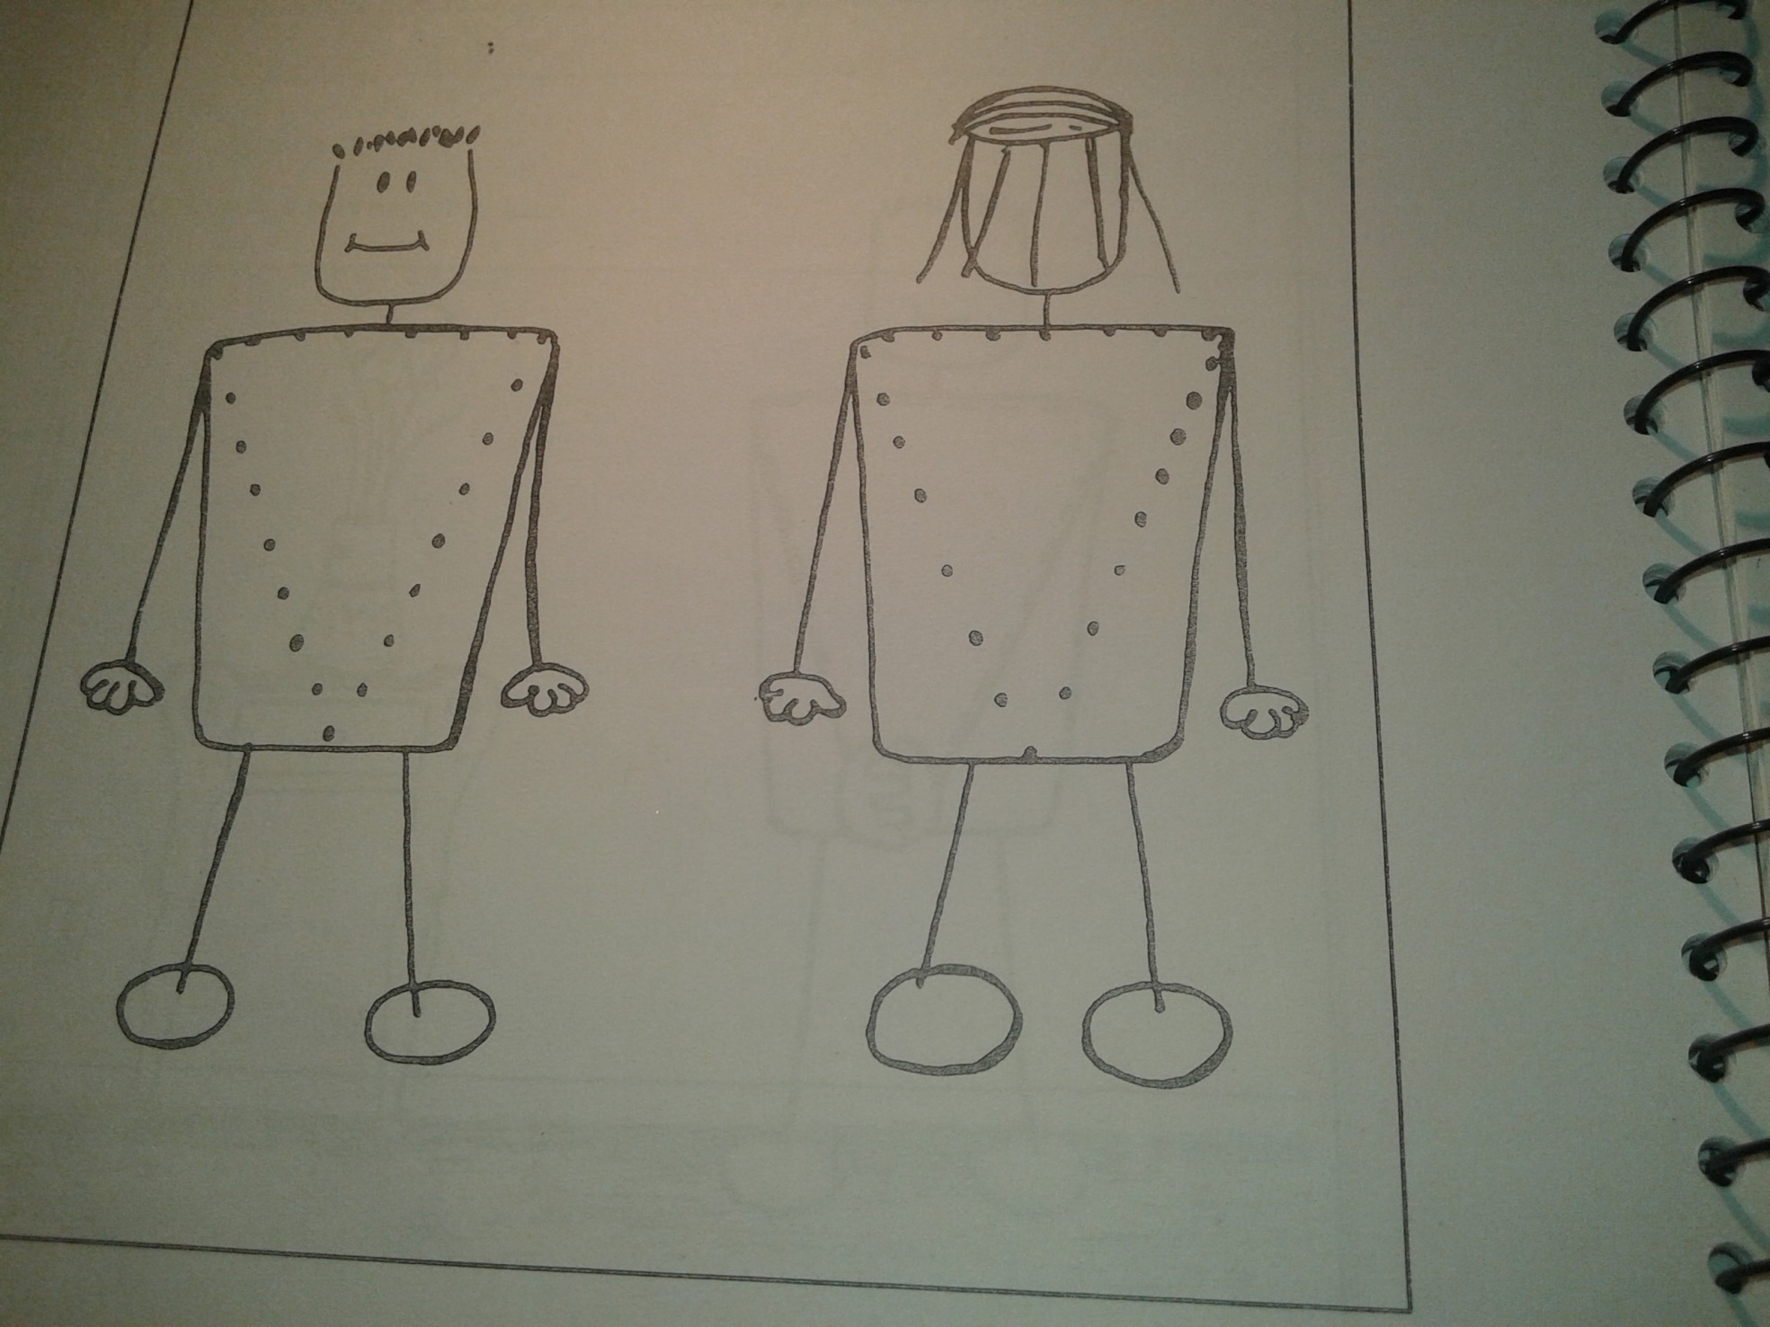
Picture 1

Slide 120
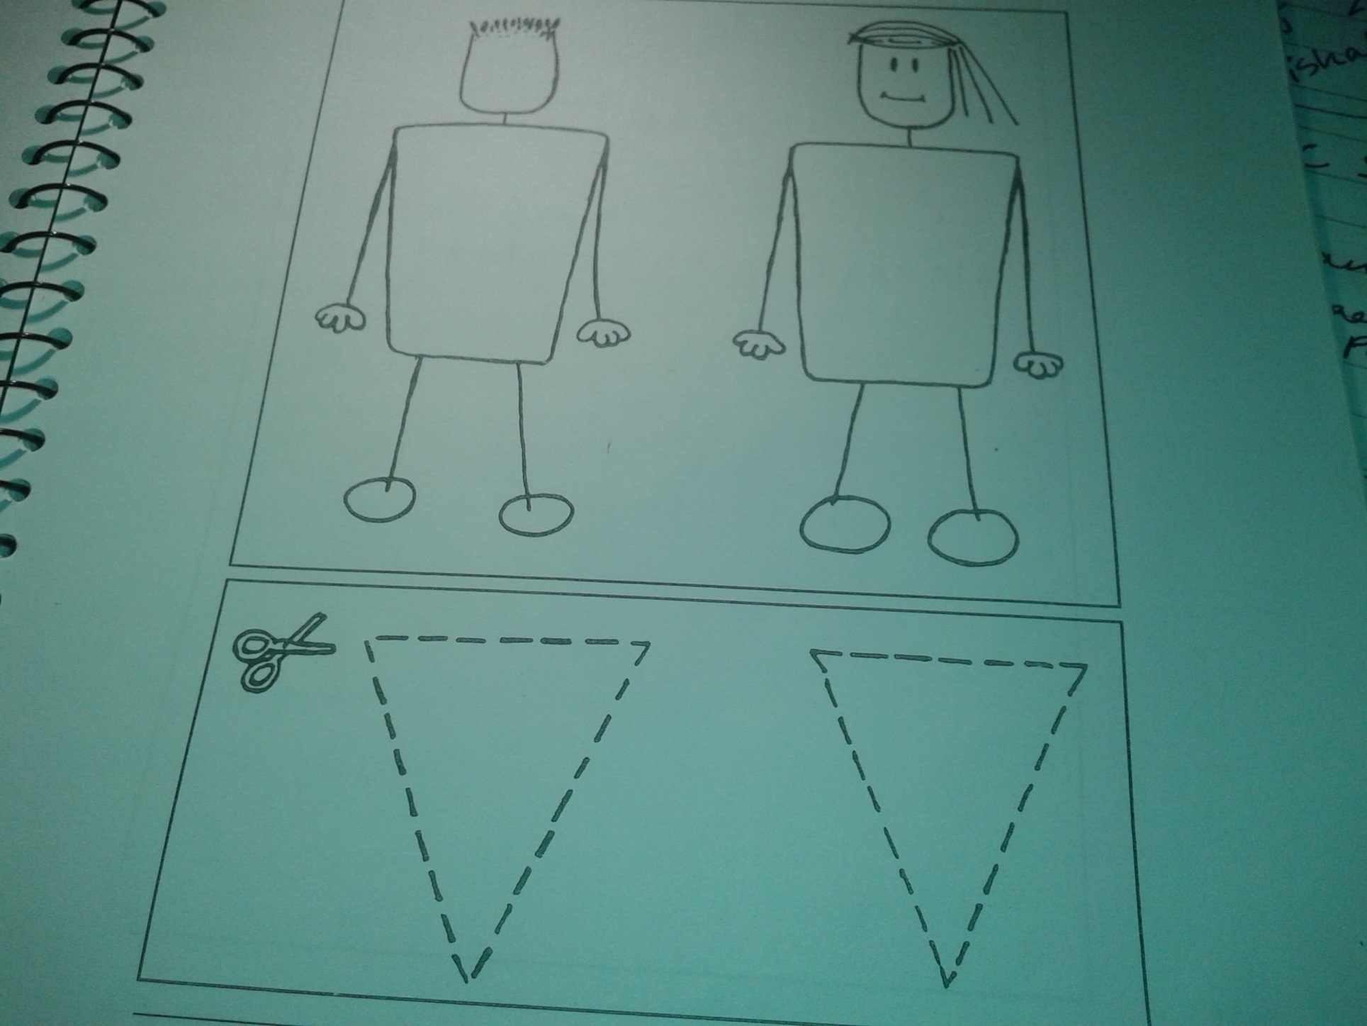
Picture 2

Slide 121
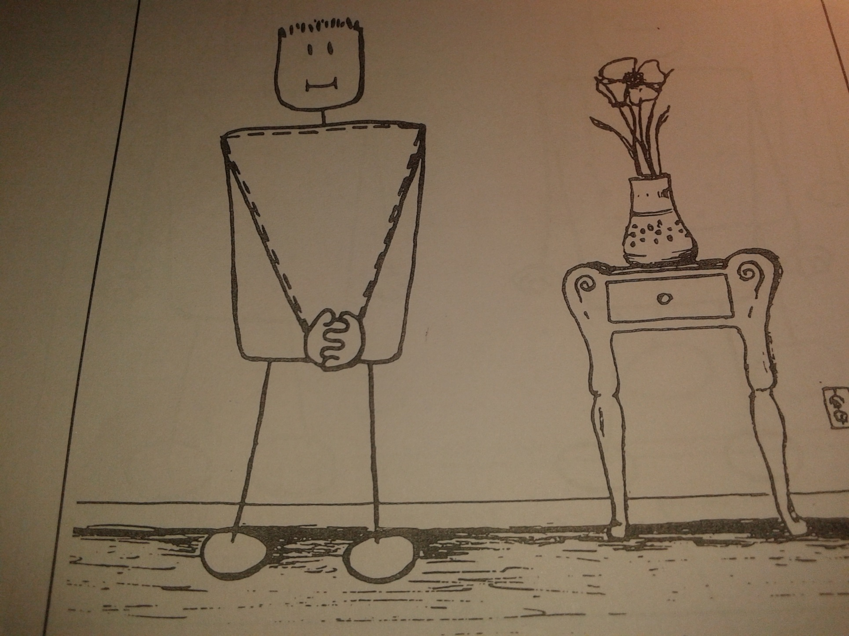
Picture 3

Slide 122
Discussion
Re-iterate and check the child’s understanding on boundaries and personal space.
Re-iterate the discussion under process 1—why people should not touch the child within the private triangle…how these are private parts that can only be touched by someone like his mother during bathing or dressing.
Discuss safety rules with the child. See ‘Suggested Safety Rules’ and ask the child to think of others.

Slide 123
Feedback & Summary
Tell us what you learnt…
Something new…
Something you might do differently…

