Slide 1
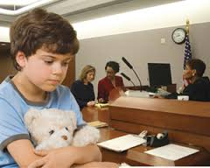
The Child As A Witness:
Developmental & Mental Health Implications for Evidence Gathering Under POCSO
Training Workshop for Special Court Judges
National Judicial Academy,
September 2018
Community Child & Adolescent Mental Health Service Project
Dept. of Child & Adolescent Psychiatry, NIMHANS
Supported by Dept. of Women & Child Development, Govt. of Karnataka

Slide 2
Objectives
Sensitization to children, childhood and experiences of abuse.
Understanding child sexual abuse basics.
Applying a child development lens to statement recording & evidence gathering.
Developing methods and skills to record statements/ gather evidence from children in the context of sexual abuse.

Slide 3
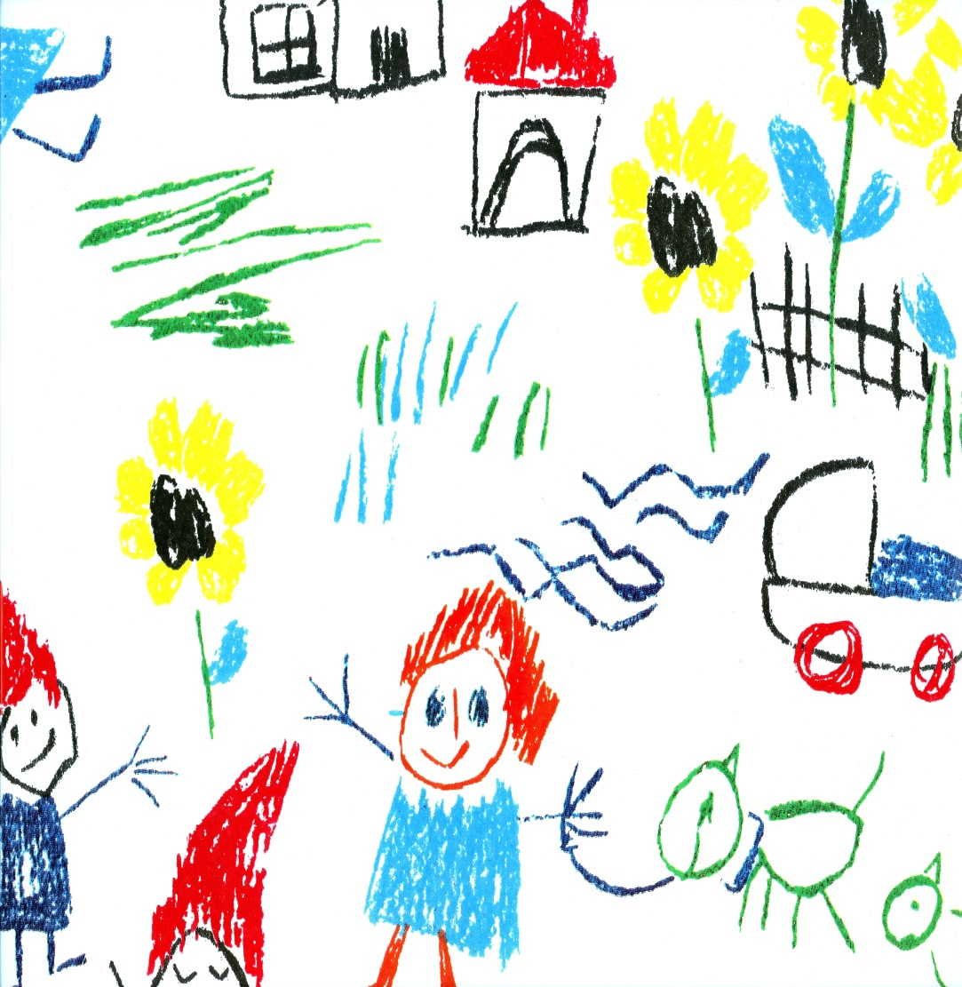
I. Children & Childhood

Slide 4
Re-Connecting with Your Childhood
Activity:
Close your eyes and remember your childhood days. Re-visit people, places, events that occurred then.
Visualize or re-visit memories of:
  i) childhood experiences
  ii) difficult or traumatic childhood experiences
  iii) childhood experiences of injustice (when someone was unfair to you…)
Share your childhood memories …

Slide 5
Discussion:
How did you feel when you re-visited happy memories versus difficult and traumatic ones?
Who helped/ how did you cope?
The importance of being in touch with your own childhoods so you know what it is like to be a child, what makes children happy, angry or sad.
How this sensitivity is essential to working effectively with children.
The importance of being aware of one’s own feelings and emotions- so that one may also understand another’s feelings and emotions better.
The impact of memories—how childhood events still impact us in adult life.

Slide 6

II. Child Sexual Abuse Basics

Slide 7
What is CSA?
an interaction between a child and an adult where the child Is used for sexual stimulation.
exploration of sexuality between a minor, traditionally understood as below 18 years of age, could be exploitative if the age difference between them is more than 5 years.
not restricted to rape/penetrative genital contact.
digital handling of the child’s genitalia.
non-genital forms of sexual touching.
non-contact forms of abuse for the pleasure of the perpetrator such as exposing the child to pornography or taking nude pictures of the child.

Slide 8
Perpetrators of CSA
Agree or disagree?
Perpetrators are those who…
Suffered physical/ sexual abuse themselves as children.
Are from lower socio-economic strata, or from difficult or deprived family circumstances.
Poor educational level/ not professionals.
‘Dirty old men’
Always men (never women).
Strangers.
Mentally ill people.

Slide 9
Where CSA Occurs
Agree or Disagree?
CSA is more likely to occur in places where risk of detection is low.
abuse happens most in lonely, isolated places that are unfamiliar to the child, or where there are no people nearby.
Ensuring children are always attended will protect them (so CCTV cameras are the way to go!).
actual abuse incident can occur quickly (commonly 5 to 15 minutes), and thus CSA can occur anywhere.
It can occur within the home (especially if the perpetrator is a family member).
It can occur in places the child regularly visits or performs routine activities, such as schools, tutorials, playgrounds and other public spaces.
*Where does it occur most? By whom?

Slide 10
CSA Processes in Younger Children
Abuse Process | Impact
Child rewarded for sexual behavior inappropriate to developmental level— ‘I will give you chocolate/ toy if you…’ Offender exchanges attention and affection for sex. Creating excitement & secrecy around the act--‘This is our special secret…no one should know about it.’ Threatening child/ creating fear in the child—’If you don’t do as I tell you/ and if you tell anyone about it…I will kill you/ I will harm your parents.’ | Confusion of sex with love and care getting/care giving Confusion about sexual identity Confusion about sexual norms Fear and compliance

Slide 11
CSA Processes in Older Children & Adolescents
Abuse Process | Impact
Offender transmits misconceptions about sexual behavior and sexual morality Conditioning of sexual activity with negative emotions & memories Pressure on child for secrecy from the offender - Offender blames, degenerates victim - Child infers attitude of shame about activities - Victim is stereotyped as “damaged goods” | Confusion of sex with love and care getting/care giving - Negative associations to sexual activities and arousal sensations - Aversion to sexual intimacy Fear and compliance - Guilt, shame - Lowered self esteem - Sense of differentness from others

Slide 12
Other Immediate Impacts
Betrayal
  Trust and vulnerability manipulated
  Violation of expectation that others will provide care and protection
  Lack of support and protection from parents
Powerlessness
  Body territory, invaded against child’s wishes
  Vulnerability to invasion continues over time
  Child feels unable to protect self and halt abuse
  Child is unable to make others believe

Slide 13
Longer-Term Impacts
Sexual preoccupations and compulsive sexual behaviors
Sexual dysfunctions; flashbacks, difficulty in arousal and orgasm
Avoidance of or phobic reactions to sexual intimacy
Discomfort in intimate relationships
Marital problems
Vulnerability to further abuse
Aggressivity

Slide 14
Emotional & Behavioural Consequences of CSA
In Younger Children…
Sexualized behaviour
Avoidance of specific adults
Nightmares/ Sleep disturbance
Clingy behaviour/ separation anxiety
Fearfulness and anxiety
Bedwetting
School refusal
Decreased scholastic performance
Medically unexplained body aches and pains

Slide 15
In Older Children/ Adolescents…
Self-harm
Depression/ isolation
Anger
Fearfulness and anxiety
Sleep disturbance/ nightmares/ flashbacks
Avoidance of specific adults
School refusal
Decreased scholastic performance
Medically unexplained body aches and pains/ fainting attacks
High risk behaviours—sexual behaviour/ substance abuse/ runaway

Slide 16
Physical Signs/ Symptoms of CSA
Pregnancy (in adolescents)
Genital injuries
Urinary infections

Slide 17
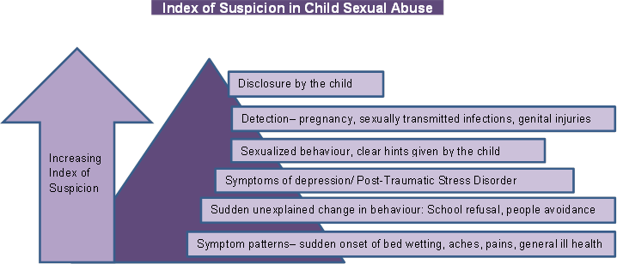

Slide 18

III. Applying the Child Development Lens

Slide 19
Identifying Child Developmental Needs & How They are Impacted by Trauma
Activity 1:
Objectives:
To identify children’s physical, social, speech & language, emotional and cognitive needs.
To understand how these developmental needs are impacted by trauma.
Implications for recording statements/ evidence gathering from children.

Slide 20
Key Areas for Child Development
Physical
Emotional
Cognitive
Social
Language

Slide 21
Process (a):
Divide into 5 sub-groups.
Round 1: Sort cards into 5 domains of development. (Each group picks up cards relevant to their domain).
Round 2: Within each domain, sort cards for abilities & skills to match needs and opportunities. (Within each group, after initial round of sorting, further categorize and match the cards).
View the categorization in plenary…discuss.
Generate ideas/ activities to further child development in each domain—physical, social, speech and language, emotional & cognitive areas. What types of activities can we do/ do you do? Let us develop a list…

Slide 22
Physical Development (1)
Abilities & Skills Needs & Opportunities
Age 0-1
Age 1-5
Age 6-12
Age 13 to 18
Speech-Language Development (2)
Abilities & Skills Needs & Opportunities
Age 0-1
Age 1-5
Age 6-12
Age 13 to 18

Slide 23
Social Development (3)
Abilities & Skills Needs & Opportunities
Age 0-1
Age 1-5
Age 6-12
Age 13 to 18
Cognitive Development (4)
Abilities & Skills Needs & Opportunities
Age 0-1
Age 1-5
Age 6-12
Age 13 to 18
Emotional Development (5)
Abilities & Skills Needs & Opportunities
Age 0-1
Age 1-5
Age 6-12
Age 13 to 18

Slide 24
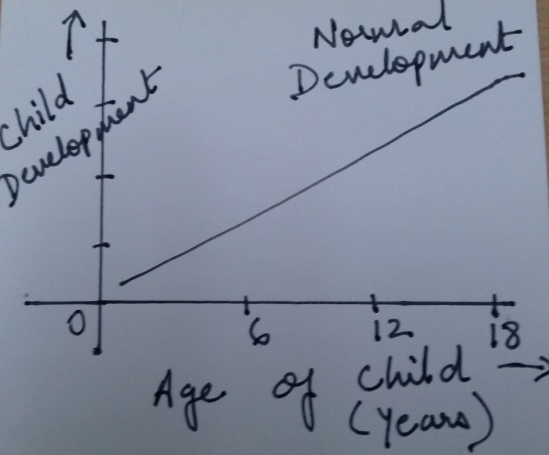
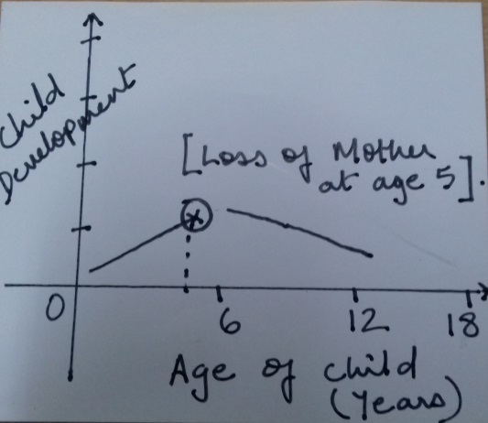
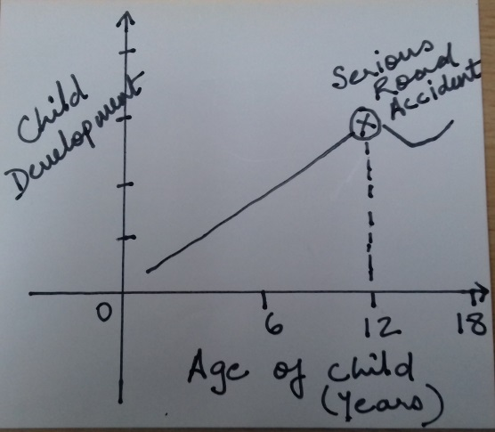
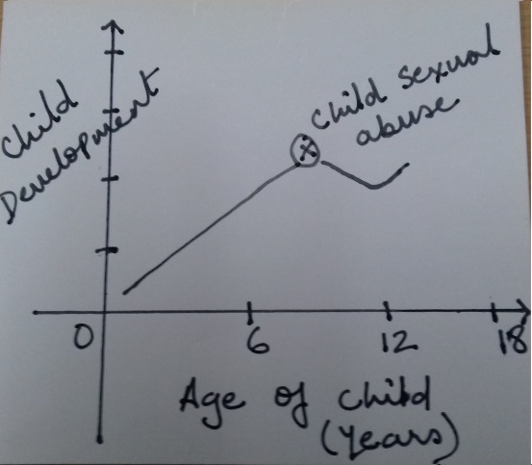
Impact of Traumatic Events on Child Development

Slide 25
Applying Child Development to Child’s Statement of Abuse-POCSO Processes
Speech & Language Abilities
10-14 months: 3 meaningful words
1.5 to 2.5 years: 2 to 3 word phrases
Age 3+: increased vocabulary/ short sentences
*Many (normal) children start developing speech late…so at 3+ they may or may not have capacity to build sentences.

Slide 26
Social Development:
10 months to 3 years: stranger anxiety (not likely to be comfortable talking to new people).
3 years: concept of privacy/ shame relating to body present (less likely to talk about body parts)
Cognitive Development:
1 to 2 years: expression & communication mostly through actions (due to speech & language abilities still developing).
3 years: Object permanence (child thinks that perpetrator can re-appear, so leads to anxiety)
3 years: Ego-centricity (expect others to understand their behaviours… ‘if I fall down, why isn’t everyone crying?’ Similarly with abuse…)
No understanding of the concept of violation…so hard to report.

Slide 27
Developmental Stages & Children's Ability To Disclose Abuse
Age | Ability to Provide Abuse Narratives | Emotional-Behavioural Symptoms Indicative of Abuse
Infancy (0-18 months) | Unable to make any disclosures of physical or sexual abuse. Cases can only be substantiated if: There is an eye witness; Perpetrator confesses; Infants are found to have an STD, sperm or semen on their examination. | Fearful of the offender, fussier than normal reluctant to have diaper changed Occasionally imitate sexual acts.
Toddlers (18-36 months) | Due their limited communication skills, toddlers are unlikely to report the abuse. Simple phrases may be the only clue that something has happened, such as, "Owie, pee-pee, Daddy" while pointing to their genital area. Toddlers cannot sequence time and place very well and will probably not be able to tell you how often something has happened, when it happened, or even where it happened. Only some children of this age group know their body parts or understand right from wrong. To substantiate the abuse, a witness, a confession, an STD, or sperm/semen are usually required. | Frequently show fear and anxiety around the perpetrator. May mimic the sexual acts with their own bodies, other children, or dolls. Regressive behaviors observable. difficulty toilet training, sleep disturbances angry outbursts and clinginess to caregivers.

Slide 28
Age | Ability to Provide Abuse Narratives | Emotional-Behavioural Symptoms Indicative of Abuse
Preschool (3-5 year olds) | During an interview, they become easily distracted, and revert to physical activity, or phrases such as "I don't know" or "I can't remember". Tend to tell small excerpts of their abuse with minimal detail, disorganized thought processes, and give relevant and irrelevant details. Time and space relationships are poorly defined, however they can relate things to before and after such as birthdays holidays, dinner, bedtime, etc. They can on occasion be specific and give enough detail to be good witnesses in court. Demonstration is a better tool than verbalization for many children this age. They may confuse he-she-me and sex specific body parts. Although substantiation may still rely on finding acute injuries, sperm or semen, or an STD, their history becomes increasingly important. Ask short and specific questions, but do not put words in their mouths. Asking them to draw or demonstrate what happened might be easier for them than verbal communication. Make the child feel at ease and safe—they may be fearful of what will happen to them if they tell. | May exhibit sexualized play, somatic complaints (headaches, abdominal pain, painful urination, genital discomfort, etc) May also have nightmares, regressed behavior, anger, aggression, withdrawal, mood lability and other psychosocial problems.

Slide 29
Age | Ability to Provide Abuse Narratives | Emotional-Behavioural Symptoms Indicative of Abuse
Elementary school aged children (6-9 years old) | Children of this age are reluctant and tentative in their disclosures and will withdraw if they perceive non-reassuring reactions from the interviewer. Role play may be an appropriate tool, as well as drawing and the use of dolls and doll houses. Building rapport is essential before the interview begins because they are frequently embarrassed and uncomfortable discussing the inappropriate touching. One way to ease their discomfort is to engage them in a simultaneous activity like drawing, colouring, or working a simple puzzle. | Feel conflicted and confused, guilt ridden, embarrassed and may be fearful Behavioral symptoms may include withdrawal, depression, emotional lability, nightmares, poor school performance, aggression, lying, stealing, and other antisocial behaviors. Physical symptoms may include enuresis, encopresis, dysuria, headaches, abdominal pain, genital pain, and tics.

Slide 30
Age | Ability to Provide Abuse Narratives | Emotional-Behavioural Symptoms Indicative of Abuse
Puberty (9-13 year olds) | Usually more at ease with an interviewer of the same sex. A more formal approach to the interview frequently minimizes the pre-adolescents discomfort with the discussion. Keep your questions brief and clinically oriented, yet let them know that their feelings and opinions are also important to the investigation. Reassure them that they are not at fault for what has happened. | Shame, guilt—feelings that the abuse was their fault. They not only feel uncomfortable about the sexual molestation, but are feeling awkward and self-conscious about their bodies and discussions regarding sexual issues.

Slide 31
Age | Ability to Provide Abuse Narratives | Emotional-Behavioural Symptoms Indicative of Abuse
Adolescents (13 to 18 year olds) | To maximize the outcome of the interview, an open, direct approach is usually the best. Be serious about their concerns and supportive of their needs. Never criticize of judge their acts. By being honest with them, they will be more likely to be cooperative with you. | Behavioral problems may include defiant, aggressive acts, truancy or school failure, criminal behavior, suicidal ideation or attempts, promiscuity, substance abuse, self-mutilation and runaway behavior. They may present to the medical clinic with chronic aches and pains, vague complaints, and hysteria.

Slide 32
Recommendations for POCSO/Statement from Child
At a minimum, a child has to be about 3.5 years of age, to even attempt taking a statement.
Even then, some children will have language delays and be unable to report.
Children with intellectual disability will need to be assessed (even those above 3 years) to understand what their abilities and deficits are…and if they can report.
Narration is a function not only of speech & language abilities but also of social and cognitive skills of the child…a child development/ mental health professional should be requested to assist… to use play and other creative methods to elicit narratives from young children and/or children with intellectual disability.

Slide 33
Understanding the Child’s Inner Voice
Inner voice…refers to the child’s internalization of the experience
How a child perceives the abuse incident and all the events that followed
May consist of various fears and anxieties + interpretation of events (based on child’s age & developmental level)
…which then leads the child to behave in certain ways (to be silent/ withdrawn/refuse to disclose further/agree to disclose further/ retract original statement…)
We need to therefore understand the child’s thoughts & perceptions, then address some of them (reassure child) before proceeding to take the statement.

Slide 34
What is the child’s inner voice…
Saira, aged 4…was sexually abused by a teacher in her school. She has been having urinary tract infections and fever. She clings to her mother and does not want to go to school or play with other children; she has nightmares and sleeps poorly.
Nikhil, aged 10 years is an orphan child residing in a child care institution. He came to a hospital for treatment for behaviour problems, during the course of which he reported sexual abuse by one of the institution staff (other staff deny that this happened in their institution, saying child is lying).

Slide 35
The Child’s Inner Voice
Be the child…
What is the child thinking?
What are his/her fears and anxieties? (Regarding the abuse incidents? Regarding the court/ statement to be given?)
Let us list these thoughts and confusions…

Slide 36
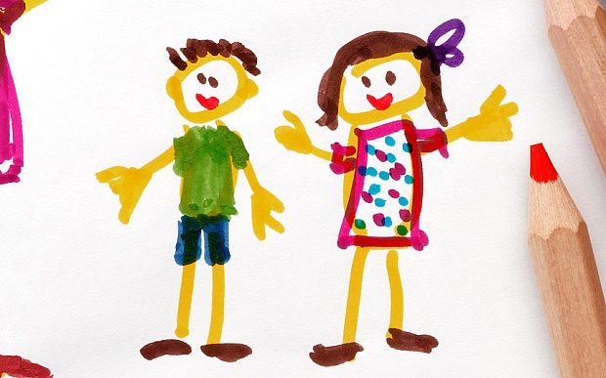
III. Communication with Children: How to Elicit the Statement about Abuse

Slide 37
Forensic Interviewing
A forensic interview is a non-leading, victim sensitive, neutral, and developmentally appropriate investigative interview that helps law enforcement determine whether a crime occurred and what happened.

Slide 38
Preliminary Steps: What Mental Health Professionals should Assist the Court with…
Before Forensic Interviewing with Child for CSA…
1. Psychosocial & Mental Health Assessment
1.1. Demographic Details:
Referral
Initial Account of Abuse Incident(s)
Medical Examination and Tests/ Reports
Mandatory Reporting Query
CSA-Associated Psychiatric Morbidity
  Child Depression Rating Scale (CDRS)
  Screen for Child Anxiety Related Disorders (SCARED)
  Children’s Impact of Traumatic Events Scale (CITES)
Academic and School History
Family History
Mental Status Examination

Slide 39
2. Developmental Assessment
(Age-appropriate?) abilities & skills in locomotor/physical, speech & language, social, emotional and cognitive developmental domains
Implications:
  Forensic interviewing (need for special assistance/ aids)
  Intervention

Slide 40
Interviewing Children for CSA
1. Rapport Building with a Young Child
Greet the child and tell him/her your name and then, ask the child his/her name.
Sit at the same physical level as child (if child is on the floor, sit on the floor…if child is sitting on a chair, sit on the chair next to her).
Use toys and play activities (dolls, puzzles, picture books, colouring books…) to engage young children & give it to the child as soon as (s)he comes to the court (while waiting for you).
Enter into play with child and spend 5 to 10 minutes engaging child in play activity… ‘what are you doing? What is the doll doing? May I see what you are colouring?’
Engage in neutral conversation with child for a few minutes (this also helps to assess the child’s developmental abilities and skills as well as mental state)--What did you eat for breakfast today? How did you come here today? Who are these people who have come with you?...’

Slide 41
For older children and adolescents, you may say ‘I really want to know you better. Tell me about the things you like to do.’
Introduce the space and the purpose of the child being there, including your role:
“My name is…my job here is to make sure that children are safe and no one hurts them. If we hear that someone is hurting or troubling children, then we do things to stop that from happening”.
‘You may be wondering about this busy place and many rooms…many people come here, just like you to talk about people who have hurt or troubled them…that’s why we need a big space like this and many people to help.’
‘Although this place may seem a little scary and confusing, you are safe here…and after we have spent a little time talking, you can go back home with your parents or caregiver’.
Explain the need for video camera/ microphone (in case you are using such equipment)—‘As you can see, we have a video-camera and microphones here. They will record our conversation so I can remember everything you tell me. Sometimes I forget things and the recorder allows me to listen to you without having to write everything down.’ (In case you are taking notes, you may provide a similar explanation to the child).

Slide 42
2. Ensuring Accurate Reporting
Establishing children’s ability to differentiate between truth & lies:
Part of my job is to talk to children[teenagers]about things that have happened to them. I meet with lots of children [teenagers] so that they can tell me the truth about things that have happened to them. So, before we begin, I want to make sure that you understand how important it is to tell the truth.
For younger children, explain: ‘What is true and what is not true’]. ‘If I say that my shoes are red (or green) is that true or not true?’ [Wait for an answer, then say:] ‘That would not be true, because my shoes are really [black/ blue/etc.].And if I say that I am sitting down now, would that be true or not true [right or not right]?’ [Wait for an answer.] It would be [true/right], because you can see I am really sitting down.’ ‘I see that you understand what telling the truth means. It is very important that you only tell me the truth today. You should only tell me about things that really happened to you.’ [Pause.]
‘If I ask a question that you don’t understand, just say, “I don’t understand.” Okay?’ [Pause] ‘If I don’t understand what you say, I’ll ask you to explain. ‘What would you say if I made a mistake and called you a 2-year-old girl [when interviewing a 5-year-old boy, etc.]?’ [Wait for an answer.] ‘That’s right. Now you know you should tell me if I make a mistake or say something that is not right.

Slide 43
3. Training in Episodic Memory
To practice providing detailed, descriptive narratives later in the interview…
‘It is very important that you tell me everything you remember about things that have happened to you. You can tell me both good things and bad things.’
Identify a recent event the child experienced- first day of school, birthday party, holiday) and build up upon that using qualifiers like ‘tell me, what happened next, ‘Think hard about [activity or event] and tell me what happened on that day from the time you got up that morning until [some portion of the event mentioned by the child in response to the previous question]. ‘Tell me more about [activity mentioned by the child].’ [Wait for an answer.] Use this prompt as often as needed throughout this section.]
‘Earlier you mentioned [activity mentioned by the child]. Tell me everything about that.’

Slide 44
4. Taking the Statement
(a) How to enquire about the abuse
Enable the child to provide you with the narrative by asking open questions such as:
-“Now that I know a little about you, I want to talk about why [you are here] today.’
-“I heard you talked to ‘X’ about something that happened – tell me what happened.”
-“I heard you saw [the doctor, a policeman, etc.] last week – tell me how come/what you talked about.”
-“Is [your mom, another person] worried about something that happened to you? Tell me what she is worried about.”
-“I understand someone might have troubled you – tell me what happened,” -“I understand someone may have done something that wasn’t right – tell me what happened.”
-“I understand something may have happened at [location] – tell me what happened.”]
b) Use gentle probes where necessary.

Slide 45
Techniques of Inquiry
i) Non-leading Techniques of Inquiry:
Questioning should proceed from general to more detailed.
Talk about "things that happen" in the child's life — things that happen at home, in school, or in another setting.

Slide 46
- Do you know why you're here today? What was explained to you about why you are here today?
- Is there something that you want to tell me?
- Is there something that you wish to tell me? (or need to tell me?)
- Are there any worries you have about home or school…?

Slide 47
ii) Minimally Leading Techniques
- I understand that you have had some trouble sleeping recently. Could you tell me if anything has happened that would make you to have trouble sleeping?
- Has anyone done things to harm you or upset you?
- I understand there have been some problems in your family. Can you tell me about them?

Slide 48
iii) Moderately Leading Techniques:
These questions further narrow the range of possible responses a child might make.

Slide 49
- Did anything happen to you when you went to visit (person)?
- How did you get along with (person) when she went to see him?
- What do you and (person) do when you go to visit?
- I understand that some things have happened between you and [the abuser]. Tell me about those things.
- Is there anything that has happened to you recently that has made you really upset?
- Can you tell me what happened between you and [the abuser]?
- I'd like you to tell me about the things you like about [the abuser]and the things you don't like about [the abuser].
- I need to know how your pee-pee got hurt. Can you tell me how that happened?

Slide 50
iv) Maximally Leading Techniques:
These include questions which tell the child what the investigator wants to discuss.
In maximally leading questioning, the interviewer does not follow the lead of the child's responses, but introduces content to the child, often communicating the interviewer's desired response.

Slide 51
- Did he [the abuser] touch your pee-pee with his finger?
- Did he [the abuser] take off his clothes when he laid down on top of you?
- He [the abuser] put his finger in your pee-pee, didn't he?
- Did [the abuser] he touch you under your clothes or over your clothes?
- These are close-ended questions, which also assume that abuser has engaged in certain behaviors with the child (thereby leaving out others).

Slide 52
Recommended Way of Questioning
Non- Leading Questions
Minimally Leading Questions
Moderately Leading Questions
Maximally Leading Questions
(Only for confirmatory details)

Slide 53


c) Use pictures to assist the child
“I will show you a picture…perhaps you can point to where this person touched or hurt you…”
(Or child could use a doll to point)

Slide 54
4. Close the interview with child
- You’ve given me lots of information and that really helps me to understand what happened.’
‘You have told me lots of things today, and I want to thank you for helping me.’
‘Is there anything else you think I should know?’
‘Is there anything else you want to tell me?’
‘Are there any questions you want to ask me?’

Slide 55
Activity: Role Playing Interviews with Children
Let us role play an interaction with a child…how would we elicit the statement required under POCSO?
*Use the steps outlined above.

Slide 56
Activity: Demonstration of Magistrate/Judge’s Statement Recording
View the video clip…
Which steps outlined in statement recording were observable?

Slide 57
A Note on Children’s Memory
Developmentally immature children too have memories but have difficulty in retrieving them.
A technique of scaffolding is used in which a series of detail-oriented questions are asked e.g. −“Did you do anything when you were at that house?” “What did you do?” “Was someone there when you did [what the child reported]?”
The interviewer thus offers “cues” or “cognitive supports” that allow the child to access his or her memory.

Slide 58
A Note on Children’s Attention
Quality of information provided by young children begins to decrease with increased attempts to refocus.
Once a three-year old has lost interest and has been refocused to the interview process several times, she or he may begin to answer questions randomly, without thought or consideration of the questions posed.

Slide 59
Age & Type of Information to Collect

Slide 60
Things to Remember
NEVER…
Hurry children to talk.
Get directly into questions about the abuse incidents (no matter how pressured you are or little time you have!) without building some rapport with the child.
Persuade child to provide information through insistence/ use of sweets, toys, chocolate. Such actions may associate you with the perpetrator of abuse and confuse and frighten the child.
Persuade children with statements beginning ‘you are a good girl, right…so now tell me…’ Avoid using words such as ‘good’ and ‘bad’—these are moral terms and when children feel judged, they are unlikely to want to engage with you.
Ask children to enact what happened.
Probe for details of how the child felt at time of abuse as unnecessary detailing will re-traumatize child.
Touch the child unnecessarily.

Slide 61
ALWAYS…
Be cognizant of the age of the child. Adolescents do not like being treated like 6 year olds!
Use simple, non-legal terms/ language.
Be aware of the child’s inner voice (thoughts, anxieties and confusions).
Make the necessary and reasonable exceptions to statement recording with regard to certain types of children, based on developmental disability and emotional states.
Ask for specialized assistance from child mental health professionals.
Keep your magic bag ready and use it!
Speak slowly and clearly so children understand you.
Ask only one question at a time; wait for the child’s response before asking the next question.
Try to find alternative ways of phrasing a question if not understood the first time i.e. avoid repeating a question if it is not answered.
Think of the statement recording process as a child’s story (of abuse and trauma) and how you are there to listen and understand it. This will create a more natural flow of conversation, making it easier to elicit the child’s statement.

Slide 62
Last Thoughts…
Role of the judge?
What types of questions (esp. from defense lawyer) can judge disallow to the child?
Language of judge?
Attitude towards sexuality and discussions on sexual matters…judge’s comfort vs hesitancy?
Can judge/ PP give advice to adolescents on how to deal with the relationship with the accused? (why/ why not?)
Judge’s position on psychosocial and mental health interventions for child/ adolescent?
Court’s liaison with child welfare committees? (esp. in case of vulnerable children/ from difficult circumstances)

