Slide 1
Community-Based Approaches to Child Protection: Engaging Children and Service Providers
November 2018
Sheila Ramaswamy
Project Coordinator
Community Child & Adolescent Mental Health Service Project
Dept. of Child & Adolescent Psychiatry NIMHANS, Bangalore
Supported by Dept. of Women & Child Development, Government of Karnataka

Slide 2
Why NIMHANS initiated Community Child Mental Health
Limited access to mental health services esp. for children low socio-economic families and communities.
Children in difficult circumstances are especially vulnerable to mental health morbidity and have poor access to services.
Poor community awareness on child mental health needs and services.
Few child mental health care services/ service providers.
Mental health services concentrated in tertiary care facilities.
Gaps in mental health knowledge and skills of child care service providers.
The need to integrate child mental health services into child care services in health/education/welfare sectors to enhance access and coverage.
Preventive/promotive child mental health services required for minimizing child mental health morbidity.
Curative child mental health services—children’s right to assistance.

Slide 3
Objectives
Establishment of community-based child and adolescent services for mental health & protection.
Training and capacity building of childcare workers and staff from various governmental and non-governmental agencies, including schools.
Develop a comprehensive community child and adolescent mental health service model that may be replicated elsewhere in the country.

Slide 4
Principles & Technical Approach
Universal access to child (mental) healthcare
Equitable coverage (with focus on vulnerable children and adolescents)
Community involvement and participation to ensure sustainability
Adoption of multi-sectional approach through involvement of various sectors such as health, education, women and child welfare.

Slide 5
Direct Services for Children
Primary Healthcare Centres
Health
Rashtriya Bal Swasthya Karyakram
Individual Interventions:
Screening
(Early) Identification of Developmental Disabilities
Assessment for Emotional/ Behavioural/ Learning Issues
First Level Responses (to Child & Caregivers)
Referral to Tertiary Care Facilities (Curative Care)
Group Interventions:
Early Stimulation
Remedial Education
Life Skills for Socio-Emotional Development/ Child Sexual Abuse Prevention & Personal Safety
Specialized Centres for Children with
Chronic Illness
Government Schools
Education
Special Schools
Anganwadis
Welfare
Child Care Institutions
Care & Protection
Children in Conflict with Law
Children with Chronic Illness
Children with Disability

Slide 6
A Framework for Understanding Violence Against Children

Slide 7
Training & Capacity Building
Child Care Service Staff
PHC workers/ASHA workers
Anganwadi teachers
School teachers/authorities
Child care institution staff/ counselors
Government Systems for Child Protection
CWC members
JJB members
Legal-probation counselors
Police
Secondary & Tertiary Mental Health Care Facilities
District Mental Health Teams
Identification & training of mental health personnel in Government Medical Colleges/ Institutes that have Dept. of Psychiatry
Judicial Personnel
JJB Magistrates
Special Court Judges

Slide 8
Materials for Programmatic Use
Assessment
Checklists for primary care providers (for identification of abuse/ neglect)
Psychosocial assessment proformas for use with institutionalized children
Guidelines for Identification of Physical & Sexual Abuse in Child Care Institutions
PAT tool (qualitative assessment on violence, for use with children—a tool developed for UNICEF)

Slide 9
UNICEF
Participatory Assessment Tool
(Dr Shekhar Seshadri, NIMHANS)
Violence research requires highly sensitive methodologies
informed not only by social science research methodology,
but more importantly by psychological pedagogy
Story telling as a participative methodology in focus group discussions,
combining qualitative interviewing methods
with quantitative data recording and coding techniques
Effectively addresses ethical concerns that arise in violence research.

Slide 10
The introduction
Our methodology consisted of an introduction to the theme of the study
followed by stories which were told and then changed and retold
with the participation of the children, followed by a set of questions
on their experiences similar to that told in the story
The story
After an introduction, a story provides an easy channel of progression
to the next stage of the research,the question session
Story 1: Radha is a little girl living with her parents and grandparents.
One day Radha’s parents adopt a little pup and she named it Cheecku.
But Radha’s mother warns her not to put the pup on the bed.
But the next morning when she finds Radha sleeping with the pup,
she complains to Radha’s father who gave her punishment
and made her stand in a corner for half an hour.

Slide 11
Fleshing out/ reconstructing stories
For example, questions like –
‘What do you think, does Radha go to school?,
Where do you think Radha lives?,
Is Cheecku a stray pup or a breed dog?’ etc
were used to trigger off their imagination.
This process can later be enumerated by field staff,
with children reacting positively and enthusiastically to such activities.

Slide 12
Emotional violence -commonly used punishment , Denial of privileges ,
verbal admonishments , denial of basic essentials
Physical violence -corporal punishment , restriction of movement ,
torturous punishment/abuse
---------------------
…enabling prevalence data on problematic actors
rather than on problematic settings
Parents/caregivers/guardians;
Relatives;
Other adults such as teachers, employers, police, NGO workers, social workers,
unknown adults on the street, etc;
Siblings;
Other children from peer groups;

Slide 13
There are many elements of the experience of violence that can be researched.
Traditional research often focuses on prevalence
(the extent to which children are abused)
and severity (the extent of ‘damage’ caused)
or the context (the location-home, school, neighbourhood, institution;
and the relationship of the child with the perpetrator)
and nature of violence (psychological/emotional, physical, sexual).
This kind of data is important as it informs public opinion ,
policy and systemic responses.
However, what is missed is the subjective experience of the child.
From a healing point of view, how a child processes
and resolves experiences of violence are critical dimensions.
Such processes are best researched by qualitative methods.
It is moot if there is ‘consensus’ between the intention of the perpetrator
and intention as perceived by the child.
Within the power structure of families and its fragmentation
in difficult circumstances like street living, how children come to expect violence and thus resolve it in a resilient fashion is a complex process.
Such complexities of perception are best captured by research methods
that take a process approach like the story method.

Slide 14
(2) Direct Interventions for Children:
Adolescents | Life Skills Series for Adolescents (1): Socio-Emotional Development Life Skills Series for Adolescents (2): Gender, Sexuality and Relationships
Children aged 7 to 12 years | Life Skills for Children aged 8 to 12 years: Socio-Emotional Development Child Sexual Abuse Prevention & Personal Safety (Activity-Based Awareness & Learning for Children aged 7 to 12 years )
Pre-schoolers | Child Sexual Abuse Prevention & Personal Safety (Activity-Based Awareness & Learning for Children aged 7 to 12 years )

Slide 15
Premises on which direct interventions with children are based on…
Not much hope for the adult world for behaviour change!
Children and adolescents are at a stage where they are developing identities (perspectives and life skills)…
If provided with the right impetus and opportunities, they are our best vehicles for violence prevention (through safety education as well as life skills for positions/ perspectives of non-violent ways of being).
Use of non-didactic, participatory, creative methods enable children to learn life skills (incl for protection).

Slide 16
LIFE SKILLS
CONTEXTS OF APPLICATION
METHODS OF LEARNING- (EXPERIENTIAL)

Slide 17
How Life Skills Teaching Works
All participants are learners;
All participate in and contribute equally to the production of knowledge, which is a continuous dialogue;
The learners are the subject and not the object of the process.

Slide 18
Experiential methodologies
Theatre
Narratives
Story-telling
Art Work

Slide 19
(3) Training Material and Manuals
Mental Health & Psychosocial Care for Children & Adolescents Training Series…
The Building Blocks
The Trauma of Loss & Abuse
Children in Conflict with the Law
Working with Pre-Schoolers
Children and HIV/AIDS
Orientation & training manuals for judicial personnel
…including videos and materials.
…use of creative participatory pedagogies.

Slide 20
Training Content…
Child Development
Child Interviewing and Communication
Abuse inquiry
Immediate/First level responses (Individual & Systemic)
Depth interventions for violence/ abuse (both in children who are victims and/or perpetrators of violence)
Special contexts and interventions: children in conflict with the law, trauma and abuse/violence…
Positive engagement with children/ use of alternative methods of disciplining and behaviour management

Slide 21
Child Protection: Prevention & Response (1)
Legal System/ Judiciary
Secondary & Tertiary Mental Health Care Facilities
Government Systems for Care & Protection
Field workers/ Frontline Service Providers
Services/Institutions Children routinely use/attend
What Adults Must Do…
- Appropriate/ safe engagement with children
- Monitor child safety
- Identify & report abuse
- Take legal action against child violence perpetrators
- Ensure affected children receive medical/psychosocial assistance for healing & recovery

Slide 22
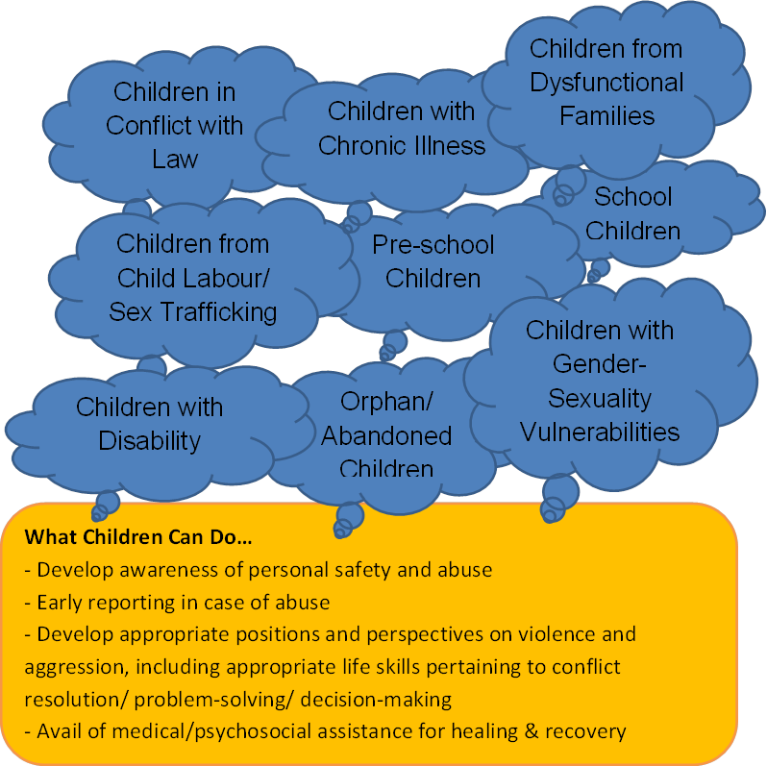
Child Protection: Prevention & Response (2)

