Slide 1
Child Sexual Abuse A Counselling Perspective Training Workshop for Childline India Foundation
14th to 16th February 2015
Dept. of Child & Adolescent Psychiatry
NIMHANS, Bangalore

Slide 2
Our Learning Objectives
Understanding the processes and effects of child sexual abuse.
Understanding the impact of sexual abuse on child development.
When to suspect/ how to identify child sexual abuse.
Developing skills in:
Counseling children who have been sexually abused.
First-level/ emergency response to CSA..
CSA prevention.
Gaining a brief understanding of systemic issues:
CSA response in schools
Legal issues & forensic interviewing in CSA

Slide 3
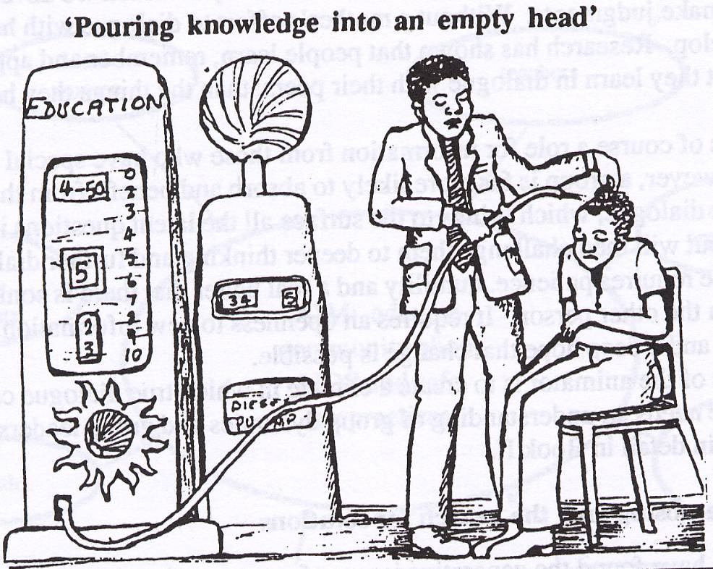
Our Learning Methods
Slides/ materials
Do-and-learn (skills)
Role Plays
Case-Studies/ Examples
Participatory Group Activities
And Discussion

Slide 4
I. Children & Childhood

Slide 5
Setting the Tone…
Re-visiting childhood.

Slide 6
Re-Connecting with Your Childhood
Activity:
Close your eyes and remember your childhood days. Re-visit people, places, events that occurred then.
Share your childhood memory with their group members. Anyone who wishes to share in the larger groups may also do so.
Repeat the process (of closing eyes and then group sharing) by re-visiting memories of:
i) happy childhood experiences
ii) difficult childhood experiences
iii) traumatic childhood experiences.

Slide 7
Discussion:
How did you feel when you re-visited happy memories versus difficult and traumatic ones?
Who helped/ how did you cope?
The importance of being in touch with your own childhoods so you know what it is like to be a child, what makes children happy, angry or sad.
How this sensitivity is essential to working effectively with children.
The importance of being aware of one’s own feelings and emotions- so that one may also understand another’s feelings and emotions better.

Slide 8
Identifying Child Developmental Needs & How They are Impacted by CSA
Activity 1:
Objectives:
To identify children’s physical, social, speech & language, emotional and cognitive needs.
To understand how these developmental needs are impacted by CSA.

Slide 9
Process 1:
Brain-storm and list the developmental needs children have according to the age group:
Age Group | Developmental Needs
 | Physical Needs | Speech & Language Needs | Social Needs | Cognitive Needs | Emotional Needs
Early Childhood (age 1 to 5 years)
Middle Childhood (age 6 to 11 years)
Adolescents (age 12 to 18 years)

Slide 10
Physical Development
Abilities/ Skills | Needs
0 to 6 years: Gross Motor Skills: mobility, ability to handle objects Fine Motor Skills: pre-writing skills, transfer functions, eye-hand coordination Physical skills necessary self- help: buttoning, brushing, feeding etc. | General growth and nutrition Physical activities/ play/ exercise Sensory experiences Fine-motor activities such as beading, colouring, buttoning…
Ages 7+: Continued physical growth Full independence in self-care. Fine motor tasks easily achieved. | General growth and nutrition Physical activities/ play/ exercise
Ages 13 to 18: Development of secondary sexual characteristics. Menstruation in girls. | Preparation for bodily changes/ education/ awareness.

Slide 11
Language Development
Abilities/ Skills | Needs
0 to 6 years: Increase fund of words. Ability to construct short sentences. Express needs. Ability to describe. | Naming and pointing games Story telling Phone games Describing games (using pictures or real life observations/events or television clips) Concept book/ flash cards
7 to 12 years: Language used for higher levels of communication—to report experiences. Ability to communicate needs and experiences. | Opportunities to describe, to be heard, to share experiences. Freedom to communicate needs.
13 to 18 years: Language used for complex social transactions, incl. life skills like refusal skills/ assertive skills/ negotiation. | To process complex feelings and relationship dynamics. To articulate opinions and choices.

Slide 12
Social Development
Abilities/ Skills | Needs
0 to 5 years Recognizing familiar people Understanding rules of play Peer interaction Understanding of spaces (and what happens there) Understanding of sequences and routines | Simple rule-based games Naming and pointing familiar people Naming and pointing familiar spaces/ places where child goes + discussion about what is done there Supervised peer interaction, group play, cooperative play (exposure to playgrounds/ play spaces) Use of pictures to explain day’s routine/ sequencing
7 to 12 years Development of gender identity Pretend/ imaginative play, group play Same sex/ peer-group play | Opportunities for peer group play, forming friendships, Comfort/ security—sense of belonging to peer group/ school/ family Affirmative sense of identity
13 to 18 years Development of sexual interests/ orientation. Peer group interactions all important. (need to ‘fit in’). Self-identity/ individuality. Questioning parental/ adult authority. | Rules and healthy boundaries, along with opportunities to practice independent decision-making skills. Relationship satisfaction. Clarity on future orientation

Slide 13
Emotional Development
Abilities/ Skills | Needs
0 to 6 years: Attachment and bonding Ability to identify emotions Ability to regulate emotions (responsiveness to soothing/ distress states not prolonged/ separation from attachment figure) Ability to recognize emotional state of another person and ascribe simple reasons to causality Differentiating between positive and negative emotions | Providing frequent and timely responses of love/ affection to child, incl. positive feed-back, verbal and non-verbal. Identifying emotions through pictures Story telling Story completion Visual analogue (emotion scale) Listing situations in which a certain emotion is felt (‘you are happy when…’)
7 to 12 years: Emotional regulation (anger/ anxiety control in context of conflict/ provocation) Ability to report emotional states. Development of empathy. Ability to provide positive emotional response (reassurance/ comfort) | Provide disclosive sharing spirit/ opportunity. Opportunities to acknowledge and process intense emotions such as emotions and fear. Appreciation, encouragement Pro-social behaviour opportunities
13 to 18 years: Ability to cope with stress. Developing and making decisions about attraction/ intimate/ sexual relationships. Dealing with peer pressure. Greater need to establish self-identify, independence. | Family, school, social support. Life skills—negotiation, assertiveness, stress & coping, problem solving Resilient handling of role task, relational & emotional challenges Happy, healthy, responsible sexual behaviour

Slide 14
Cognitive Development
Abilities/ Skills | Needs
0 to 6 years: Fund of information Knowledge of use of objects Ability to form associations Ability to form categories Sequencing and organizing abilities Ability to understand concepts such as shape, size, distance, directions | Puzzles Identification of colors, shapes Story telling (including discussions) Story Completion Use of pictures for sequencing events/ stories Play to demonstrate use of objects Attention enhancing tasks (joining dots, spotting the difference, eye-hand coordination activities) Concept book/ flash cards
7 to 12 years: Learn the difference between ‘right’ and wrong’. Ability to think and reason from concrete visible events. Play more complex rule-based games. | Conversations, debating on real life situations and television images, discussions on existing social realities, including inequity. Story-telling, drama. (More complex themes for adolescents: gender, sexuality, abuse, risk behaviours, conflict resolution…)
13 to 18 years: Less likely to accept what is stated by others/ more likely to question. Creative thinking/Abstract abilities—can generalize from specific situations. Ability for self-introspection, analysis, judgement.

Slide 15
II. Child Sexual Abuse Basics

Slide 16
What is CSA?
an interaction between a child and an adult where the child Is used for sexual stimulation.
exploration of sexuality between a minor, traditionally understood as below 18 years of age, could be exploitative if the age difference between them is more than 5 years.
not restricted to rape/penetrative genital contact.
digital handling of the child’s genitalia.
non-genital forms of sexual touching.
non-contact forms of abuse for the pleasure of the perpetrator such as exposing the child to pornography or taking nude pictures of the child.

Slide 17
Perpetrators of CSA
Agree or disagree?
Perpetrators are those who…
Suffered physical/ sexual abuse themselves as children.
Are from lower socio-economic strata, or from difficult or deprived family circumstances.
Poor educational level/ not professionals.
‘Dirty old men’
Always men (never women).
Strangers.
Mentally ill people.

Slide 18
Where CSA Occurs
Agree or Disagree?
CSA is more likely to occur in places where risk of detection is low.
abuse happens most in lonely, isolated places that are unfamiliar to the child, or where there are no people nearby.
Ensuring children are always attended will protect them (so CCTV cameras are the way to go!).
actual abuse incident can occur quickly (commonly 5 to 15 minutes), and thus CSA can occur anywhere.
It can occur within the home (especially if the perpetrator is a family member).
It can occur in places the child regularly visits or performs routine activities, such as schools, tutorials, playgrounds and other public spaces.
*Where does it occur most? By whom?

Slide 19
CSA Processes in Younger Children
Abuse Process | Impact
Child rewarded for sexual behavior inappropriate to developmental level— ‘I will give you chocolate/ toy if you…’ Offender exchanges attention and affection for sex. Creating excitement & secrecy around the act--‘This is our special secret…no one should know about it.’ Threatening child/ creating fear in the child—’If you don’t do as I tell you/ and if you tell anyone about it…I will kill you/ I will harm your parents.’ | Confusion of sex with love and care getting/care giving Confusion about sexual identity Confusion about sexual norms Fear and compliance

Slide 20
CSA Processes in Older Children & Adolescents
Abuse Process | Impact
Offender transmits misconceptions about sexual behavior and sexual morality Conditioning of sexual activity with negative emotions & memories Pressure on child for secrecy from the offender - Offender blames, degenerates victim - Child infers attitude of shame about activities - Victim is stereotyped as “damaged goods” | Confusion of sex with love and care getting/care giving - Negative associations to sexual activities and arousal sensations - Aversion to sexual intimacy Fear and compliance - Guilt, shame - Lowered self esteem - Sense of differentness from others

Slide 21
Other Immediate Impacts
Betrayal
Trust and vulnerability manipulated
Violation of expectation that others will provide care and protection
Lack of support and protection from parents
Powerlessness
Body territory, invaded against child’s wishes
Vulnerability to invasion continues over time
Child feels unable to protect self and halt abuse
Child is unable to make others believe

Slide 22
Longer-Term Impacts
Sexual preoccupations and compulsive sexual behaviors
Sexual dysfunctions; flashbacks, difficulty in arousal and orgasm
Avoidance of or phobic reactions to sexual intimacy
Discomfort in intimate relationships
Marital problems
Vulnerability to further abuse
Aggressivity

Slide 23
Emotional & Behavioural Consequences of CSA
In Younger Children…
Sexualized behaviour
Avoidance of specific adults
Nightmares/ Sleep disturbance
Clingy behaviour/ separation anxiety
Fearfulness and anxiety
Bedwetting
School refusal
Decreased scholastic performance
Medically unexplained body aches and pains

Slide 24
In Older Children/ Adolescents…
Self-harm
Depression/ isolation
Anger
Fearfulness and anxiety
Sleep disturbance/ nightmares/ flashbacks
Avoidance of specific adults
School refusal
Decreased scholastic performance
Medically unexplained body aches and pains/ fainting attacks
High risk behaviours—sexual behaviour/ substance abuse/ runaway

Slide 25
Physical Signs/ Symptoms of CSA
Pregnancy (in adolescents)
Genital injuries
Urinary infections

Slide 26
When to Suspect Child Sexual Abuse

Slide 27
Activity 1/Process 2:
What is the impact of CSA on children’s developmental needs?
Age Group | Developmental Needs
 | Physical Needs | Speech & Language Needs | Social Needs | Cognitive Needs | Emotional Needs
Early Childhood (age 1 to 5 years)
Impact of CSA
Middle Childhood (age 6 to 11 years)
Impact of CSA
Adolescents (age 12 to 18 years)
Impact of CSA

Slide 28
III. Communication Techniques & Counselling Skills with Sexually Abused Children

Slide 29
Activity 1: Thinking about What Trauma Means
Objective:
To understand what trauma is and how we view it.
Method: Visualization, drawing, narrative
Materials: paper and colours
Process:
Ask participants to do the following, step by step:
Close your eyes and think of a traumatic time/event in your lives.
Imagine the event/ time as an image (not a narrative/ not in words)…like a still photograph.
Now, draw it.
Now describe it—either to yourself or the person next to you.
Discussion:
What sort of images and feelings came back to you?
Was it easy to express the emotions you felt?

Slide 30
Trauma Internalizations

Slide 31
Basic Skills: How to Communicate with Sexually Abused Children
Getting to know the child (Rapport Building)
Listening and Interest
Recognizing and acknowledging emotions
Non-judgemental approach
Questioning and paraphrasing

Slide 32
Skill 1: Getting to Know the Child
Rapport Building:
First stage of building a relationship with the child.
3 steps to rapport building get to know the child
Step 1: Greeting the Child
Step 2: Preliminary Establishment of Context
Step 3: Let’s get to know each other (activities)

Slide 33
Step 1: Introducing yourself (as PSS Counselor/Childcare worker)
Greeting
Greet the child.
Shake hands if appropriate.
Tell her your name and ask her’s.
Clearing misconceptions about counselling/ alleviating fears
“I am not here to give you medicines or injections. Am only here to talk to you and play with you when you feel like it…and just to be with you.”
“I am aware that you and your family are going through a difficult time. My intention is to assist you in this situation.”
Normalizing the phenomenon of getting help
‘When you have fever or tummy ache, you go to a doctor to help you. In the same way, when you are feeling sad and upset about many things, I am here to help you feel better and see how to solve some of the problems you might have. We can play or talk about the things that are worrying you and we can see how best to make them better.’
‘At school, you have a foot-ball/ sports coach who helps you play games better. I am a bit like that…I am here to help you feel stronger and happier…to help you with any troubles you may have…help you think about things and think about how best to solve some of your troubles.’

Slide 34
Step 2: Preliminary Establishment of Context
Establishing child’s knowledge and understanding:
“I am aware of the difficult experience you have gone through. Would you like to tell me anything about it…your concerns and worries about it?
Universalizing the child’s experience:
‘Like you, other children, have had similar, difficult experiences. Some of them are frightened and upset and need help with what they are feeling and experiencing—just like you might .’
Individualize the child’s experience: In response to what the child may say about why he/ she is with you:
‘While other children may have gone through such an experience--similar to your’s,--your experience is personal and specific to you. Everyone needs help in different ways. I am here to understand and support you.’
Ensuring Confidentiality
‘I want you to also know that when we talk or play, whatever we share will be between us. I won’t tell anyone about your feelings or upsets. If there is a time/ a need to have to tell some of it to other people, I will only do it after consulting you and getting your permission—never without.’ (Assuming that CSA has already been reported).

Slide 35
Step 3: Let’s get to know each other…
Ask child neutral, non-threatening questions to elicit information about his/ her likes/ dislikes and interests:
What did you eat today?/What have you been doing all morning?
Flip a coin: The counselor and the child each choose ‘heads’ or ‘tails’ of a coin. When the coin is flipped, depending on what comes up, the person has to reveal a personal detail i.e. if the counselor chose ‘heads’ and heads comes up, she must reveal a fact about herself; if ‘tails’ comes up, it is the child’s turn to reveal a fact about herself. Example: “Blue is my favorite colour”, or “my favourite food is…”.
Establish a spirit of collaboration
Do an activity together—drawing/ coloring, a puzzle, reading a story…anything that interests the child.

Slide 36
Activity 1: Getting to Know the Child
Objective:
To learn to build rapport with the child who has undergone CSA.
Process:
Role play in pairs…
Introduce yourself to the child
Establish context of interaction.
Get to know each other better
Discussion:
Volunteers?
What did we do right?
What elements of the 3 steps were we able to implement?

Slide 37
Skill 2: Listening and Interest
Reflective Listening/ Verbal response:
Ok…
Hmm…
Alright…
Yes…
Attentive listening:
Maintaining eye contact
Nodding of the head
Body posture like leaning forwards towards the child.
Empathetic gestures like supportive pat on the shoulder or hand.

Slide 38
Appropriate Body Language:
Attentive but relaxed sitting posture (no slouching/ drooping).
No fidgeting.
No writing notes/ doing other activities.
No looking elsewhere/ poor eye contact.
Listening Dos and Don’ts…
DO… Show interest. Be empathetic and understanding. Demonstrate your interest through verbal and non-verbal cues. Listen for causes of the problem. Observe silence as appropriate. | DO NOT… Argue. Interrupt. Be inattentive. Do other work. Pass judgment. Give advice immediately. Jump to conclusions.

Slide 39
Activity 2: Listening & Interest
Objectives:
Learning different ways of listening.
Process:
Divide into pairs. One member of each pair leaves the room and one stays in.
Round 1: Group that is outside (when they re-join their partners) to talk for a minute continuously about some very important event in their lives to their partners. Instruct the group inside to sit with their fingers blocking their ears i.e. not to listen to their partners talking.
Round 2: Group outside to talk for a minute about some very happy event in their lives tot heir partners. Instruct the group inside to look away, not make eye contact, not respond and act as if they are not listening.
Round 3: Group inside and outside to talk non-stop to their partners. Neither should listen.
Round 4: Group outside to share some very difficult experience in their lives with their partners. Instruct the group inside to be attentive, make eye contact, and express emotion.

Slide 40
Discussion:
How the group outside felt during each round of the game?
Various levels of listening i.e. from not listening at all (1) to ‘hearing’ without listening (2) to talking so much that there is no listening (3) and finally active listening (4). In which round is good communication taking place? Why?

Slide 41
Skill 3: Recognizing and Acknowledging Emotions
What are the ways in which we recognize and identify emotions?
Non-verbal cues: facial expressions, gestures
Verbal expressions: tone of voice, actual content of speech
Other behaviours
Of course we sympathize…and we feel for the child but how do we show it?
Non-verbal cues (holding hands, facial expressions, hugging…)
Verbal expressions ( tone of voice, “I know it must have been difficult…it seems like you are really hurt and angry…”
NO judgement of emotions expressed! Emotions are neither good nor bad…they just are and we feel them, no matter that. “It is alright for you to feel angry and frustrated…”

Slide 42
Activity 3: Recognizing and Acknowledging Emotions
Objective:
How to identify and recognize emotions.
How to communicate to a child that you recognize & acknowledge his/her emotions.
Process:
Divide into pairs.
Read the children’s expressions provided.
Identify the emotions expressed.
Next, one participant assumes role of child and the other that of PSS counselor.
Use the dialogues of the children (below) and do the following:
Role-play your response to the child. How will you respond to them?
State your verbal response—to show that you recognize and acknowledge the emotions felt by the child.
Demonstrate non-verbal responses you would provide.

Slide 43
Children’s Narratives (Activity 3: Recognizing & Acknowledging Emotions)
Saira, age 5
“Anna at school is bad. He took me again and again to the store room …he said he will show me something special. And he hurt me in my wee-wee, with his hand. I don’t like him.”
Shekhar, age 10
“Two years ago, I was sent to work as a helper in a shop to supplement the family income. The shop owner often in whose room I sleep makes me touch his private parts. But I cannot do anything because my family needs the little money that I earn.”
Mamata, age 14:
“ My 25 year old cousin came to stay with us for a holiday. When my family was in another room, he said he loved me and he kissed me and put his hands inside my blouse and touched my breasts. I did not like it; he has gone back and is not in contact with me. I don’t know what to do.”

Slide 44
Skill 4: Non Judgemental Attitude & Acceptance
What does non-judgemental attitude mean?
Allowing the child to hurt herself in distress?
Telling the child it is alright not to go to school if she does not feel comfortable?
Assuring the child it is alright for him to feel very angry about the shop owner’s abusing him?
Acknowledging to the child that the store room can indeed by frightening?
Non-judgemental attitude involves…
Recognizing and acknowledging a feeling/emotion—WITHOUT being judgemental about whether that feeling is ‘right’ or ‘wrong’.
NOT giving your personal opinion in a way that is critical or blaming in any way.
Accepting the child for who and what he/she is.

Slide 45
Activity 4: Non-Judgemental Attitude
Objectives:
To understand what non-judgemental attitude means.
To reflect non-judgemental attitude in communication with children.
Process:
Read the two scenarios/conversations below between counselor & child.
Discussion:
What did the counselor do differently in scenario 2 versus scenario 1?
Which do you think would be more effective in building a relationship with the child and why?
How do you think the child would have responded/ said next in i) scenario 1; scenario 2?

Slide 46
Counsellor-Child conversations in a Child Care Institution: (Activity 4: Non-Judgemental Attitude)
Scenario 1 | Scenario 2
Child: I hate being here in this home! I don’t want to stay here! I want to go back to my life on the street…! Counselor: Yes, it may be difficult for you to be here. But think about all those children who do not have been abused on the street such as you have… Child: How do I know that I can be safe here? Counselor: Has anything happened here for you to feel unsafe? No, right? So, then why are you saying that? | Child: I hate being here in this home! I don’t want to stay here! I want to go back to my life on the street…! Counselor: Yes, it must be difficult for you…it must make you angry to be in a place you dislike, where you don’t have the freedom you are used to. But we are concerned about your safety… Child: How do I know I can be safe here? Counselor: It is natural for you to feel insecure, given what you have gone through…we will try to ensure that we identify a supervisor of your choice to assist you.

Slide 47
Counsellor-Adolescent conversations in the context of pregnancy (Activity 4: Non-Judgemental Attitude)
Scenario 1 | Scenario 2
Counselor: Did you know this person before you ran away with him? Adolescent: Yes, we were friends. Counselor: But he was so much older than you… Adolescent: Yes, but he said he cared for me and that he would look after me. Counselor: Don’t you know that girls should be careful? and it will be a problem if we just believe some man like that… Child is silent. Counselor: And now you see what has happened…girls should be careful about who they give themselves to… and once an unmarried girl gets pregnant… | Counselor: Did you know this person before you ran away with him? Adolescent: Yes, we were friends. Counselor: Did you feel comfortable and confident being with him? Adolescent: Yes, he said he cared for me and that he would look after me. Counselor: Yes, I guess you trusted him. Sometimes we all can get manipulated. Child is silent. Counselor: Now that pregnancy has happened, we would like to help you carry out whatever decisions you want to take. I know this must be frightening and confusing for you but I assure you of our support to you.

Slide 48
Discussion:
What did the counselor do differently in scenario 2 versus scenario 1?
Which do you think would be more effective in building a relationship with the child and why?
How do you think the child would have responded/ said next in i) scenario 1; scenario 2?
Process (b):
Divide (participants) into pairs and role play a conversation between counselor and child on the following issues:
A 15 year old boy who sexually abused a 8 year old girl.
A 16 year old girl who ran away with an older man and has just returned home, with genital injuries. There are also severe complaints from her parents about her behaviour/ family reputation etc.

Slide 49
Skill 5: Questioning & Paraphrasing
Closed ended questions: These type of questions lead to responses in monosyllables, which might not help explore what happened or encourage the child to talk about all the aspects and dimension of his/her situation.
Leela : He behaved badly with me.
Counselor: Did he touch you?
Leela: Yes.
Counselor: Did he touch you in your private parts?
Leela: Yes.
Counselor: Did you try to scream for help?
Leela: Yes.
Counselor: And did someone come to help you?
Note: Close-ended questions are not wrong or unnecessary! Use them but to a lesser extent and in ways that will not block further information/ response.

Slide 50
Open ended questions: These types of question lead to elaborate answers that do not end in one word.
Leela : He behaved badly with me.
Counselor: What happened?”
Leela: He touched me and made me uncomfortable.
Counselor: Could you tell me a little more about that?
Leela: He put his hands under my skirt and rubbed it.
Counselor: What did you do then?
Leela: I was so scared…I tried to scream…and then I ran from there…
Counselor: Sounds really scary. What happened next?

Slide 51
Paraphrasing:
re-phrasing the content shared by the child to ensure and confirm that the counselor has not misinterpreted or missed out any information provided by the child.
helps avoid incorrect inferences, conclusions and judgments being made by the counselor.
Also allows for reflection of child’s feelings about the experience.
Example:
“It looks like he touched you on your private parts and made you really uncomfortable and scared. But you managed to scream for help and run away, despite being scared—and that shows quick thinking and presence of mind.”

Slide 52
Activity 5: Questioning & Paraphrasing
Objectives:
To learn when and how to use open and close-ended questions.
To learn how to paraphrase what children express.
Process:
Divide into pairs.
Assume role of child and counselor.
Use the (children’s) sentences below to practice exploring/understanding the issue with the child by asking open-ended questions and paraphrasing:
“I hate what he did to me.”
“I feel like killing him, am so angry…”
“I feel scared all the time…if it will happen again…”
Use the same sentences above to develop a communication with close-ended questions.
Paraphrase your conversation with the child.

Slide 53
Discussion:
What was the difference between using open versus close-ended questions?
Which one was helpful and why/ where?
Why is paraphrasing important?

Slide 54
IV. Child Sexual Abuse Response & Prevention

Slide 55
A Framework for Working with CSA Issues
CSA Response: When CSA is occurs…
Reporting to CWC/ Police (Mandatory Reporting).
Guiding/ Supporting family through Medical & Legal Processes.
First-Level/ Emergency Response with Child
Longer-Term/ Healing Responses with Child

Slide 56
CSA Prevention:
Can CSA really be prevented from occurring?
Limitations of human nature will always exist.
Those motivated to engage in CSA will always find ways to do so.
Child safety policies (CCTVs/ background checks etc), though useful, as they act as deterrents, cannot totally prevent abuse.
Coercive/ violent acts of sexual abuse are not preventable i.e. children cannot be expected to protect themselves.
Non-coercive forms of CSA (contact and non-contact) occur due to the nature of child adult relationships i.e. hierarchical/ authoritative…in a culture of obedience, where it is not acceptable for children to say ‘no’…protecting themselves from CSA is difficult.

Slide 57
So then what does CSA prevention really mean? How can preventive activities help ?
Early reporting by children/ family/ caregivers.
Increased alertness and ability of child to resist (further) abuse.
Reduced psychological morbidity (greater awareness/ understanding—therefore less chances of shame/ guilt and negative self-thoughts).
Adolescents at risk, due to family and situation vulnerabilities, can be better equipped to protect themselves from abuse. (eg- devadasi children/ street children).
*Prevention= Response=Prevention or prevention is a part of response.

Slide 58
A. CSA Response
What are immediate/ emergency responses? (Medical and immediate psychosocial issues)
How to address family concerns?
What role can you play in legal processes and forensic interviewing?
What are medium to long term responses to the child? (Working with the child).

Slide 59
Immediate Medical Interventions for Child Sexual Abuse
Medical Interventions
Check and treat for injuries.
Consider use of PEP Kit (Post-exposure prophylaxis kit)—emergency kit for protection from HIV, sexually transmitted infection and pregnancy.
Usually used for rape/ sexual assault survivors
Used ideally within 2‐24 hours and no later than 48‐72 hours).
Contains anti-retroviral (HIV), morning after pill (pregnancy) and antibiotics (sexually transmitted infections).
Check if medical termination of pregnancy needs to be done for (young/unmarried adolescents) BUT only in consultation with the adolescent!

Slide 60
Psychosocial Care Interventions
a) Family:
Where is the child living?
Depending on who abused child (perpetrator within family or outside), is the child safe with the family?
How to protect further abuse?
Does the family understand what has happened to child?
Does family understand how to support child, including medical interventions?
How to reassure the family?
Does the family want to go legal/ report?
Mandatory reporting as per POCSO?
b) Social:
Does the school know?
Is it necessary for the school to know?
Placement issues?

Slide 61
Guiding Families/ Caregivers on CSA Response
Immediate Response of Caregivers/ Families…
Do not ignore or undermine a child’s statements and innocuous remarks.
Believe what your child tells you.
Do not to blame the child.
Contact Childline (1098) for assistance on how to report to police, Child Welfare Committee and medical/ psychological help systems.
File an FIR or police report.
Ensure that the child is provided with emergency medical services (EMS) (within 24 hours of filing the FIR) provided by state Registered Medical Practitioners (RMP) in government hospitals.
Seek counselling from child mental health experts in government institutions to ensure that psychosocial assistance and healing interventions are provided to the child; and that evidence gathering and other legal processes are embedded within the healing context.
Tellthe child that the abuse was not the child’s fault. Explain to the child about the measures that are being taken to make the child feel safe at home and at school.
Show openness to the child sharing his/her experiences by saying,” When you want to tell me about what happened, how you feel about it, I am ready to listen."
Get the child back to maintaining regular home (mealtime, bedtime) and school routines. (Normalizing process is essential to recovery)

Slide 62
Dilemmas of Mandatory Reporting
POCSO states that if you know of CSA, you must report to police/ CWC.
Family and/or child may not be willing to report or pleads with you not to report.
Your dilemma: mandatory reporting vs violation of confidentiality of child/ family.
What is in the best interests of the child?
Discussion and persuasion on reporting is a process (not a one-off):
Understand family/ child’s hesitations.
Address & reassure them accordingly.
Ensure confidentiality.
Explain all processes involved to child and family.

Slide 63
Immediate Psychological Interventions with Child
Asking questions ,attempting to establish depth interventions when the child is facing a crisis is not a useful beginning. This is not the time to for detailed enquiry.
If there are serious and disruptive manifestations --like self harm behaviours, incapacitating anxiety, PTSD symptoms with severe panic:
Appropriate psychiatric referral at this stage is important (psychiatric medication).
Long term/ healing work

Slide 64
Objectives of Initial Anxiety & Trauma
First-level response is about alleviating immediate suffering and providing initial relief.
If anxiety is not dealt with, or is very severe, it becomes difficult for the child to carry out daily activities.
Feelings of unpredictability and lack of control can be debilitating for a child.
Anxiety becomes the basis for development of depression (and other psychological problems).
Severe anxiety manifesting itself in aches/pains/black-outs can be very frightening and worrying for children and caregivers—therefore immediate reassurance on the cause should be provided.
Makes the child increasingly vulnerable to negative coping mechanisms—such as aggressive behaviours, substance abuse etc.

Slide 65
What Initial Psychological Response Entails
Reassure child about safety/help.
Focus on containment techniques…containment techniques are:
A means of temporarily suppressing bothersome feelings and memories to shield the child from the immediate impact of abuse.
Used when the child may be too overwhelmed to address the issues and feelings at hand.
Used to keep the child from extreme levels of anxiety/ increasing anxiety that might make him/ her even more dysfunctional.
Containment techniques: Relaxation, recreation, family support/ reassurance, meeting developmental needs

Slide 66
1. Relaxation Exercises for Child
Deep Breathing
Close your eyes and sit up straight.
Place your hand on your lower stomach/ abdomen.
Close your mouth and breathe deeply through your nose—you should feel your hand moving outwards as your stomach/abdomen moves outwards (you are taking in lots of air...as much as you possibly can).
Slowly breathe out through your mouth—open your mouth and expel all the air you took in.
Do this several times...like 10 to 20 times or more until you feel begin to feel calmer.

Slide 67
Guided Imagery
Close your eyes and relax in your chair. Sit in a comfortable position…take your shoes off if you like. Let your hands and legs lose, relax your body muscles. Let slow, relaxed energies flow from your head, down to your neck and shoulders, your arms, your hands and finger-tips…from your neck down to your chest, stomach and abdomen…to your thighs, knees, legs…your feet and toes…until you feel your body relax and quiet. We are now going to leave this therapy room and go on a little journey, away from here…we are walking out of this room, down the steps and out of the building and up the path that leads to the street…and there on the road where the trees are, your feet lift off the ground and you slowly begin to fly…higher and higher and higher, until you pass the branches and are at tree-top level…and then you are above the trees. You move higher until the trees and buildings are far, far below you and they grow smaller and smaller in the distance.
You float along the clouds…you can reach out and touch them, soft and warm and light…feel the sunlight streaming through the clouds to touch you…and so you fly on and on until suddenly you come out of the clouds and find yourself descending, slowly, gradually…you can now see the tree tops again as you pass them by and fly lower and lower until your feet touch the ground. Then you find that you are in a beautiful garden and your feet are on soft green carpet of grass. You walk along a while and see the flowers…roses lillies and some unusual ones you’d never seen before…in colours bright and pale…pink, red, orange, yellow, sunset colours, white, mauve and blue…a lovely mix of sweet fragrances reaches you. You can hear the birds chip and the rustling of the breeze through other fruit trees…mangoes, coconut, chikoo and guava. You decide to sit under the mango tree…your favourite fruit…and you eat a delicious, juicy mango…now you lick the juice that’s running down your elbow…and as you look around for a place to rinse your hands, you see a beautiful lake.
You are standing on the soft, white sands by the backwaters of the lake…your feet sink into the sand as you make patterns with your toes. When you reach down to touch the water, it feels wonderfully cool and clean. The water is so clear that as you look down at it, you can see all the way down to the bottom of it…and you can see lots of coloured fish…big fish, small fish, tiny fish…orange, red, spotted, silver and gold, some swimming quickly, others quietly floating or asleep. The water feels so good that you dip your feet in it. Then you slowly begin walking away, back into the garden, letting the breeze dry your feet and hands.
Now it’s time to go back home. You feel your feet lift off the ground and begin to fly…upwards, higher and higher, past the tree tops, back into the clouds, where now the sun is no longer yellow…the pinky-orange rays of the setting sun reach you through the clouds…still soft but tinged purple and blue now. It’s evening and the light is beginning to fade. After a time of flying, you slowly begin to descend…gradually you come lower and lower until your feet are firmly on the ground again. You find yourself once more under the tree on the road outside the hospital building. You walk slowly back towards the building, enter the child psychiatry block and walk up the stairs, down the corridor and back into the room where we are now. Relax, stretch and when you are ready, you can open your eyes.

Slide 68
How to use relaxation techniques…
Remember to tell children:
Why we use relaxation techniques—to feel better, to calm down, to reduce anxiety.
When to use guided imagery/breathing techniques i.e. when they feel their anxiety rising.
(If this is not explained, they will not understand why and when—and the activities will not work!)
Then, teach them how to do it…demonstrate!

Slide 69
2. Responding to Aches & Pains/ Fainting Fits
A manifestation of the extreme anxiety the child feels due to trauma.
Occurs when a child feels so much anxiety that he/ she cannot cope with a situation/ event. Eg: fainting is a means to avoid dealing with the event.
Child not lying/ doing ‘a drama’.
Use relaxation excercises.
Explain why child experiences aches/ pains/ fainting spells—to child & caregiver/ parents.

Slide 70
Explanatory model for child:
Explain the mind-body relationship:
Example 1: What happens when some children become very tense about an exam? They sweat, their hands shake and they have butterflies in their stomach, stomach ache etc. These physical symptoms do not occur by themselves or in isolation…but they also do not occur because these children have any physical ailment (is the child actually sick? No.). They are caused by an emotion—emotions of worry, stress, anxiety.
Example 2: If you have pizza, coffee, ice-cream, sandwich and then tea, all together, one after another, what would happen? Your stomach would hurt. Similarly, if we put a lot of things into your head…think excessively about things…what would happen to it? It would hurt.
Reassure the child that he is alright physically— “Am happy to tell you that there is nothing to worry about your physical health…so we can all be relieved about that…”

Slide 71
Explanatory Model for Parents:
Use similar models as you do for children, to explain mind-body relationships.
Explain PTSD/anxiety symptoms to parents—and how children are impacted by conflict.
Educate parents on how children are not ‘lying’ or ‘pretending’ or ‘acting’ when they suffer psychosomatic issues—the pain is very real, children suffer very much!
Advise parents to:
Spend more time playing with their child in these situations.
Reassure the child that there is no physical problem.
Be considerate and sympathetic when the child expresses these pains but NOT constantly remind the child about them i.e. do not keep asking the child how he is.
Distract the child and do something fun or recreational when these ‘pains’ occur.

Slide 72
3. Developing Routine
Get the child/ parents/ institution to organize child’s day—to include time for:
Daily self-care activities (bathing, eating etc.)
School
Play
Relaxation and recreation
Family time
Why does developing a routine/schedule help?
It helps restore normalcy and balance.
It helps restore predictability.
It enables the child to feel that he/she has some control over time and activities, and decisions on what to do—and therefore reduces anxiety.

Slide 73
B. CSA Prevention
Not helpful to talk directly about sexual abuse (especially with younger children).
Need to gradually introduce related issues of relationships, health and safety, consent & permission…talk about sexual abuse risks in this context.
Thus, we use a Window Approach…

Slide 74
Window 1: Health
Objectives:
Enabling children to understand the concept of health and well-being.
To lay the ground for discussions on health in relation to sexuality and abuse issues.

Slide 75
A. The Human Body and Health
Naming human body parts and discussing their functions.
The concept of health—if these parts are functioning well, then one is healthy.
What are some of the things we need to do to ensure that they are functioning well? What must we do to stay healthy?
Hygiene and cleanliness
Healthy/ balanced life style/ habits (food/ exercise/play)
Protecting ourselves from illness (wearing warm clothes in cold weather/ washing hands to keep germs away)

Slide 76
B. Acknowledging Needs and Pleasures
What kind of physical needs do we have?
For adolescents: include sexual needs.
What are ways in which we can get them?
How do we feel when these needs are met? (Joy/ pleasure…)
When physical needs are met, at some point there may also be negative effects felt. When does this happen? What might be some negative effects?
Validate needs and pleasures…discuss the amount consumed/ time spent…introduce concepts of balanced approach (incl. in sexual needs/ pleasure).

Slide 77
Window 2: Safety
Objectives:
Enabling children to understand concepts of personal safety and boundaries.

Slide 78
A. General safety issues
Discuss Road safety
Discuss precautions we take at home (use of electricity/gas/ locking doors at night…)

Slide 79
How to explain trust to sexually abused children?
“Everybody deserves to feel safe and protected. Trusting a person means knowing or believing that this person will not hurt you in any way or do anything that makes you feel confused or uncomfortable. Children who have been hurt by someone have had their trust broken. It can be hard to trust others again when you have been hurt or been unsafe and unprotected. Sometimes you may not even trust yourself—and you may even believe that it was your fault that you were hurt. But you need to know that what happened was NOT YOUR FAULT!”

Slide 80
B. Personal Safety
Process:
Draw a picture of a person (or people) you can trust.
Draw a picture of a person (or people) you cannot trust.
List places
Discussion:
Why do you feel safe/ unsafe in these places?
Has anything ever happened to you or other children in these places to make you feel the way you do?
What does trust mean to you?
The person you trust—what are some of the things that this person does (or does not do) that makes you feel he/she is trustworthy?
Can you share secrets with this person? Even secrets that are hard to tell?
The person you do not trust-- what are some of the things that this person does (or does not do) that makes you feel he/she is NOT trustworthy?
What are some ways you feel that trust can be broken?

Slide 81
Suggested Safety Rules
It is ok to say ‘no’ to someone who wants to get in your personal space.
It is ok to express any feeling as long as you don’t hurt anyone or anything.
Keep a safe distance from strangers or people who make you feel uncomfortable.
It is advisable to avoid places that seem unsafe to you.

Slide 82
Window 3: Privacy
Objective:
To understand the idea of privacy.
To identify what activities are done privately with certain people only.

Slide 83
How to explain concepts of privacy to children?
“Why do windows have curtains? So that people, especially strangers, cannot look into our rooms/homes and see what we are doing. Why do bathrooms have doors? Because there are certain things we do in privacy, in our personal space—such as bathing or dressing—and we do not want everyone to see us doing them…unlike activities like playing, studying or eating, which we do not need to do in privacy”.

Slide 84
Use examples to help children understand the concept of privacy—why do we shut the door when we are bathing? Why do windows have curtains?
List public and private spaces.
What kind of activities do people do in public versus private spaces?
Do people behave differently in these spaces?
Why is there a difference in ways people behave in different spaces?

Slide 85
Window 4: Consent & Permission
For children to understand issues of coercion versus permission.

Slide 86
In what spaces/ for what issues/ from what people do we need to take permission? (List examples).
Why do people need to take permission/ consent?
Let us practice how to take permission in some of these situations…
What happens if we do not take permission?
How would you feel if people did something without your permission?
Discuss the importance of permission/ consent—respect for others’ feelings/ choices even when they are not the same as your’s.

Slide 87
Window 5: Relationships
Objectives:
Helping children understand relationships and the roles and boundaries they entail.
Helping adolescents make decisions about sexual relationships/ behaviours.

Slide 88
A. Family Relationships
List various types of relationships within families.
Describe the nature and characteristics of these relationships:
Feelings involved
Activities done within them
Expectations of each person involved
What are the differences even within the family, between various relationships?
Introduce the concept of rules and boundaries—that each relationship has certain boundaries/ people in it have certain roles to play…if they fail to play these roles/ do them differently, there might be a problem/ a violation.

Slide 89
Non-Family Relationships
List various types of relationships outside of the family.
Describe the nature and characteristics of these relationships:
Feelings involved
Activities done within them
Expectations of each person involved

Slide 90
Sexual Relationships:
Using the above framework, let us explore romantic relationships…
How do we make decisions about sexual involvement?
Discuss 3 parameters:
Relationship issues: Do I know him/ her? How well do I know him/ her? Do I love this person? What are my expectations of this relationship? Long/ short term relationship?
Health & safety issues: Will I be safe? Are there ways to have safe sex? (Sexually transmitted diseases/ use of condoms)
Consent and Permission: Am I being forced? Can I trust this person?

Slide 91
Window 6: Abuse & Protection
Helping children protect themselves from sexual abuse.

Slide 92
A. Boundaries & Privacy (For Younger Children)
First, explain to the child:
When you were born, like everyone else, you had a special need to be protected and kept safe. People have their own personal space around their bodies to make them feel safe. This is called a boundary. A boundary means: like when you colour a picture, you stay within the lines…this is called a boundary.
If someone hits you or touches you in ways that make you uncomfortable, they have violated your boundaries.
Sometimes, when our boundaries get broken, we feel confused about whether it is ok or not ok for someone to have done this.
So now we are going to learn more about personal space boundaries, so that you can protect yourself and know when your boundaries are broken.
Join the dots in picture 1 to form the personal boundaries of these children.
Colour in the personal space of the children in picture 2.
Now draw a picture of yourself and colour the personal space/ mark the boundary around yourself.
Look at picture 3…what this child is doing is making his private triangle. What do you think that means…? That this is his private space and no one can touch him within the private triangle. Look and the picture and let us practice making your own private triangle with your hands. (Ask the child to do it).
Connect the dots in picture 4—and colour the private triangle.
Cut out the triangle and paste it on the picture of the two children—showing where the private triangle should be.

Slide 93
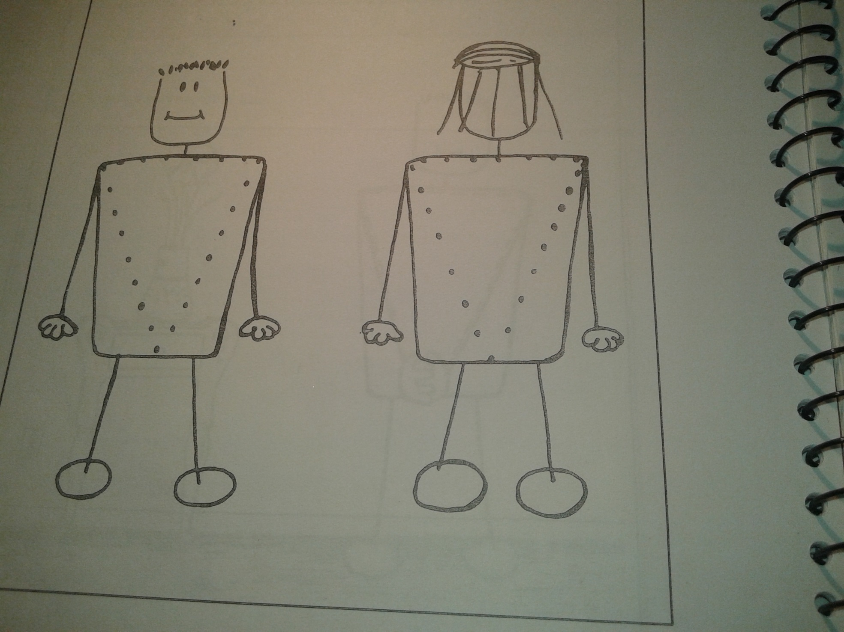
Picture 1

Slide 94
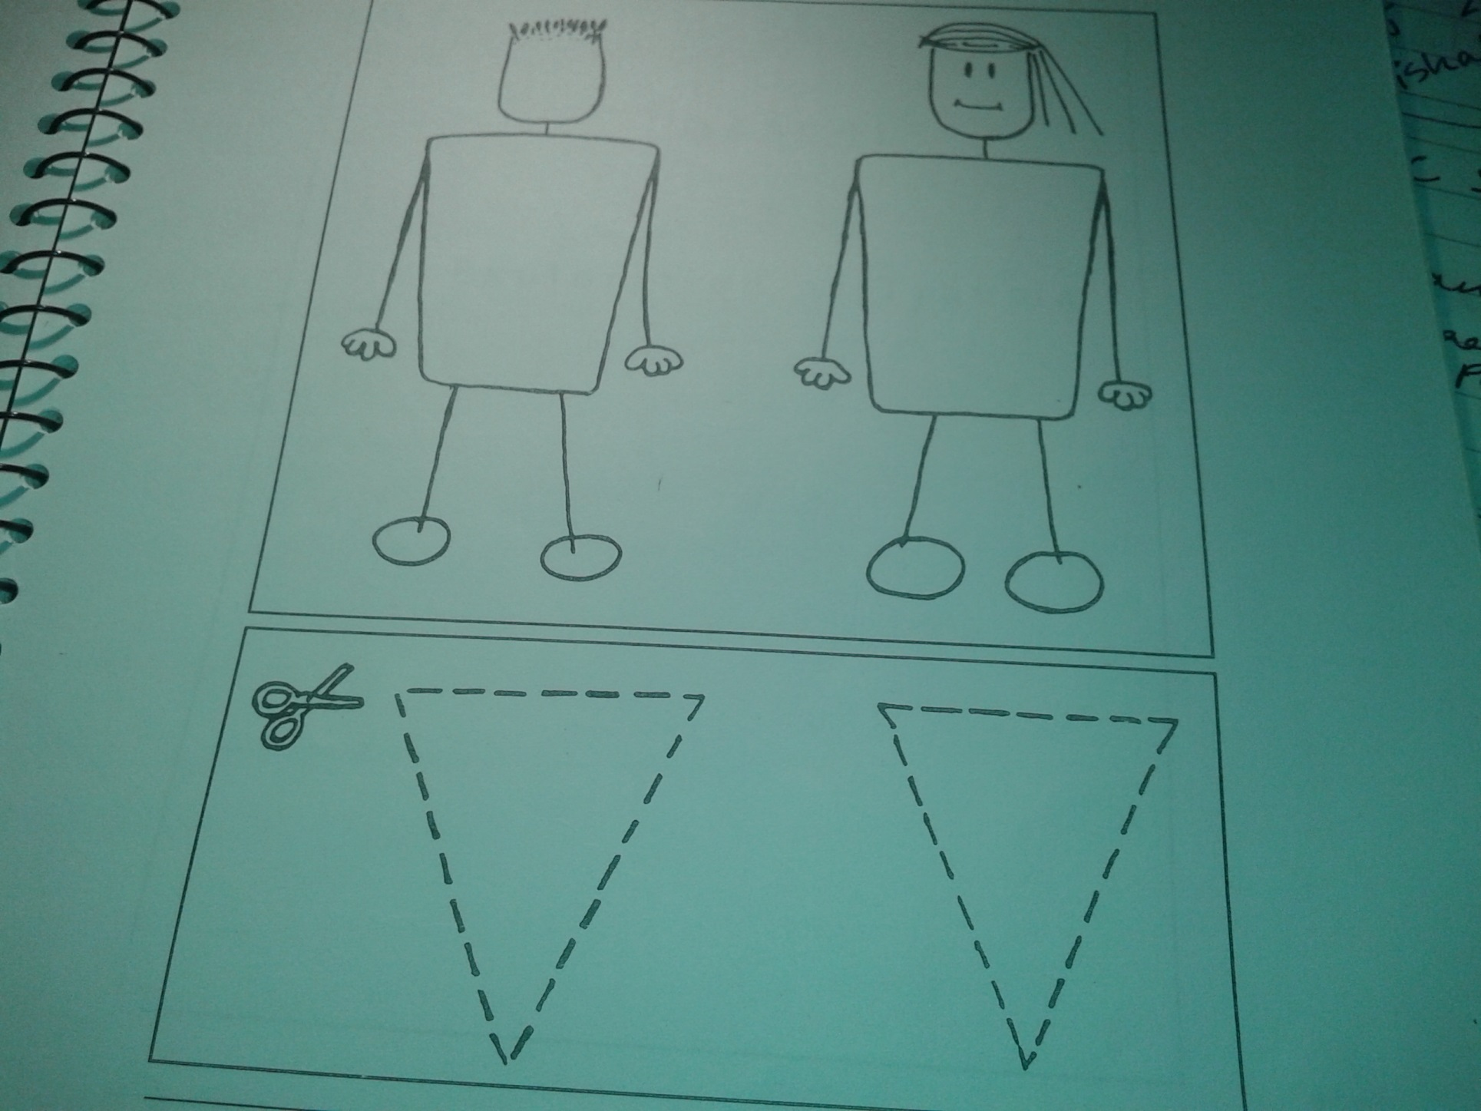
Picture 2

Slide 95
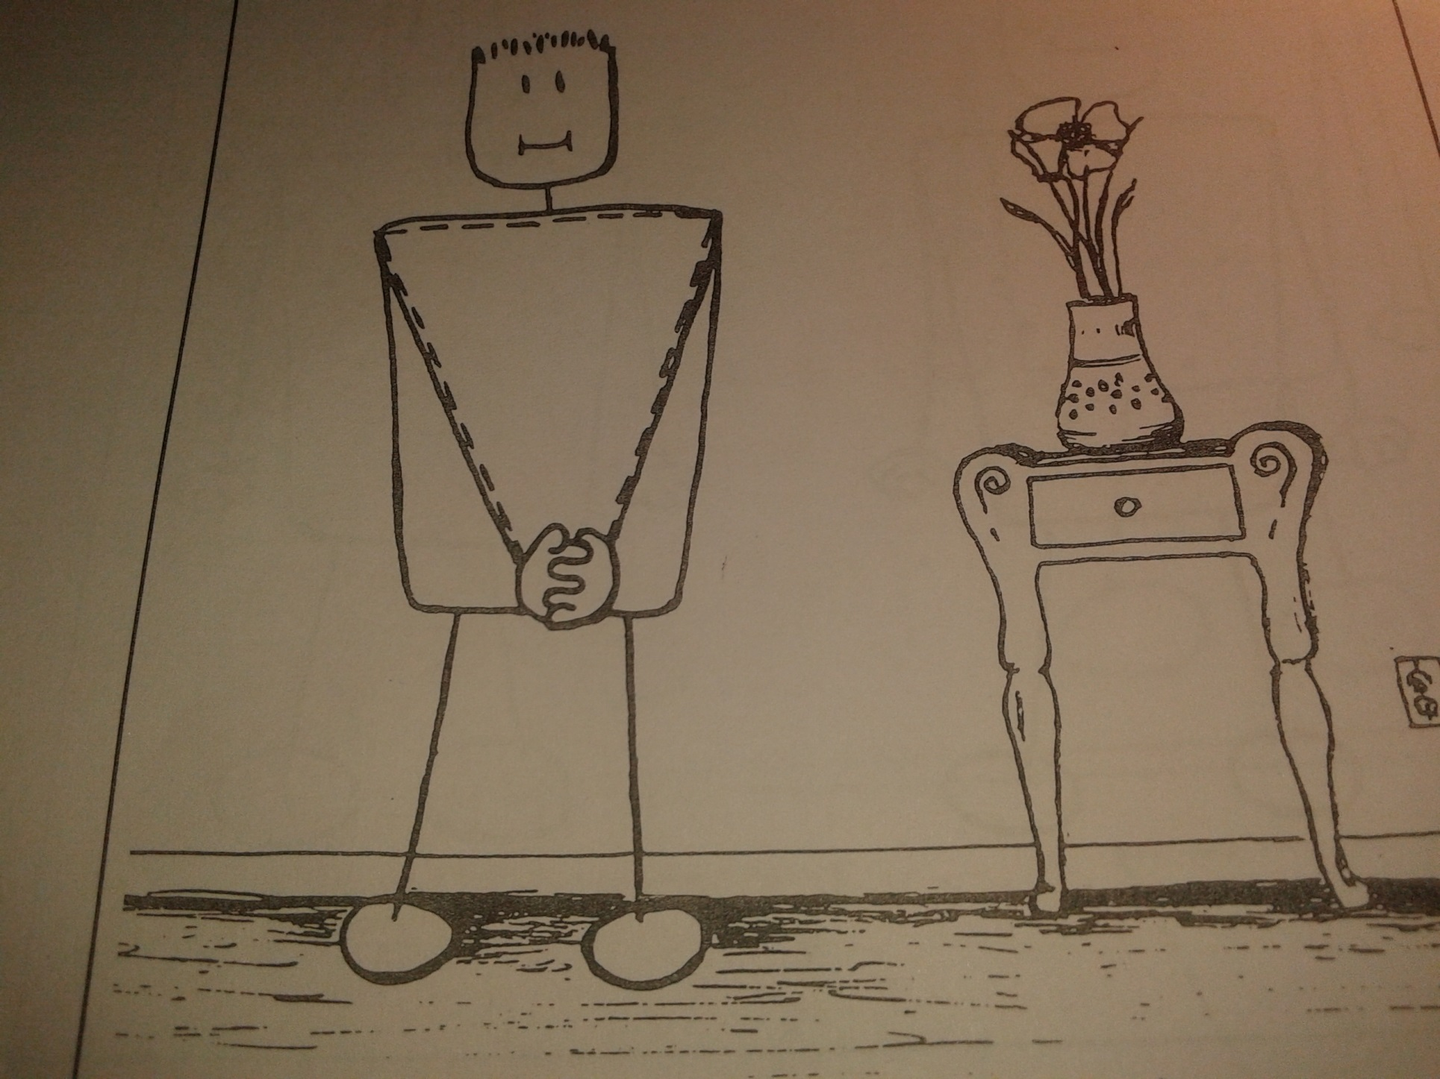
Picture 3

Slide 96
Discussion
Re-iterate and check the child’s understanding on boundaries and personal space.
Re-iterate the discussion under process 1—why people should not touch the child within the private triangle…how these are private parts that can only be touched by someone like his mother during bathing or dressing.
Discuss safety rules with the child. See ‘Suggested Safety Rules’ and ask the child to think of others.

Slide 97
B. Body Mapping/ Physical Touch/ Privacy (For Children and Adolescents)
Ask a child volunteer to lie down on the large piece of paper on the floor: another outlines the shape of the body. It may be useful to do this exercise in two groups, one of girls and the other of boys.
Name/label all the visible body parts—as many as the children can name (according to age). Make sure to name the private parts—whatever name the children give them.
Discussion:
Which parts do you protect from the rain/cold? Are all these private?
Draw a triangle on that part of your body that you consider private. Why do you consider it private/vulnerable?
Some games have rules about touching: for example: in basket ball, you are not allowed to touch the ball with your feet; in foot-ball, you are not allowed to touch the ball with your hands. Which part is it not ok for anyone to touch?
How to you greet people/ by shaking hands? Which parts are ok for people for touch and when? By whom?
What would you do if someone touched you in ways that did not feel comfortable? Who would you tell?

Slide 98
V. Understanding Systemic Responses to CSA

Slide 99
CSA Prevention & Response in Schools
Systemic Response
When an incident of Child Sexual Abuse is Reported: Protocol for Schools
Whether the Act…
Occurs within or outside the school premises,
Is done by school staff or others.
Is reported by the child to anyone in school
…The School’s Position…
Should be one of acknowledgment that the incident occurred.
Involvement and absolute support for the child.
The School’s Response…
Ensure a pre-set response plan which should include:
Identification of a person at school known to the children, and who can respond in a sensitive and gentle manner to alleged instances of abuse reported by the child.
Identification of a next-level reporting authority (such as the principal) who will inform the parents.
Provision of guidance and help to parents to access the first level medical and other facilities, including reporting to the Child Welfare Committee (CWC).
Referral to trained counsellors/ child mental health experts to provide psychosocial support and assistance to the child.
Adoption of a proactive stance with the concerned parents and other parents, by addressing their fears and reassuring them that the necessary actions will be taken to help the child.
Organization of de-briefing sessions for students and teachers following an incident.
Preparation to receive the child back at school in natural and non-stigmatizing ways so that the child re-integrates comfortably.

Slide 100
Guiding School Teachers’ …When a Sexually Abused Child Returns to School:
Recognizing the context of the child’s behavioural issues, and respond appropriately.
Do not use punitive methods even for difficult behaviours.
Maintain a consistent daily schedule and having clear expectations about behaviour--this helps these children gain predictability and regain a sense of control.
Facilitate expression of child’s feelings by encouraging them to participate in art, music and drama.
Some of these children may develop low self-esteem. So, help in fostering their sense of competency by setting reasonable classroom tasks and appreciating them for the efforts made at achieving the goals.
Point out children’s strengths. Make statements such as:“You are a brave person for standing up for your friend,” help child re-gain a sense of self-identity.

Slide 101
Prevention of CSA in Schools
Ensure background checks/ adherence of code of conduct for teachers.
Teachers conduct child safety/ protection activities to create awareness amongst children about sexual abuse risks/ recognizing abuse when it happens.
Teachers observs and understans child behaviour - note any changes in behaviour and report accordingly.
Teachers encourage child participation and decision making.
Teachers maintain open stance and tell children to approach them with problems/ confidences, including encouraging reporting of uncomfortable experiences.

Slide 102
Legal Issues & Forensic Interviewing
Role of Police:
As soon as the affected child reports to the police station, the police must:
Register an FIR.
Direct the child and family to seek assistance from Registered Medical Practitioners (RMP) in government hospitals, for the following:
Medical examination
Forensic interviewing
Acute and on-going provision of psychosocial care
During the healing and investigation process:
Do not hasten interview processes with children. This can increase the trauma and be detrimental to the child’s well-being. Forensic interview protocols have to be part of a larger healing process.
Never take a child back to the scene of crime and ask him/her to explain or demonstrate what happened.
Ensure that investigative processes are planned and not repetitive.
Collaborate with child mental health experts in government institutions to ensure that evidence-gathering is done in the context of psychosocial assistance and healing processes that are in the best interests of the child.

Slide 103
During the healing and investigation process (Cont…):
Child should not be interviewed in police station.
Interview should be conducted in one of the following places:
child’s home/ place of residence
a neutral space such as Police Commissioner’s Office (create child-friendly space within?)
What Police Interviewing must Avoid:
Having the perpetrator and the child come face to face.
Repeated questioning.
Taking the child to the scene of crime and/or re-enacting event.
Persuading child to provide information through insistence/ use of sweets, toys, chocolate.
Touching the child unnecessarily.

Slide 104
Forensic Interviewing of Child in CSA Investigation Processes
Goal of Forensic Interview:
To obtain a statement from a child, in a developmentally-sensitive, unbiased and truth seeking manner that will support accurate and fair decision-making in the criminal justice and child welfare systems.
Who Conducts it:
Law enforcement officers, child protection services personnel, or forensic interviewers/ child mental health experts.
BUT only those trained in forensic interviewing methods with children.

Slide 105
How Forensic Interviewing with Children is done:
Establish a comfortable environment (such as a playroom).
Establish child’s general capacity to understand and respond through simple, neutral questions & games. (Establish child’s developmental level—whether age-appropriate).
Establish child’s ability to describe and remember people/ events/ actions.
Free narrative from child (of what happened/ where etc).
Photo identification of the perpetrator.
All questions to be non-leading and open ended.

