Slide 1
Interviewing
Sexually Abused Children
IPS South Zone CME
30th June 2018
Dr. Shekhar Seshadri
Professor & Head
Dept. of Child & Adolescent Psychiatry, NIMHANS

Slide 2
Objectives
Sensitization to children and childhood and experiences of abuse.
Developing methods and skills to elicit the magistrate’s statement.

Slide 3
Re-Connecting with Your Childhood
Activity:
Close your eyes and remember your childhood days. Re-visit people, places, events that occurred then.
Visualize or re-visit memories of:
  i) childhood experiences
  ii) difficult or traumatic childhood experiences
  iii) childhood experiences of injustice (when someone was unfair to you…)
Share your childhood memories …

Slide 4
Discussion:
How did you feel when you re-visited happy memories versus difficult and traumatic ones?
Who helped/ how did you cope?
The importance of being in touch with your own childhoods so you know what it is like to be a child, what makes children happy, angry or sad.
How this sensitivity is essential to working effectively with children.
The importance of being aware of one’s own feelings and emotions- so that one may also understand another’s feelings and emotions better.
The impact of memories—how childhood events still impact us in adult life.

Slide 5
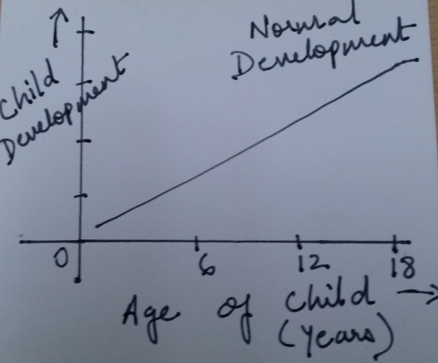
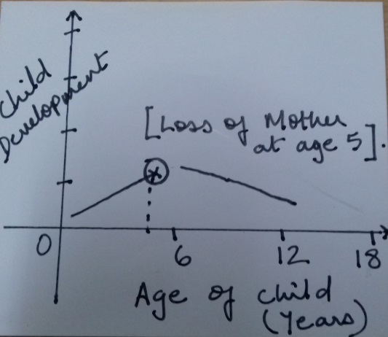
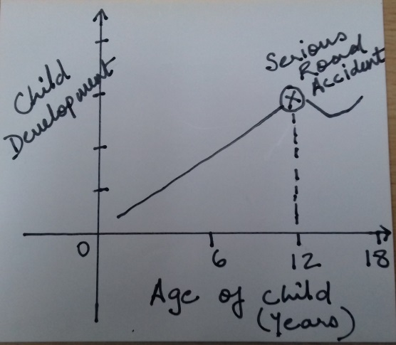
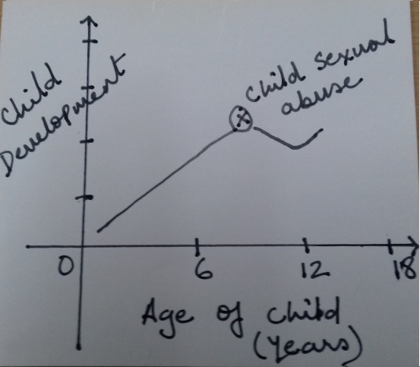
Impact of Traumatic Events on Child Development

Slide 6
Applying Child Development to Child’s Statement of Abuse-POCSO Processes
Speech & Language Abilities
10-14 months: 3 meaningful words
1.5 to 2.5 years: 2 to 3 word phrases
Age 3+: increased vocabulary/ short sentences
*Many (normal) children start developing speech late…so at 3+ they may or may not have capacity to build sentences.

Slide 7
Social Development:
10 months to 3 years: stranger anxiety (not likely to be comfortable talking to new people).
3 years: concept of privacy/ shame relating to body present (less likely to talk about body parts)
Cognitive Development:
1 to 2 years: expression & communication mostly through actions (due to speech & language abilities still developing).
3 years: Object permanence (child thinks that perpetrator can re-appear, so leads to anxiety)
3 years: Ego-centricity (expect others to understand their behaviours… ‘if I fall down, why isn’t everyone crying?’ Similarly with abuse…)
No understanding of the concept of violation…so hard to report.

Slide 8
Recommendations for POCSO/Statement from Child
At a minimum, a child has to be about 3.5 years of age, to even attempt taking a statement.
Even then, some children will have language delays and be unable to report.
Children with intellectual disability will need to be assessed (even those above 3 years) to understand what their abilities and deficits are…and if they can report.
Narration is a function not only of speech & language abilities but also of social and cognitive skills of the child…a child development/ mental health professional should be requested to assist… to use play and other creative methods to elicit narratives from young children and/or children with intellectual disability.

Slide 9
Emotional & Behavioural Consequences of CSA
In Younger Children…
Sexualized behaviour
Avoidance of specific adults
Nightmares/ Sleep disturbance
Clingy behaviour/ separation anxiety
Fearfulness and anxiety
Bedwetting
School refusal
Decreased scholastic performance
Medically unexplained body aches and pains

Slide 10
In Older Children/ Adolescents…
Self-harm
Depression/ isolation
Anger
Fearfulness and anxiety
Sleep disturbance/ nightmares/ flashbacks
Avoidance of specific adults
School refusal
Decreased scholastic performance
Medically unexplained body aches and pains/ fainting attacks
High risk behaviours—sexual behaviour/ substance abuse/ runaway

Slide 11
Physical Signs/ Symptoms of CSA
Pregnancy (in adolescents)
Genital injuries
Urinary infections

Slide 12
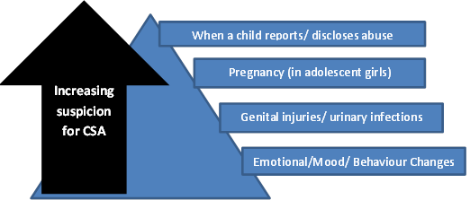
When to Suspect Child Sexual Abuse

Slide 13
Understanding the Child’s Inner Voice
Inner voice…refers to the child’s internalization of the experience
How a child perceives the abuse incident and all the events that followed
May consist of various fears and anxieties + interpretation of events (based on child’s age & developmental level)
…which then leads the child to behave in certain ways (to be silent/ withdrawn/refuse to disclose further/agree to disclose further/ retract original statement…)
We need to therefore understand the child’s thoughts & perceptions, then address some of them (reassure child) before proceeding to take the statement.

Slide 14
What is the child’s inner voice…
Saira, aged 4…was sexually abused by a teacher in her school. She has been having urinary tract infections and fever. She clings to her mother and does not want to go to school or play with other children; she has nightmares and sleeps poorly.
Nikhil, aged 10 years is an orphan child residing in a child care institution. He came to a hospital for treatment for behaviour problems, during the course of which he reported sexual abuse by one of the institution staff (other staff deny that this happened in their institution, saying child is lying).

Slide 15
The Child’s Inner Voice
Be the child…
What is the child thinking?
What are his/her fears and anxieties? (Regarding the abuse incidents? Regarding the court/ statement to be given?)
Let us list these thoughts and confusions…

Slide 16
Communication with Children:
How to Elicit the Statement about Abuse

Slide 17
Preliminary Steps: Before Forensic Interviewing with Child for CSA
1. Psychosocial & Mental Health Assessment
1.1. Demographic Details:
Referral
Initial Account of Abuse Incident(s)
Medical Examination and Tests/ Reports
Mandatory Reporting Query
CSA-Associated Psychiatric Morbidity
  Child Depression Rating Scale (CDRS)
  Screen for Child Anxiety Related Disorders (SCARED)
  Children’s Impact of Traumatic Events Scale (CITES)
Academic and School History
Family History
Mental Status Examination

Slide 18
2. Developmental Assessment
(Age-appropriate?) abilities & skills in locomotor/physical, speech & language, social, emotional and cognitive developmental domains
Implications:
  Forensic interviewing (need for special assistance/ aids)
  Intervention

Slide 19
Interviewing Children for CSA
1. Rapport Building with a Young Child
Greet the child and tell him/her your name and then, ask the child his/her name.
Sit at the same physical level as child (if child is on the floor, sit on the floor…if child is sitting on a chair, sit on the chair next to her).
Use toys and play activities (dolls, puzzles, picture books, colouring books…) to engage young children & give it to the child as soon as (s)he comes to the court (while waiting for you).
Enter into play with child and spend 5 to 10 minutes engaging child in play activity… ‘what are you doing? What is the doll doing? May I see what you are colouring?’
Engage in neutral conversation with child for a few minutes (this also helps to assess the child’s developmental abilities and skills as well as mental state)--What did you eat for breakfast today? How did you come here today? Who are these people who have come with you?...’

Slide 20
For older children and adolescents, you may say ‘I really want to know you better. Tell me about the things you like to do.’
Introduce the space and the purpose of the child being there, including your role:
“My name is…my job here is to make sure that children are safe and no one hurts them. If we hear that someone is hurting or troubling children, then we do things to stop that from happening”.
‘You may be wondering about this busy place and many rooms…many people come here, just like you to talk about people who have hurt or troubled them…that’s why we need a big space like this and many people to help.’
‘Although this place may seem a little scary and confusing, you are safe here…and after we have spent a little time talking, you can go back home with your parents or caregiver’.
Explain the need for video camera/ microphone (in case you are using such equipment)—‘As you can see, we have a video-camera and microphones here. They will record our conversation so I can remember everything you tell me. Sometimes I forget things and the recorder allows me to listen to you without having to write everything down.’ (In case you are taking notes, you may provide a similar explanation to the child).

Slide 21
2. Ensuring Accurate Reporting
Establishing children’s ability to differentiate between truth & lies:
Part of my job is to talk to children[teenagers]about things that have happened to them. I meet with lots of children [teenagers] so that they can tell me the truth about things that have happened to them. So, before we begin, I want to make sure that you understand how important it is to tell the truth.
For younger children, explain: ‘What is true and what is not true’]. ‘If I say that my shoes are red (or green) is that true or not true?’ [Wait for an answer, then say:] ‘That would not be true, because my shoes are really [black/ blue/etc.].And if I say that I am sitting down now, would that be true or not true [right or not right]?’ [Wait for an answer.] It would be [true/right], because you can see I am really sitting down.’ ‘I see that you understand what telling the truth means. It is very important that you only tell me the truth today. You should only tell me about things that really happened to you.’ [Pause.]
‘If I ask a question that you don’t understand, just say, “I don’t understand.” Okay?’ [Pause] ‘If I don’t understand what you say, I’ll ask you to explain. ‘What would you say if I made a mistake and called you a 2-year-old girl [when interviewing a 5-year-old boy, etc.]?’ [Wait for an answer.] ‘That’s right. Now you know you should tell me if I make a mistake or say something that is not right.

Slide 22
3. Training in Episodic Memory
To practice providing detailed, descriptive narratives later in the interview…
‘It is very important that you tell me everything you remember about things that have happened to you. You can tell me both good things and bad things.’
Identify a recent event the child experienced- first day of school, birthday party, holiday) and build up upon that using qualifiers like ‘tell me, what happened next, ‘Think hard about [activity or event] and tell me what happened on that day from the time you got up that morning until [some portion of the event mentioned by the child in response to the previous question]. ‘Tell me more about [activity mentioned by the child].’ [Wait for an answer.] Use this prompt as often as needed throughout this section.]
‘Earlier you mentioned [activity mentioned by the child]. Tell me everything about that.’

Slide 23
4. Taking the Statement
(a) How to enquire about the abuse
Enable the child to provide you with the narrative by asking open questions such as:
-“Now that I know a little about you, I want to talk about why [you are here] today.’
-“I heard you talked to ‘X’ about something that happened – tell me what happened.”
-“I heard you saw [the doctor, a policeman, etc.] last week – tell me how come/what you talked about.”
-“Is [your mom, another person] worried about something that happened to you? Tell me what she is worried about.”
-“I understand someone might have troubled you – tell me what happened,” -“I understand someone may have done something that wasn’t right – tell me what happened.”
-“I understand something may have happened at [location] – tell me what happened.”]
b) Use gentle probes where necessary.

Slide 24
Techniques of Inquiry
i) Non-leading Techniques of Inquiry:
Questioning should proceed from general to more detailed.
Talk about "things that happen" in the child's life — things that happen at home, in school, or in another setting.

Slide 25
- Do you know why you're here today? What was explained to you about why you are here today?
- Is there something that you want to tell me?
- Is there something that you wish to tell me? (or need to tell me?)
- Are there any worries you have about home or school…?

Slide 26
ii) Minimally Leading Techniques

Slide 27
- I understand that you have had some trouble sleeping recently. Could you tell me if anything has happened that would make you to have trouble sleeping?
- Has anyone done things to harm you or upset you?
- I understand there have been some problems in your family. Can you tell me about them?

Slide 28
iii) Moderately Leading Techniques:
These questions further narrow the range of possible responses a child might make.

Slide 29
- Did anything happen to you when you went to visit (person)?
- How did you get along with (person) when she went to see him?
- What do you and (person) do when you go to visit?
- I understand that some things have happened between you and [the abuser]. Tell me about those things.
- Is there anything that has happened to you recently that has made you really upset?
- Can you tell me what happened between you and [the abuser]?
- I'd like you to tell me about the things you like about [the abuser]and the things you don't like about [the abuser].
- I need to know how your pee-pee got hurt. Can you tell me how that happened?

Slide 30
iv) Maximally Leading Techniques:
These include questions which tell the child what the investigator wants to discuss.
In maximally leading questioning, the interviewer does not follow the lead of the child's responses, but introduces content to the child, often communicating the interviewer's desired response.

Slide 31
- Did he [the abuser] touch your pee-pee with his finger?
- Did he [the abuser] take off his clothes when he laid down on top of you?
- He [the abuser] put his finger in your pee-pee, didn't he?
- Did [the abuser] he touch you under your clothes or over your clothes?
- These are close-ended questions, which also assume that abuser has engaged in certain behaviors with the child (thereby leaving out others).

Slide 32
Recommended Way of Questioning
Non- Leading Questions
Minimally Leading Questions
Moderately Leading Questions
Maximally Leading Questions
(Only for confirmatory details)

Slide 33


c) Use pictures to assist the child
“I will show you a picture…perhaps you can point to where this person touched or hurt you…”
(Or child could use a doll to point)

Slide 34
4. Close the interview with child
- You’ve given me lots of information and that really helps me to understand what happened.’
‘You have told me lots of things today, and I want to thank you for helping me.’
‘Is there anything else you think I should know?’
‘Is there anything else you want to tell me?’
‘Are there any questions you want to ask me?’

Slide 35
Let us role play an interaction with a child…how would we elicit the statement required under POCSO?
*Use the steps outlined above.

Slide 36
A Note on Children’s Memory
Developmentally immature children too have memories but have difficulty in retrieving them.
A technique of scaffolding is used in which a series of detail-oriented questions are asked e.g. −“Did you do anything when you were at that house?” “What did you do?” “Was someone there when you did [what the child reported]?”
The interviewer thus offers “cues” or “cognitive supports” that allow the child to access his or her memory.

Slide 37
A Note on Children’s Attention
Quality of information provided by young children begins to decrease with increased attempts to refocus.
Once a three-year old has lost interest and has been refocused to the interview process several times, she or he may begin to answer questions randomly, without thought or consideration of the questions posed.

Slide 38
Age & Type of Information to Collect

Slide 39
Things to Remember
NEVER…
Hurry children to talk.
Persuade child to provide information through insistence/ use of sweets, toys, chocolate.
Ask children to enact what happened.
Probe for details of how the child felt at time of abuse (unnecessary details that might re-traumatize child).
Touch the child unnecessarily.
ALWAYS…
Ask only one question at a time.
Wait for the child’s response.

