Slide 1
Basic Psychosocial Care for Children in Difficult Circumstances Training Workshop Child Welfare Committee, Karnataka
December 2017/ June 2018
Community Child & Adolescent Mental Health Service Project
Dept. of Child & Adolescent Psychiatry
NIMHANS, Bangalore
In Collaboration with
Dept. of Women & Child Development, Government of Karnataka

Slide 2
Our Learning Objectives
Understanding children’s psychosocial issues.
Linking child protection and psychosocial care, including understanding issues of abuse and trauma.
Skill building with a focus on:
Getting started with children.
Developing basic communication skills to facilitate supportive care worker-child relationships.

Slide 3
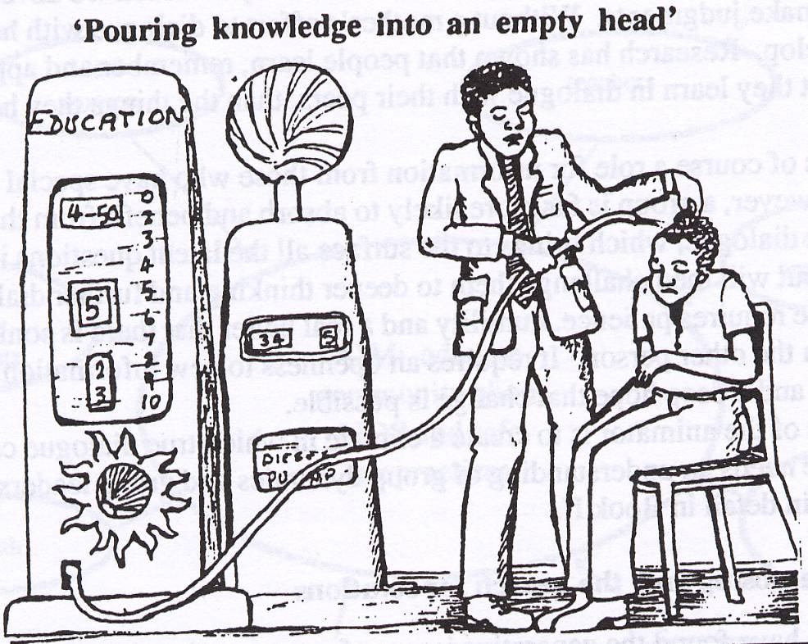
Our Learning Methods
Slides/ materials
Do-and-learn (skills)
Role Plays
Case-Studies
Participatory Group
Activities and
Discussion

Slide 4
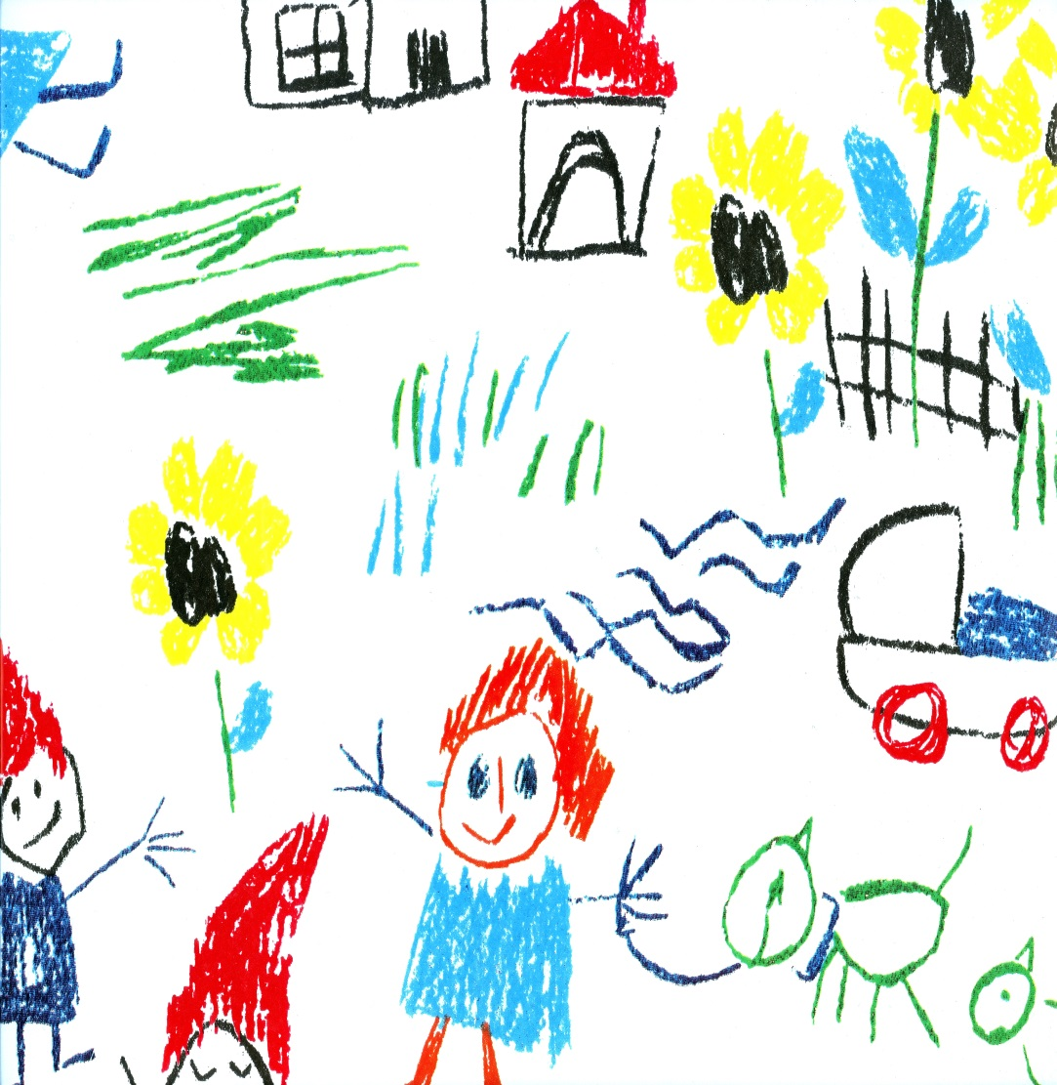
I. Children & Childhood

Slide 5
Re-Connecting with Your Childhood
Activity:
Close your eyes and remember your childhood days. Re-visit people, places, events that occurred then.
Share your childhood memory with the group…
Repeat the process (of closing eyes and then group sharing) by re-visiting memories of:
difficult childhood experiences
traumatic childhood experiences.

Slide 6
Discussion:
How did you feel when you re-visited happy memories versus difficult and traumatic ones?
Who helped/ how did you cope?
The importance of being in touch with your own childhoods so you know what it is like to be a child, what makes children happy, angry or sad.
How this sensitivity is essential to working effectively with children.
The importance of being aware of one’s own feelings and emotions- so that one may also understand another’s feelings and emotions better.
The impact of memories—how childhood events still impact us in adult life.

Slide 7
Identifying Child Developmental Needs & How They are Impacted by Difficult Circumstances
Activity 1:
Objectives:
To identify children’s physical, social, speech & language, emotional and cognitive needs.
To understand how these developmental needs are impacted by difficult circumstances.

Slide 8
Key Areas for Child Development
Physical
Emotional
Cognitive
Social
Language

Slide 9
Process (a):
Divide into 5 sub-groups.
Round 1: Sort cards into 5 domains of development. (Each group picks up cards relevant to their domain).
Round 2: Within each domain, sort cards for abilities & skills to match needs and opportunities. (Within each group, after initial round of sorting, further categorize and match the cards).
View the categorization in plenary…discuss.
Generate ideas/ activities to further child development in each domain—physical, social, speech and language, emotional & cognitive areas. What types of activities can we do/ do you do? Let us develop a list…

Slide 10
Physical Development (1)
Abilities & Skills Needs & Opportunities
Social Development (2)
Abilities & Skills Needs & Opportunities
Speech & Language Development (3)
Abilities & Skills Needs & Opportunities
Emotional Development (4)
Abilities & Skills Needs & Opportunities
Cognitive Development (5)
Abilities & Skills Needs & Opportunities

Slide 11
Let’s Talk about Attachment…
Nature of the bond between child and care-giver
Usually, attachment figure is mother (sometimes there can be extended attachments)
Strong attachment is related to security and well-being
Loss of attachment figure (through loss or separation) can give rise to insecurity and related anxiety problems—clinginess and expectation.
Contexts/ Situations where child is at risk of insecure attachment:
Children in intact families
Parental conflict
Neglect
Non-response to child’s needs
Physical/ sexual abuse
Frequent separation experiences.
Children in conflict areas:
Abandoned/orphaned
Suffering loss in conflict areas,
Institutional upbringing,
Frequent change of care takers

Slide 12
Physical Development
Abilities/ Skills | Needs
0 to 6 years: Gross Motor Skills: mobility, ability to handle objects Fine Motor Skills: pre-writing skills, transfer functions, eye-hand coordination Physical skills necessary self- help: buttoning, brushing, feeding etc. | General growth and nutrition Physical activities/ play/ exercise Sensory experiences Fine-motor activities such as beading, colouring, buttoning…
Ages 7+: Continued physical growth Full independence in self-care. Fine motor tasks easily achieved. | General growth and nutrition Physical activities/ play/ exercise
Ages 13 to 18: Development of secondary sexual characteristics. Menstruation in girls. | Preparation for bodily changes/ education/ awareness.

Slide 13
Language Development
Abilities/ Skills | Needs
0 to 6 years: Increase fund of words. Ability to construct short sentences. Express needs. Ability to describe. | Naming and pointing games Story telling Phone games Describing games (using pictures or real life observations/events or television clips) Concept book/ flash cards
7 to 12 years: Language used for higher levels of communication—to report experiences. Ability to communicate needs and experiences. | Opportunities to describe, to be heard, to share experiences. Freedom to communicate needs.
13 to 18 years: Language used for complex social transactions, incl. life skills like refusal skills/ assertive skills/ negotiation. | To process complex feelings and relationship dynamics. To articulate opinions and choices.

Slide 14
Social Development
Abilities/ Skills | Needs
0 to 5 years Recognizing familiar people Understanding rules of play Peer interaction Understanding of spaces (and what happens there) Understanding of sequences and routines | Simple rule-based games Naming and pointing familiar people Naming and pointing familiar spaces/ places where child goes + discussion about what is done there Supervised peer interaction, group play, cooperative play (exposure to playgrounds/ play spaces) Use of pictures to explain day’s routine/ sequencing
7 to 12 years Development of gender identity Pretend/ imaginative play, group play Same sex/ peer-group play | Opportunities for peer group play, forming friendships, Comfort/ security—sense of belonging to peer group/ school/ family Affirmative sense of identity
13 to 18 years Development of sexual interests/ orientation. Peer group interactions all important. (need to ‘fit in’). Self-identity/ individuality. Questioning parental/ adult authority. | Rules and healthy boundaries, along with opportunities to practice independent decision-making skills. Relationship satisfaction. Clarity on future orientation

Slide 15
Emotional Development
Abilities/ Skills | Needs
0 to 6 years: Attachment and bonding Ability to identify emotions Ability to regulate emotions (responsiveness to soothing/ distress states not prolonged/ separation from attachment figure) Ability to recognize emotional state of another person and ascribe simple reasons to causality Differentiating between positive and negative emotions | Providing frequent and timely responses of love/ affection to child, incl. positive feed-back, verbal and non-verbal. Identifying emotions through pictures Story telling Story completion Visual analogue (emotion scale) Listing situations in which a certain emotion is felt (‘you are happy when…’)
7 to 12 years: Emotional regulation (anger/ anxiety control in context of conflict/ provocation) Ability to report emotional states. Development of empathy. Ability to provide positive emotional response (reassurance/ comfort) | Provide disclosive sharing spirit/ opportunity. Opportunities to acknowledge and process intense emotions such as emotions and fear. Appreciation, encouragement Pro-social behaviour opportunities
13 to 18 years: Ability to cope with stress. Developing and making decisions about attraction/ intimate/ sexual relationships. Dealing with peer pressure. Greater need to establish self-identify, independence. | Family, school, social support. Life skills—negotiation, assertiveness, stress & coping, problem solving Resilient handling of role task, relational & emotional challenges Happy, healthy, responsible sexual behaviour

Slide 16
Cognitive Development
Abilities/ Skills | Needs
0 to 6 years: Fund of information Knowledge of use of objects Ability to form associations Ability to form categories Sequencing and organizing abilities Ability to understand concepts such as shape, size, distance, directions | Puzzles Identification of colors, shapes Story telling (including discussions) Story Completion Use of pictures for sequencing events/ stories Play to demonstrate use of objects Attention enhancing tasks (joining dots, spotting the difference, eye-hand coordination activities) Concept book/ flash cards
7 to 12 years: Learn the difference between ‘right’ and wrong’. Ability to think and reason from concrete visible events. Play more complex rule-based games. | Conversations, debating on real life situations and television images, discussions on existing social realities, including inequity. Story-telling, drama. (More complex themes for adolescents: gender, sexuality, abuse, risk behaviours, conflict resolution…)
13 to 18 years: Less likely to accept what is stated by others/ more likely to question. Creative thinking/Abstract abilities—can generalize from specific situations. Ability for self-introspection, analysis, judgement.

Slide 17
Process (b):
Consider the five domains of child development…how are the abilities and skills of children in difficult circumstances impacted?
How is their access to activities and opportunities impacted?

Slide 18
Understanding Children’s Emotional & Behavioural Problems
Context: Home/ School/ Family/ Public Space/ Social Spaces
Basis of Understanding Child/ Basis of Counsellor’s Response & Intervention
Impact on Child: Emotions/ Behaviours
Child’s Experience: Happy/Difficult/ Traumatic (Loss/ Abuse)

Slide 19
Identifying Emotional/ Behaviour Problems & Contexts
Case 1: A 15-year old girl has suicidal thoughts, refuses to eat and has disturbed sleep, she is often seen crying, has recurrent disturbed images of her past. She lost her mother a year ago, after which her father has re-married. He no longer wanted to be responsible for her, so she was married off to a 30-year old man, who sexually abused her multiple times; she was also beaten/ burnt on various parts of her body by her mother-in-law.
Case 2: A 14 year old girl, was rescued by Childline team from the streets where she had lived for about 2 years. Her mother had died when she was 5 yrs old; although she was sent home, her father refused to take her in (he was re-married) when the family was tracked and none of her relatives wanted her. So she ran away again. This time around she lived with a transgender person (who was in sex work) for a year. This person wanted to keep the child safe and brought her to CWC/ institution. The child now shows a lot of anger/ aggression behaviours; she does not obey anyone; she has lying and stealing problems. No institution is able to manage her & they don’t want her.

Slide 20
Case 3: A 10 year old girl spends all his time alone, does not eat properly and has sleep problems. She has no friends and is often ‘in his own world’ (‘lost’). She also has academic problems. She was sexually abused by her father and brother; her father killed her mother.
Case 4: A 14 year old girl is always angry and aggressive, but also has a tendency to be very clingy i.e. if a person she has befriended someone, she does not like her to engage with any other children/ people. Her mother died when she was about 10 years old. She was on the streets from the age of 8, begging, as parents were alcohol dependent and did not take care of the child. She still misses her mother very much and says that had she known about her mother’s hospitalization, she could have saved her (it’s my fault that my mother died).

Slide 21
Case 5: A 14 year old boy is often angry, gets into fights with other children, breaks window panes, and does not adhere to the rules of the institution. Previously, he was part of gangs and into smoking. The child had lost his father; his mother re-married and he was physically abused by his step father—who also made him discontinue school and work at a cycle shop. The step-father is also into gangs and physically abuses the child’s mother.
Case 6:
A 11 year old boy was reported by the institution to have anger issues --hitting and biting other children—as well as runaway behaviour. The child was sent to a hostel by his grandmother and he ran away from the hostel twice because he was beaten there. There is marital discord in the family : mother has re-married and she resides in Hassan, the child does not wish to stay with his mother as he reports that beats him and makes him sleep outside the house/ does not give him food. The child’s biological father resides in another town with his family , the child has better relationship with his father but the father has alcohol dependence and he does not wish to take the responsibility of the child.

Slide 22
Developing Basis for Response: Understanding the Child
Context (orphan/ abandoned/marital conflict/single parent/HIV+/domestic violence…) | Experience (Happy/ Difficult/ Traumatic…) | Child’s Inner Voice/Thoughts (‘I am…) | Emotions (anxious, sad, angry…) | Behaviours (bed-wetting, isolated, verbal abuse…)

Slide 23
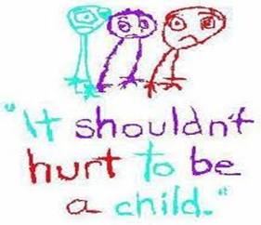
II. Communication Techniques with Children
Rapport Building
Listening
Recognition & Acknowledgement of Emotions
Acceptance & Non-Judgemental Approach
Questioning & Paraphrasing

Slide 24
Skill 1: Getting to Know the Child
Rapport Building:
First stage of building a relationship with the child.
3 steps to rapport building get to know the child
Step 1: Greeting the Child
Step 2: Preliminary Establishment of Context
Step 3: Let’s get to know each other (activities)

Slide 25
Step 1: Introducing yourself (as CWC member/ childcare worker)
Greeting
Greet the child.
Shake hands if appropriate.
Tell her your name and ask her’s.
Introducing yourself/ your role
“There are many children (like you) who have problems and difficulties, at home or outside. My job is to work with such children and see how best to solve the problems.”
“As you can see/ you may have heard, we have a committee to help children when they get hurt or have problems. I am part of this committee.”
“I would like to know more from you, about what you see as problems, so that I understand better how to assist you…and whatever plans and decisions are to be made for you, I/ this committee will make along you—in consultation with what your wishes.”

Slide 26
Step 2: Preliminary Establishment of Context
Establishing child’s knowledge and understanding:
“I am aware of the difficult experience you have gone through. Would you like to tell me anything about it…your concerns and worries about it?
Universalizing the child’s experience:
‘Like you, other children, have had similar, difficult experiences. Some of them are frightened and upset and need help with what they are feeling and experiencing—just like you might .’
Individualize the child’s experience: In response to what the child may say about why he/ she is with you:
‘While other children may have gone through such an experience--similar to your’s,--your experience is personal and specific to you. Everyone needs help in different ways. I am here to understand and support you.’
Ensuring Confidentiality
‘I want you to also know that when we talk or play, whatever we share will be between us. I won’t tell anyone about your feelings or upsets. If there is a time/ a need to have to tell some of it to other people, I will only do it after consulting you and getting your permission—never without.’ (Assuming that CSA has already been reported).

Slide 27
Step 3: Let’s get to know each other…
Ask child neutral, non-threatening questions to elicit information about his/ her likes/ dislikes and interests:
What did you eat today?/What have you been doing all morning?
Flip a coin: The counselor and the child each choose ‘heads’ or ‘tails’ of a coin. When the coin is flipped, depending on what comes up, the person has to reveal a personal detail i.e. if the counselor chose ‘heads’ and heads comes up, she must reveal a fact about herself; if ‘tails’ comes up, it is the child’s turn to reveal a fact about herself. Example: “Blue is my favorite colour”, or “my favourite food is…”.
Establish a spirit of collaboration
Do an activity together—drawing/ coloring, a puzzle, reading a story…anything that interests the child.

Slide 28
Activity 1: Getting to Know the Child
Objective:
To learn to build rapport with the child.
Process:
Role play in pairs…
Introduce yourself to the child
Establish context of interaction.
Get to know each other better
Discussion:
Volunteers?
What did we do right?
What elements of the 3 steps were we able to implement?

Slide 29
Skill 2: Listening and Interest
Reflective Listening/ Verbal response:
Ok…
Hmm…
Alright…
Yes…
Attentive listening:
Maintaining eye contact
Nodding of the head
Body posture like leaning forwards towards the child.
Empathetic gestures like supportive pat on the shoulder or hand.

Slide 30
Appropriate Body Language:
Attentive but relaxed sitting posture (no slouching/ drooping).
No fidgeting.
No writing notes/ doing other activities.
No looking elsewhere/ poor eye contact.
Listening Dos and Don’ts…
DO… Show interest. Be empathetic and understanding. Demonstrate your interest through verbal and non-verbal cues. Listen for causes of the problem. Observe silence as appropriate. | DO NOT… Argue. Interrupt. Be inattentive. Do other work. Pass judgment. Give advice immediately. Jump to conclusions.

Slide 31
Activity 2: Listening & Interest
Objectives:
Learning different ways of listening.
Process:
Divide into pairs. One member of each pair leaves the room and one stays in.
Round 1: Group that is outside (when they re-join their partners) to talk for a minute continuously about some very important event in their lives to their partners. Instruct the group inside to sit with their fingers blocking their ears i.e. not to listen to their partners talking.
Round 2: Group outside to talk for a minute about some very happy event in their lives tot heir partners. Instruct the group inside to look away, not make eye contact, not respond and act as if they are not listening.
Round 3: Group inside and outside to talk non-stop to their partners. Neither should listen.
Round 4: Group outside to share some very difficult experience in their lives with their partners. Instruct the group inside to be attentive, make eye contact, and express emotion.

Slide 32
Discussion:
How the group outside felt during each round of the game?
Various levels of listening i.e. from not listening at all (1) to ‘hearing’ without listening (2) to talking so much that there is no listening (3) and finally active listening (4). In which round is good communication taking place? Why?

Slide 33
Skill 3: Recognizing and Acknowledging Emotions
What are the ways in which we recognize and identify emotions?
Non-verbal cues: facial expressions, gestures
Verbal expressions: tone of voice, actual content of speech
Other behaviours
Of course we sympathize…and we feel for the child but how do we show it?
Non-verbal cues (holding hands, facial expressions, hugging…)
Verbal expressions ( tone of voice, “I know it must have been difficult…it seems like you are really hurt and angry…”
NO judgement of emotions expressed! Emotions are neither good nor bad…they just are and we feel them, no matter that. “It is alright for you to feel angry and frustrated…”

Slide 34
Activity 3: Recognizing and Acknowledging Emotions
Objective:
How to identify and recognize emotions.
How to communicate to a child that you recognize & acknowledge his/her emotions.
Process:
Divide into pairs.
Read the children’s expressions provided.
Identify the emotions expressed.
Next, one participant assumes role of child and the other that of PSS counselor.
Use the dialogues of the children (below) and do the following:
Role-play your response to the child. How will you respond to them?
State your verbal response—to show that you recognize and acknowledge the emotions felt by the child.
Demonstrate non-verbal responses you would provide.

Slide 35
Children’s Narratives (Activity 3: Recognizing & Acknowledging Emotions)
Saira, age 6
“When I went to school and came back, my father was gone. No one knows where he went. My mother left me here [in the institution]…but will she come back to see me?”
Puneet, age 8
“My mother died a year ago…then I went to my aunt and uncle’s house and stayed there for sometime. They said my parents were bad people and that I was useless and just taking up space in the house…they did not want me so they sent me here [to institution].”
.
Shekhar, age 10
“Two years ago, I was sent to work as a helper in a shop to supplement the family income. The shop owner often yelled at me and hits me even for minor mistakes. But I cannot do anything because my family needs the little money that I earn.”
.
Mamata, age 14:
“ I feel scared all the time…I cannot eat, I cannot sleep…if I try to close my eyes, I see images of that man—he is coming towards me and I know he is going to hurt me.”

Slide 36
Skill 4: Non Judgemental Attitude & Acceptance
What does non-judgemental attitude mean?
Allowing the child to hurt herself in distress?
Telling the child it is alright not to go to school if she does not feel comfortable?
Assuring the child it is alright for him to feel very angry about the shop owner’s abusing him?
Acknowledging to the child that the store room can indeed by frightening?
Non-judgemental attitude involves…
Recognizing and acknowledging a feeling/emotion—WITHOUT being judgemental about whether that feeling is ‘right’ or ‘wrong’.
NOT giving your personal opinion in a way that is critical or blaming in any way.
Accepting the child for who and what he/she is.

Slide 37
Activity 4: Non-Judgemental Attitude
Objectives:
To understand what non-judgemental attitude means.
To reflect non-judgemental attitude in communication with children.
Process:
Read the two scenarios/conversations below between counselor & child.
Discussion:
What did the counselor do differently in scenario 2 versus scenario 1?
Which do you think would be more effective in building a relationship with the child and why?
How do you think the child would have responded/ said next in i) scenario 1; scenario 2?

Slide 38
Counsellor-Child conversations in a Child Care Institution: (Activity 4: Non-Judgemental Attitude)
Scenario 1 | Scenario 2
Child: I hate being here in this home! I don’t want to stay here! I want to go back to my life on the street…! Counselor: Yes, it may be difficult for you to be here. But think about all those children who have been abused on the street such as you have… Child: How do I know that I can be safe here? Counselor: Has anything happened here for you to feel unsafe? No, right? So, then why are you saying that? | Child: I hate being here in this home! I don’t want to stay here! I want to go back to my life on the street…! Counselor: Yes, it must be difficult for you…it must make you angry to be in a place you dislike, where you don’t have the freedom you are used to. But we are concerned about your safety… Child: How do I know I can be safe here? Counselor: It is natural for you to feel insecure, given what you have gone through…we will try to ensure that we identify a supervisor of your choice to assist you.

Slide 39
Counsellor-Adolescent conversations in the context of pregnancy (Activity 4: Non-Judgemental Attitude)
Scenario 1 | Scenario 2
Counselor: Did you know this person before you ran away with him? Adolescent: Yes, we were friends. Counselor: But he was so much older than you… Adolescent: Yes, but he said he cared for me and that he would look after me. Counselor: Don’t you know that girls should be careful? and it will be a problem if we just believe some man like that… Child is silent. Counselor: And now you see what has happened…girls should be careful about relationships… and didn’t you know about the dangers of HIV? Should you not think about your health? | Counselor: Did you know this person before you ran away with him? Adolescent: Yes, we were friends. Counselor: Did you feel comfortable and confident being with him? Adolescent: Yes, he said he cared for me and that he would look after me. Counselor: Yes, I guess you trusted him. Sometimes we all can get manipulated. Child is silent. Counselor: Now that HIV has happened, we would like to help you carry out whatever decisions you want to take. I know this must be difficult and frightening for you but I assure you of our support to you.

Slide 40
Discussion:
What did the counselor do differently in scenario 2 versus scenario 1?
Which do you think would be more effective in building a relationship with the child and why?
How do you think the child would have responded/ said next in i) scenario 1; scenario 2?
Process (b):
Divide (participants) into pairs and role play a conversation between counselor and child on the following issues:
A 15 year old boy who sexually abused a 8 year old girl.
A 16 year old girl who ran away with an older man and has just returned home, and found to test positive for HIV etc.

Slide 41
Skill 5: Questioning & Paraphrasing
Closed ended questions: These type of questions lead to responses in monosyllables, which might not help explore what happened or encourage the child to talk about all the aspects and dimension of his/her situation.
Useful to obtain precise details on date/ time/ no. of times an event happened/ who—when only a single answer is possible.
Leela : He behaved badly with me.
Counselor: Did he touch you?
Leela: Yes.
Counselor: Did he touch you in your private parts?
Leela: Yes.
Counselor: Did you try to scream for help?
Leela: Yes.
Counselor: And did someone come to help you?
Note: Close-ended questions are not wrong or unnecessary! Use them but to a lesser extent and in ways that will not block further information/ response.

Slide 42
Open ended questions: These types of question lead to elaborate answers that do not end in one word.
Help to explore How and Why. (Descriptive…where multiple answers are possible/ many details required).
Leela : He behaved badly with me.
Counselor: What happened?”
Leela: He touched me and made me uncomfortable.
Counselor: Could you tell me a little more about that?
Leela: He put his hands under my skirt and rubbed it.
Counselor: What did you do then?
Leela: I was so scared…I tried to scream…and then I ran from there…
Counselor: Sounds really scary. What happened next?

Slide 43
Paraphrasing:
re-phrasing the content shared by the child to ensure and confirm that the counselor has not misinterpreted or missed out any information provided by the child.
helps avoid incorrect inferences, conclusions and judgments being made by the counselor.
Also allows for reflection of child’s feelings about the experience.
Example:
“It looks like he touched you on your private parts and made you really uncomfortable and scared. But you managed to scream for help and run away, despite being scared—and that shows quick thinking and presence of mind.”

Slide 44
Activity 5: Questioning & Paraphrasing
Objectives:
To learn when and how to use open and close-ended questions.
To learn how to paraphrase what children express.
Process (a): Open or Close Ended Question?? Convert it…
What happened yesterday?
O so he hurt, you did he?
How many times did he do that to you?
When did these events happen?
Who was the person who asked you to go with him?
Can you identify the people who accompanied you to the railway station?
Tell me more about how he hurt you…
What was your relationship with your mother like?
Did you have a good relationship with your father?
What are the things that make you angry?
If someone shouts at you, do you get angry?
Why do you feel anxious?
Do you feel worried everyday?

Slide 45
Process (b):
Divide into pairs.
Assume role of child and counselor.
Use the (children’s) sentences below to practice exploring/understanding the issue with the child by asking i) close-ended questions; ii) open-ended questions and later paraphrasing:
“I hate what he did to me.”
“I feel like killing him, am so angry…”
“I feel scared all the time…if it will happen again…”
Use the same sentences above to develop a communication with close-ended questions.
Paraphrase your conversation with the child.
Discussion:
What was the difference between using open versus close-ended questions?
Which one was helpful and why/ where?
Why is paraphrasing important?

Slide 46
Film Screening
Children of Heaven

Slide 47
II. Common Child Mental Health Problems

Slide 48
Why understand basic child mental health problems?
To assess child growth and development.
Identify developmental disabilities and common emotional and behaviour problems.
To develop a care plan for the child.
To be able to refer to specialized psychiatric care facilities (for medication and therapy as necessary).

Slide 49
Activity: Memory Game…Learning about Common Child Mental Health Disorders
Objective:
To understand and learn the signs and symptoms of common mental health issues in children.
Process:
Divide into 5 groups (6 members in each group).
Each team will be given 2 mins time to see and memorize all the symptoms of the mental health problem which is displayed.
Later, each team will be given opportunity to recall all the symptoms which was displayed.
The team which is able to recall all the symptoms correctly are awarded 10 points.

Slide 50
What is disability or developmental problem?
Lack of skills/ abilities in one or more of the areas of child development.
Delay in skills/ abilities in one or more of the areas of child development.
Results in impaired day-to-day functioning of the child/ problems with activities for daily living.

Slide 51
Types of Disability
Physical Disability
Vision problems
Hearing disability (which results in speech problems)
Other oro-muscular problems(causing speech problems)
Locomotor Disability
Locomotor Disabilities
Due to congenital defects/ malformations
Brain damage that leads to spasticity/ problems with body movement
Child may have trouble with self-help skills
Child may have problems with eye-hand coordination tasks such as writing
Some may also have intellectual disability but not necessarily/ not all

Slide 52
Intellectual Disability
Mild ID:
Able to learn practical life skills & function in daily life.
Attains reading and math skills up to grade levels 3 -6.
Able to blend in socially.
Moderate ID:
Noticeable developmental delays (i.e. speech, motor skills)
May have physical signs of impairment (i.e. thick tongue)
Can communicate in basic, simple ways
Able to learn basic health and safety skills
Can complete self-care activities—requires much training.
Severe ID
Considerable delays in development
Understands speech, but little ability to communicate
Able to learn daily routines
May learn some very simple self-care—with a lot of training.
Needs direct supervision in social situations
Profound ID
Significant developmental delays in all areas (physical/ social/ emotional/ language/ speech)
Obvious physical and congenital abnormalities
Requires close supervision/ Not capable of independent living
Requires complete assistance in self-care activities

Slide 53
10 Questions for Basic Disability Assessment
1. Compared with other children, did the child have any serious delay in sitting, standing or walking?
2. Compared with other children does the child have difficulty seeing, either in the daytime or at night?
3. Does the child appear to have difficulty hearing?
4 .When you tell the child to do something, does he/she seem to understand what you are saying?
5. Does the child have difficulty in walking or moving his/her arms or does he/she have weakness and/or stiffness in the arms or legs?
6. Does the child sometimes have fits, become rigid, or lose consciousness?
7. Does the child learn to do things like other children his/her age?
8. Does the child speak at all (can he/she make himself/herself understood in words; can he/she say any recognizable words)?
9. Is the child's speech in any way different from normal (not clear enough to be understood by people other than his/her immediate family)?
Can he/she name at least one object (for example, an animal, a toy, cup/ spoon)?
10. Compared with other children of his/her age, does the child appear in any way mentally backward, dull or slow?

Slide 54
Specific Developmental Disorder of Scholastic Skills/ Specific Learning Disabilities
How to Diagnose it?
Significant degree of impairment in scholastic skills (reading/ writing/ mathematics).
The disability is not explained by intellectual disability/ lack in general intelligence.
Disability not explained by visual or motor skills deficits.
Problem should have been present in early years of schooling (not acquired later).
Problem not due to external factors or inadequate learning opportunity—such as being absent from school/ grossly inadequate teaching.

Slide 55
II. Emotional/ Internalizing issues:
Anxiety
Depression
PTSD

Slide 56
Emotional Disorders & their Contexts
Emotional Disorders |  | Contexts
Anxiety | Separation Anxiety | Domestic violence, alcohol dependence in family, parental marital discord, financial problems at home, SLD, child sexual abuse Lack of social exposure, over-protection by parents, specific ‘bad’ experiences (incl. CSA)
 | School Refusal
 | Psychosomatic Symptoms
 | Bed Wetting
 | Selective Mutism
 | Social Anxiety
Depression | Adjustment Disorder | Abuse (physical/sexual), loss/ grief/ trauma
 | Major Depression
Post-Traumatic Stress Disorder

Slide 57
Psycho somatic/ Dissociative disorder…frequently occurs in children in difficult circumstances
Frequent stomach aches, headaches or ‘fainting fits/ black outs’ and other physical complaints (pain in specific body parts) with no apparent medical cause.
These occur due to trauma/ as avoidance mechanism/ inability to cope with event or situation.
Therefore, a symptom of anxiety/ stress.
Contexts in which Dissociative Disorder Occurs:
Learning disabilities/ academic problems
Exam stress/ performance anxiety
Stressful life situations including family conflict/problem, physical/sexual abuse
*Do not confuse fainting fits with epilepsy!

Slide 58
Contexts in which Dissociative Disorder Occurs:
Learning disabilities/ academic problems
Exam stress/ performance anxiety
Stressful life situations including family conflict/problem, physical/sexual abuse

Slide 59
The Depressed Child
• Frequent sadness, tearfulness, crying
• Decreased interest in activities; or inability to enjoy previously favorite activities
• Hopelessness
• Persistent boredom; low energy
• Social isolation, poor communication , refusal to play
• Low self-esteem and guilt
• Extreme sensitivity to rejection or failure
• Increased irritability, anger, or hostility
• Difficulty with relationships
• Frequent complaints of physical illnesses such as headaches and stomach aches
• Frequent absences from school or poor performance in school
• Poor concentration
• A major change in eating and/or sleeping patterns
• Talk of or efforts to run away from home
• Thoughts or expressions of suicide or self-destructive behavior

Slide 60
Post-Traumatic Stress Disorder (PTSD)
Experiencing recurring images and nightmares of the event
Avoiding people, places, events that remind them of the traumatic event
Intense physical and psychological distress when exposed to sights/ sounds symbolizing events
Fear and anxiety
Sad, crying, clinging to parent
Withdrawal from family and friends
Irritable and easily angry
Difficulty concentrating
Loss of interest/ no motivation to carry on daily activities, even those that they like i.e. play
Lack of energy, tiredness, (also a result of stress)
Body aches--children particularly may complain headaches, chest pain and abdominal/ stomach pain.
Feeding problems/ loss of appetite
Sleep disturbances
Bed-wetting
Attempts of suicide/ self-harm
Frequent illness and skin and respiratory ailments
Use of drugs/ alcohol to cope with the situation

Slide 61
III. Behavioural/ Externalizing issues:
Attention Deficit Hyperactive Disorder (ADHD)
Conduct Issues

Slide 62
Identifying Attention Deficiency Hyperactive Disorder (ADHD)
Lack of Attention:
Often has trouble keeping attention on tasks or play activities.
Often does not seem to listen when spoken to directly.
Often does not follow instructions and fails to finish schoolwork/ activity; moves on to something else.
Often loses things needed for tasks and activities (e.g. toys, school assignments, pencils, books, or tools).
Is often easily distracted.
Is often forgetful in daily activities.

Slide 63
Hyperactivity:
Often restless/fidgets with hands or feet or squirms in seat.
Often gets up from seat when remaining in seat is expected.
Excessive running/ climbing (more than other kids).
Often has trouble playing rule-based games or enjoying leisure activities quietly.
Is often "on the go" or often acts as if "driven by a motor."
Impulsivity:
Often has trouble waiting one's turn.
Often interrupts or intrudes on others. (pushing/poking/hitting…).
Impaired social judgement/ hasty decisions without due thought (older children).

Slide 64
Is it just playfulness/ high energy or ADHD? How do we know?
How does the child compare with his peers?
Is the behavior similar to other children of the same age or is this behavior more extreme, more disruptive?
Is the behavior leading to chronic problems in daily functioning?
Does the behavior occur in more than one setting (for example, at school and at home)?
Is the behavior innate to the child or could it be caused by other factors and conditions?

Slide 65
Conduct Disorder
How to identify conduct problems?
Excessive fighting or bullying
Cruelty to animals or other people
Severe destructiveness to property
Fire setting
Stealing
Repeated lying
Truancy from school
Running away from home
Defiant, disobedient, provocative behaviour

Slide 66
Problem Areas of Children
Limited ability to process and solve problems
Distorted perception regarding events
Emotional dysregulation
Antisocial values (relatively small percentage of children)

Slide 67
Basis of Conduct Problems
Poor quality family relationships
Harsh/ punitive/ emotionally rejecting parenting;
Neglect
(Parental) marital discord
Peer influences
Tendency to like and to be liked by other aggressive children
Rejected by more socially appropriate peers
Aggressive behaviour reinforced in the context of peer group
ADHD
Quite common in children who have run away/ have emotional regulation issues/ are impulsive in their decisions and actions…

Slide 68
Run Away Behaviours
Check what the basis is for child running away:
Family problems/ domestic violence/ physical or sexual abuse?
ADHD—impulsivity and poor emotional regulation?
Peer influence—child thought it might be fun to go see the world with friends?
Financial difficulties—child left home to get a job?
Your plans for the child depends entirely on the child’s reason for leaving home…so ask why before you make decisions or judgements!
Never force child to go back home when he/she does not wish to, as:
Child will just run away again
This is not in keeping with child rights (to make decisions)
Offer options instead…such as living in an institution/ hostel…let child see the place if possible and then decide.

Slide 69
Activity: Child Mental Health Problem Game
Listen to each case study that is read out.
Decide what child mental health issue the said child may have (from amongst the problems & disorders that you know of now).
Stand by the card that that corresponds to the disorder that you have decided on for a given case.
Justify your decision!

Slide 70
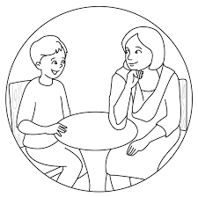
III. Individual Care Plan
Objectives
Format/ Methods
Developing Intervention Plans

Slide 71
Objectives of Assessment & Care Plan
Not just for your Files!
Not a statistical record of demographic data!
To understand clearly the context of the child.
Identify psychosocial health issues that the child requires assistance with.
To be able to develop an individual care plan and refer to specialized facilities when necessary.

Slide 72
Assessment Format
Section 1: Basic Information
Section 2: Immediate/ Emergency Concerns (Observation & Consultation)
Section 3: Presenting Problems/ Complaints (if any—emotional or behaviour problems observed currently):

Slide 73
Section 4: Family, School & Institutional History
Family Issues Identified (Child’s living arrangements/parental relationships/ child’s emotional relationship & attachment to parents/ illness & alcoholism in parents/ single-parenting…)
Institutional History (where child has been/lived, for what periods of time, experiences & difficulties, circumstances of coming to the institution)
Schooling History (Was the child attending school/Last grade/class attended current grade/class/ if child was not attending school, reasons for child not attending school, including child refusing to go to school).

Slide 74
Section 5: Abuse Experiences (Physical, Sexual & Emotional Abuse Experiences)
Section 6: Substance Abuse
Section 7: Feelings and Emotions (Depression and Anger)
Section 8: Child’s Perception of Problem (child’s understanding of problem/ child’s wish)
Section 9: Summary and Action Plan

Slide 75
What to do with the Assessment??
Developing Interventions...
First level responses (validation of emotions/ immediate attention to medical aid & basic needs/relaxation techniques)
List problem areas you/ the child need to work on.
List areas/ issues does counselling need to focus on, incl. methods you may use.
Broadly sequence the areas of counseling/ work—what will you tackle first, next etc?
Session plan and recording of process

Slide 76
Criteria for Referral
Self-harm and suicide
Severely traumatic contexts such as sexual abuse/ trafficking (wherein child has been sexually exploited or experienced severe physical violence…)
Substance use (high frequency/ intensity use especially of alcohol/cannabis…)
Repeated run away behaviour (child may need to be treated for ADHD and/or substance use)
Excessive violence (destruction of property/ causing severe injury to others through physical or sexual abuse)
‘Odd behaviours’ such as talking to self/ no time or place orientation/ disinhibited behaviours/become very suspicious or paranoid/hear or see things that are not there/act very differently than they did before/

Slide 77
Final Perspectives
Case 1: R, a 17 year old and his sister, V, a 16 year old approached the CWC on their own, asking for assistance. They reported that they had been out of school for the past two years because the mother said she was having financial problems; the mother had a male friend who visited frequently and there were parties nearly daily at home, wherein alcohol was consumed—R particularly feared for his sister’s safety at these times. Their father who had separated from their mother some years back had returned to be economically supported by the mother; he had daily conflicts with the children, repeatedly throwing them out of the house. There was also the children’s step-father (through mother’s second marriage), whom the children said they loved as he was very good to them.
R and V were admitted to the boys’ home and girls’ home respectively. When the mother was called, she said that the children’s reports were false and that theirs’ was a happy home/ that she loved her children etc. She pleaded with CWC to release them, saying she had now made arrangements for regular school. The case worker whom CWC sent to the home was received by the mother…and the worker said there was nothing wrong with the home. The CWC then decided to release the children.
Do you agree with the CWC’s decision? Why/ why not?
What are the risks that CWC took in taking the decision that they did?
What might you have done in such a case?

Slide 78
Case 2: M was a 17 year old girl who had been living in children’s institution since age 8. She loved the institution and the caregivers, saying it had been her home and that she had every facility there; in fact, the institution was now supporting her college education in journalism.
Over the last 10 days, M is in the girls’ home. Her mother, who had severely physically abused her/ discriminated against her for being a girl and put her in the institution had returned and wanted custody of her. M was crying and pleading to return to her institution, saying that she could not go back home to her mother, given her past experiences. The institution requested that the girl be released and sent back to them so she could continue her life/ education.
The CWC said that they must consider the mother’s request as ‘after all, she was the girl’s mother…and how wrong could mothers be? All mothers love their children and do the best for them…’ They insisted that M receive counselling and reconcile with her mother.
Do you agree with the CWC’s decision? Why/ why not?
What are the risks that CWC took in taking the decision that they did?
What might you have done in such a case?

Slide 79
Case 3:
A sexually abused adolescent girls comes to the girls home late at night. She is much disturbed, very restless, crying all the time and refuses to eat or sleep. The superintendent is very concerned and makes an emergency referral to a government child psychiatry facility.
The CWC, who were not in sitting on that day, were informed by phone and a note was made in the girl’s file. When the CWC came into session, they blamed the superintendent for ‘breaking the rules’, saying that no child can be referred for help/ treatment without their permission and order; they said that they need to first see and talk to the child…and then they will make a decision about what is necessary for the child (including medical treatment). Following this, the superintendent makes no decisions regarding the children, as she is too afraid.
Do you agree with the CWC’s decision? Why/ why not?
What are the risks that CWC took in taking the decision that they did?
What might you have done in such a case?

Slide 80
Case 4:
It is brought to your notice by counsellors and doctors that the home for 0 to 6 year olds is not running satisfactorily. During their work in the home, they have observed the following:
That children with disability are treated roughly; in fact, one child’s shoulder got dislocated because of this.
That children with disability are offered less food so that they go to the toilet less frequently & don’t need to be cleaned up.
That the children are physically abused by the staff, who justify this as ‘discipline’.
As CWC, what might your actions be if such issues were brought to your notice?
How would you approach the issue and with whom/ how?

Slide 81
Case 5:
P is a 17 year old boy who has been rescued from child labour—he was working for a family who had deprived him of food and severely physically abused him daily. A counsellor/ psychiatrist from a psychiatric facility who assessed him said that he had severe post-traumatic stress order and prescribed medication—which the institution was responsible for giving him. A few days later, on a follow-up visit on the counsellor, it was found that the institution staff had not given the boy the prescribed medicine, saying that there was nothing wrong with him and that he should just go home. Conversations with the superintendent were of no use as her focus was to get an age determination test done. She believed that the boy was 18 years old and so she need not keep him in this institution. The issue is brought to CWC’s notice.
What do you think of the institution/ superintendent’s decision?
What actions would you take?

Slide 82
Case 6:
S was a 13 year old boy who was sexually abused by a caretaker in his institution. He reported this during the course of a hospital admission in a psychiatric facility (where he was being treated for anger-aggression problems). The hospital brought the matter to the notice of CWC. The CWC did all that was necessary for the child, assisting with police FIR registration/ magistrate’s statement etc. They were very supportive of continued psychosocial support to the child and ensure that he was placed in another institution.
Was there anything else that the CWC should have considered?
What else should they have done and how?

Slide 83
In summary, consider…
Child’s psychosocial context and issues
Child’s right (to decide)
The best interests of the child (safety)
Other systems’ responses to the child/ how child is affected/ how you will respond to systems
…based on the above, plan for placement/ reintegration of child into family/referral to psychiatric facilities…

Slide 84
Feedback and Summary
One thing you un-learnt...
One new thing you learnt...
One method/ skill you will try out in your work with children...

Slide 85
We are always available!
Call us or mail us any time you require guidance/ advice while working with children...
Dr. Shekhar Seshadri:
9845130639
shekhar@nimhans.ac.in
Sheila Ramaswamy:
9886148500
sheila.childproject.nimhans@gmail.com

